Slide 1
Unit 1

Slide 2
Definitions
Psychology is the study of human behaviors and cognitive activities.
Notes:
Behaviors are all actions, plus automatic bodily functions that can be measured by machines (heartbeat, respiration, eye movement, perspiration, etc.)
C.A. includes dreams, perceptions, thoughts, and memories. Can neuroimaging analyze these, or only show them?
Are emotions behaviors or cognition? Maybe neither, maybe both.

Slide 3
Definitions
Psychology is the study of human behaviors and cognitive activities.
  Behaviors are actions observable and measurable by others
Notes:
Behaviors are all actions, plus automatic bodily functions that can be measured by machines (heartbeat, respiration, eye movement, perspiration, etc.)
C.A. includes dreams, perceptions, thoughts, and memories. Can neuroimaging analyze these, or only show them?
Are emotions behaviors or cognition? Maybe neither, maybe both.

Slide 4
Definitions
Psychology is the study of human behaviors and cognitive activities.
  Behaviors are actions observable and measurable by others
  Cognitive Activities are mental processes
Notes:
Behaviors are all actions, plus automatic bodily functions that can be measured by machines (heartbeat, respiration, eye movement, perspiration, etc.)
C.A. includes dreams, perceptions, thoughts, and memories. Can neuroimaging analyze these, or only show them?
Are emotions behaviors or cognition? Maybe neither, maybe both.

Slide 5
Definitions
Psychology is the study of human behaviors and cognitive activities.
  Behaviors are actions observable and measurable by others
  Cognitive Activities are mental processes
  Emotions are studied as well
Notes:
Behaviors are all actions, plus automatic bodily functions that can be measured by machines (heartbeat, respiration, eye movement, perspiration, etc.)
C.A. includes dreams, perceptions, thoughts, and memories. Can neuroimaging analyze these, or only show them?
Are emotions behaviors or cognition? Maybe neither, maybe both.

Slide 6
What is a science?
Natural Science vs. Social Science
Even the definition is relatively new
Begins with an hypothesis

Slide 7
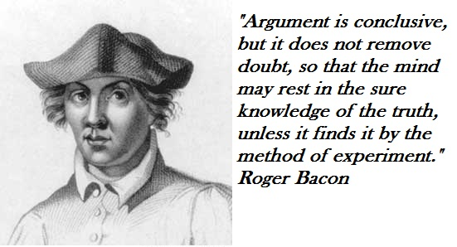
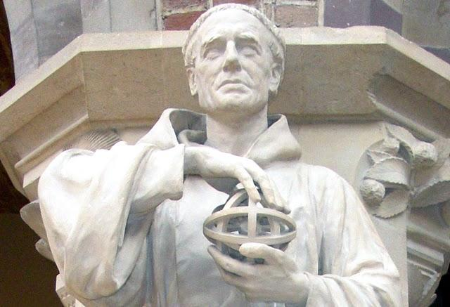

Slide 8
The real purpose of the scientific method is to make sure Nature hasn’t misled you into thinking you know something you don’t actually know.
          Robert Pirsig
Notes:
This is a good place for the True or False quiz on perceived truths.

Slide 9
Scientific Method
Observe a Phenomenon

Slide 10
Scientific Method
Observe a Phenomenon
Form an Hypothesis

Slide 11
Scientific Method
Observe a Phenomenon
Form an Hypothesis
Design & Conduct an Experiment

Slide 12
Scientific Method
Observe a Phenomenon
Form an Hypothesis
Design & Conduct an Experiment
  Independent Variable

Slide 13
Scientific Method
Observe a Phenomenon
Form an Hypothesis
Design & Conduct an Experiment
  Independent Variable
  Dependent Variable

Slide 14
Scientific Method
Observe a Phenomenon
Form an Hypothesis
Design & Conduct an Experiment
  Independent Variable
  Dependent Variable
  Confounding Variable

Slide 15
Scientific Method
Observe a Phenomenon
Form an Hypothesis
Design & Conduct an Experiment
Diligently Record all Observations

Slide 16
Scientific Method
Observe a Phenomenon
Form an Hypothesis
Design & Conduct an Experiment
Diligently Record all Observations
Analyze the Data

Slide 17
Scientific Method
Observe a Phenomenon
Form an Hypothesis
Design & Conduct an Experiment
Diligently Record all Observations
Analyze the Data
Reevaluate the Hypothesis
  If necessary, modify it or create a new hypothesis

Slide 18
Scientific Method
Observe a Phenomenon
Form an Hypothesis
Design & Conduct an Experiment
Diligently Record all Observations
Analyze the Data
Reevaluate the Hypothesis
  If necessary, modify it or create a new hypothesis
Now you may have a Theory

Slide 19
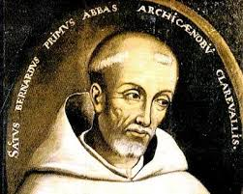
Ockham’s Razor
Notes:
Make as few assumptions as possible.

Slide 20
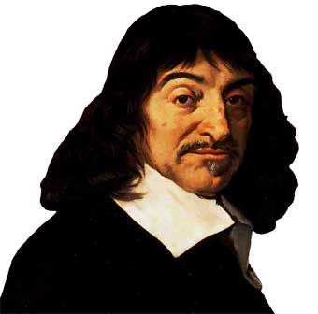
René Descartes
Avoid prejudgment (ideas must be clear)
Divide problems into smallest parts
Think in an orderly way (start simple and build)
Be Complete
(leave nothing out)
DOUBT EVERYTHING!

Slide 21
Other Developments
Repeatability
Peer Review
Control Groups
Blind Studies
Randomization
Placebo
Double-Blind Studies

Slide 22
Things to be..

Slide 23
Things to be..
A good critical thinker

Slide 24
Things to be..
A good critical thinker
Somewhat skeptical

Slide 25
Things to be..
A good critical thinker
Somewhat skeptical
Committed to evidence

Slide 26
Things to be..
A good critical thinker
Somewhat skeptical
Committed to evidence
Able to ignore persuasion

Slide 27
Things to be..
A good critical thinker
Somewhat skeptical
Committed to evidence
Able to ignore persuasion
Resistant to authority

Slide 28
Things to be..
A good critical thinker
Somewhat skeptical
Committed to evidence
Able to ignore persuasion
Resistant to authority
Alert to Cognitive Dissonance

Slide 29
Traps to Avoid
Notes:
Barnum said a good circus should have something for everyone, so many false sciences have generalities and tidbits that could fit just about anyone.

Slide 30
Traps to Avoid
Confirmation Bias
Notes:
Barnum said a good circus should have something for everyone, so many false sciences have generalities and tidbits that could fit just about anyone.

Slide 31
Traps to Avoid
Confirmation Bias
Hindsight Bias
Notes:
Barnum said a good circus should have something for everyone, so many false sciences have generalities and tidbits that could fit just about anyone.

Slide 32
Traps to Avoid
Confirmation Bias
Hindsight Bias
Confusing Correlation with Causation (Illusory Correlation)
Notes:
Barnum said a good circus should have something for everyone, so many false sciences have generalities and tidbits that could fit just about anyone.

Slide 33
Traps to Avoid
Confirmation Bias
Hindsight Bias
Confusing Correlation with Causation (Illusory Correlation)
Seeing Order in Random Events
Notes:
Barnum said a good circus should have something for everyone, so many false sciences have generalities and tidbits that could fit just about anyone.

Slide 34
Traps to Avoid
Confirmation Bias
Hindsight Bias
Confusing Correlation with Causation (Illusory Correlation)
Seeing Order in Random Events
Overconfidence
Notes:
Barnum said a good circus should have something for everyone, so many false sciences have generalities and tidbits that could fit just about anyone.

Slide 35
Traps to Avoid
Confirmation Bias
Hindsight Bias
Confusing Correlation with Causation (Illusory Correlation)
Seeing Order in Random Events
Overconfidence
The “Barnum Effect”
Notes:
Barnum said a good circus should have something for everyone, so many false sciences have generalities and tidbits that could fit just about anyone.

Slide 36
True or False?
If you want to teach someone a new habit that will last, you should reward the behavior every time it occurs, not just intermittently.

Slide 37
True or False?
Patients whose brains are surgically split down the middle survive and function pretty much the same as they did before the surgery.

Slide 38
True or False?
Traumatic experiences, like childhood abuse or seeing a loved one killed are typically “repressed” from active memory.

Slide 39
True or False?
Most abused children become abusive adults.

Slide 40
True or False?
Most infants recognize their own reflection in a mirror by the end of their first year.

Slide 41
True or False?
Adopted siblings usually develop different personalities, even though they are reared by the same parents.

Slide 42
True or False?
Fears of harmless objects, like flowers, are just as easy to acquire as fears of potentially dangerous objects, such as snakes.

Slide 43
True or False?
Lie detection tests are often wrong.

Slide 44
True or False?
People who define themselves as “Republicans” tend to have a larger amygdala, and are therefore more likely to be fearful of more things.

Slide 45
True or False?
Intelligence tests have shown that people who define themselves as “Democrats” are likely to be more intelligent than those who define themselves as “Republicans”.

Slide 46
So, why is Psychology “inexact”?
It is relatively new as a science.
It deals with diverse human beings.
We know very little about the mind.
It is difficult to experiment exactly.
It is difficult to be completely objective.
It is difficult to make accurate predictions.
Theories change frequently.

Slide 47
The danger of false sciences.
The example of Astrology…
  Practiced for many centuries
  Part of many cultures
  A seeming path to meaning or success
  Followed by many leaders
  If the Moon can sway tides…
  As an ART, it has different measurements
  It seems to work often

Slide 48
The uses of Psychology

Slide 49
The uses of Psychology
Through study, we can help people get better results in their living.

Slide 50
The uses of Psychology
Through study, we can help people get better results in their living.
Theories help us predict and then modify behavior.

