Slide 1
Psychological Disorders
Behavior patterns or mental processes that cause personal suffering or interfere with daily life

Slide 2
Acute ?
OR
Chronic ?

Slide 3
Psychological Disorders
Criminals ?
Shackles
Straightjackets
Electroshock Therapy
Frontal Lobotomy

Slide 4
Psychological Disorders
For people aged 15 – 44, it is the leading cause of disability.
26.2% of adults have a diagnosable disorder
  6% are serious
  90% of suicides
47.1 million doctor visits per year

Slide 5
2008 Study
Psychological Disorder | Percentage
Generalized Anxiety | 3.1
Social Anxiety | 6.8
Specific Phobia | 8.7
Mood Disorder | 9.5
Obsessive-Compulsive | 1.0
Schizophrenia | 1.1
PTSD | 3.5
ADHD | 4.1
Any Disorder | 26.2

Slide 6
Psychological Disorders
4 Key Features
  Typicality
  Maladaptivity
  Emotional Discomfort
  Social Unacceptability

Slide 7
We are out to diagnose…
EVERYONE !!!

Slide 8
Aspects for Diagnosis
A specific, noticeable behavior or activity
Symptoms and specifics are clinically significant
Other causes have been ruled out
There must be significant distress in social situations, work settings, or other major life activities
There is usually a specific time component

Slide 9
Neurodevelopmental Disorders
Intellectual Disability (Rated by Severity)
Communication Disorders
  Such as Childhood-Onset Fluency Disorder
Autism Spectrum
ADD & ADHD
Specific Learning Disability
  The 3 R’s
Motor Disorder
  Coordination, Tics, Stereotypic Movements

Slide 10
Schizophrenia & Psychotic D.
Schizotypal
Delusional
Schizophreniform
Schizophrenia
Schizoaffective
Catatonia

Slide 11
Schizophrenia
Paranoid – delusions (grandeur, persecution, jealousy); auditory hallucinations; not-so-bizarre: agitated, confused, afraid
Disorganized – incoherent thoughts; disorganized behavior; disordered delusions; nonsensical; loss of body awareness and functions
Catatonic – disturbances of movement; odd positions and flexibility

Slide 12
Schizophrenia
Where does it come from?
  Psychoanalytic – the id overwhelms the ego, forcing it to regress and confuse fantasy with reality
      Modern: familial with intense emotions and pushy critical attitudes
  Biological – hereditary, loss of synapses, pregnancy complications, widened sulci, too much dopamine

Slide 13
Bipolar Disorder
Manic-Depressive

Slide 14
Depressive Disorder
Major Depression
Dysthymia
Premenstrual Dysphoric

Slide 15
Depressive Disorder
Major Depression – 8 to 18% of the population
  Persistent, most of the day
  Loss of interest/pleasure in activities
  Significant weight change
  Sleep changes
  Reaction changes
  Fatigue
  Worthlessness or guilt
  Concentration lapses, decision-making problems
  Recurring death/suicide ideations

Slide 16
Depressive Disorders
Where do they come from?
  Psychoanalytic = displaced anger from childhood loss
  Learning = “learned helplessness”
  Cognitive = Due to our explanations or negativity, we create a cycle and change
  Biological = Familial; Serotonin & Noradrenaline

Slide 17
Anxiety Disorder
Separation Anxiety
Social Anxiety
Panic Disorder
Agoraphobia
Generalized Anxiety Disorder
Other Phobias

Slide 18
Anxiety Disorders
Phobias – must lead to avoidance
  Zoo- , Claustro- , Acro- , Arachno- , Coulro-

Slide 19
Anxiety Disorders
Where do they come from?
  Psychoanalytic = repressed childhood sexual or aggression ideas
  Learning = conditioned in childhood
  Biological = genetic / evolutionary
  Cognitive = exaggerated threats, helpless to deal

Slide 20
Obsessive-Compulsive related D.
Obsessive-Compulsive
Body Dysmorphic Disorder
Hoarding
Trichotillomania
Excoriation

Slide 21
What are the most common…
OBSESSIONS ?
  40% are concerned with dirt and germs
  24% expect something terrible to happen
  17% desire symmetry, order, or exactness
COMPULSIONS ?
  85% excessively wash hands, bathe, brush teeth, etc.
  51% repeat rituals
  46% check doors, locks, appliances, homework (!)

Slide 22
Trauma & Stressor related D.
Reactive Attachment
Disinhibited Social Engagement
Post-Traumatic Stress Disorder
Acute Stress Disorder
Adjustment

Slide 23
Dissociative Disorder
Dissociative Identity Disorder
Dissociative Amnesia (Fugue)
Depersonalization/Derealization

Slide 24
Dissociative Disorders
Where do they come from?
  Psychoanalytic – to repress unacceptable urges
  Learning – we simply forget, to avoid stress

Slide 25
Somatic Symptom Disorders
Illness Anxiety
Conversion Disorder
Psychological Factor Affecting Disorder
Factitious (Self or By Proxy)

Slide 26
Somatic Symptom Disorders
Focus on physical symptoms (no faking)
Hypochondriasis ?
Where do they come from?
  Psychoanalytic – repressed urges become physical
    Look for a connection
  Behavioral – means of escape

Slide 27
Feeding & Eating Disorders
Pica
Rumination
Avoidant/Restrictive Food Intake
Anorexia Nervosa
Bulimia Nervosa
Binge-Eating

Slide 28
Elimination Disorders
Enuresis
Encopresis

Slide 29
Sleep-Wake Disorders
Insomnia
Hypersomnolence
Narcolepsy
Breathing-Related
  Apnea
  Hypoventilation
  Circadian
Parasomnias
  Non-REM Arousal (Walking or Terrors)
  REM Arousal
  Nightmare
  Restless Leg Syndrome

Slide 30
Sexual Dysfunctions
Delayed or Premature Ejaculation
Erectile Dysfunction
Female Orgasmic Disorder
Female Interest/Arousal Disorder
Genito-Pelvic Pain
Male Hypoactive Desire Disorder
Substance/Medicine-Induced Dysfunction

Slide 31
Gender Dysphoria
Divided by Children & Adults

Slide 32
Disruptive, Impulse-Control, & Conduct Disorders
Oppositional-Defiant D.
Intermittent Explosive D.
Conduct D. – bullying, fighting, cruelty, destructive, rule-breaking
Pyromania (DSM)
Kleptomania (DSM)

Slide 33
Substance-Related & Addictive D.
Substance | Use | Intoxication | Withdrawal
Alcohol | X | X | X
Caffeine | O | X | X
Cannabis | X | X | X
Hallucinogen | X | X | O
Inhalant | X | X | O
Opioid | X | X | X
Sedative | X | X | X
Stimulant | X | X | X
Tobacco | X | O | X

Slide 34
Substance-Related & etc.
Hallucinogen Persisting Perception D.
Non-Substance Disorders
  Gambling Addiction

Slide 35
Neurocognitive Disorders
Difficulties with:
Major Disorders include Alzheimer’s, Traumatic Injury, Parkinson’s & Huntington’s
Minor D. could be any in the chart
Complex Attention | Executive Function
Learning & Memory | Language
Perceptual-Motor Function | Social Cognition

Slide 36
Personality Disorders
General
Cluster A: Paranoid, Schizoid, Schizotypal
Cluster B: Antisocial, Borderline, Histrionic, and Narcissistic
Cluster C: Avoidant, Dependent, & Obsessive-Compulsive

Slide 37
Personality Disorders
Where do they come from?
  Psychoanalytic = Arrested Development
  Cognitive = Thought Processes
  Learning = Examples in Environment
  Biological = Heredity & Development

Slide 38
Paraphilic Disorders
Voyeuristic
Exhibitionistic
Frotteuristic
Masochism
Sadism
Pedophilic
Transvestic
Fetishistic

Slide 39
OTHER Mental Disorders
Either due to a medical condition or an unspecified cause.

Slide 40
Medically-Induced…
Movement and Adverse Effects

Slide 41
OTHER Conditions
Includes people who:
  Seek too much clinical attention
  Have problems dealing with their occupation, housing, or economic conditions
  Struggle with Relationships or Family
  Suffer from abuse, neglect, or psychological abuse

Slide 42
Can I inherit a disorder?
Bipolar Disorder @84%
Schizophrenia @81%
Anorexia Nervosa @60%
Major Depression @37%
Generalized Anxiety @28%
REMEMBER – This is reflective, not predictive.
  Do not assume that because your parent has a disorder that you are this likely to have one of your own.

Slide 43
Risk Factors | Protective Factors
Academic Failure | Aerobic exercise
Birth Complications or Low Weight | Secure, empowering community
Caring for persons with Disorders | Economic Independence
Child abuse or neglect | Effective parenting
Chronic insomnia or pain | Feelings of mastery or control
Family disorganization/conflict | Feelings of security
Low socioeconomic status | Literacy
Medical Illness | Positive attachment/early bonding
Neurochemical Imbalance | Positive parental relationships
Parental Disorders or substance abuse | Problem-solving skills
Personal loss/bereavement | Resilient coping w/ stress/adversity
Poor work skills and habits | Self-esteem
Reading or Sensory disabilities | Social & work skills
Stress and Trauma | Support from family/friends
Substance Abuse
Social Incompetence

Slide 44
What if you really are a criminal?

Slide 45
The Insanity Defense
Legally, it is all or nothing
  Not a Psychological term
The M’Naghten Rule
  Did not understand the nature of the act
    OR
  Did not realize it was wrong

Slide 46
Insanity Defense
Famous Examples

Slide 47
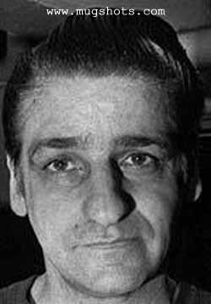
Albert
DeSalvo

Slide 48
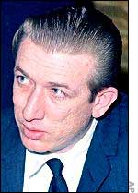
Richard
Speck

Slide 49
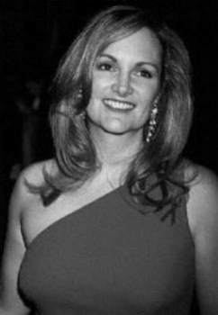

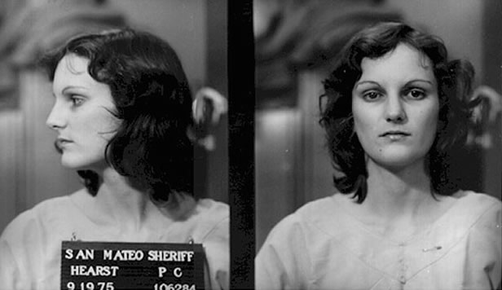
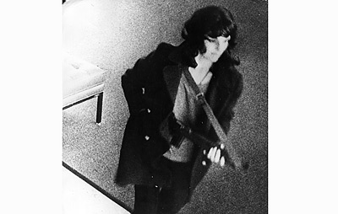

Slide 50
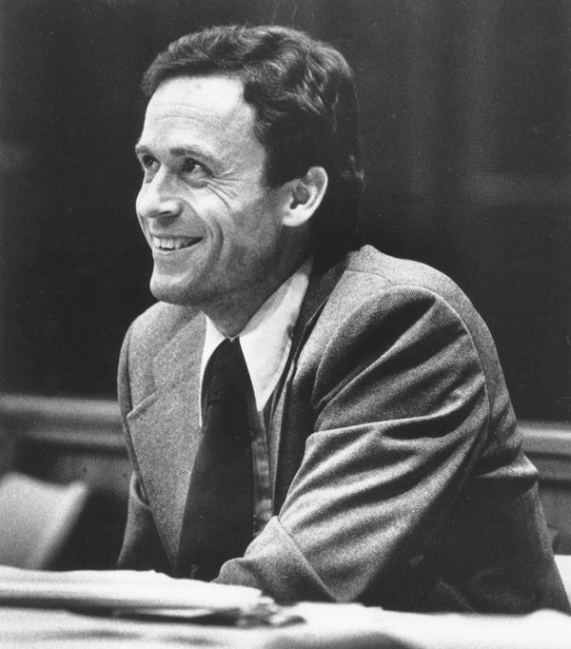
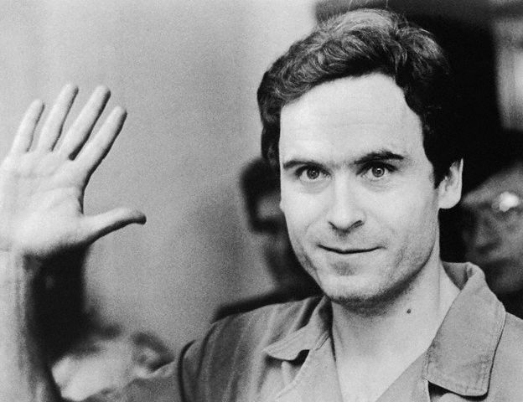

Slide 51
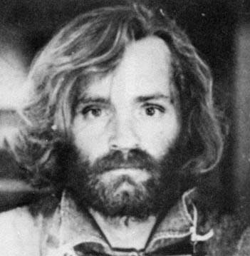
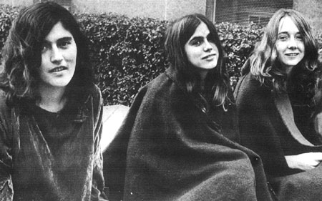
Helter
Skelter
{~}

