Slide 1
Unit III
BRAIN BIOLOGY
Or “What’s inside my head?”
Notes:
Unit 3 is about the actual biology of the human brain. We've already talked about the Biological school of psychology, so now we are looking at the way in which the brain can affect us in terms of psychological concerns if the biology of the brain is in some way compromised.
The human brain is quite simply the most complicated computer ever devised. It contains billions of cells and uncountable possibilities in terms of calculations, information, and interpretations of our environment. As such, it is extremely difficult for us to attempt to fully understand. It remains the only organ in the human body that cannot be transplanted. The complicated connections between our brain and our bodily functions are a constant source of new investigation , experimentation, and insight.

Slide 2
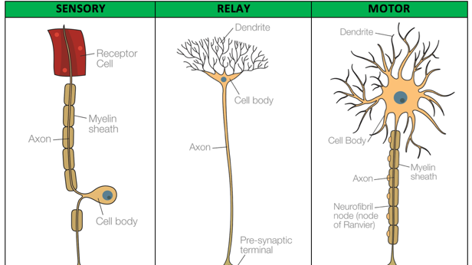
Notes:
Here you see the three different types of neurons that exist in the human body. These three types of neurons carry all the information that our body needs in order to function properly.
*Sensory neurons are those which provide us with information from our five major senses: sight, hearing , taste, touch, and smell. The outermost end of a sensory neuron is the receptor cell. That's that red rectangle you see at the top. The receptor cell does exactly what its name implies. It receives information from our environment and sends it on to our brain to be processed. The slender thread that runs from the receptor cell to the cell body and then on into our brain is known as an Axon. As you can see in the picture, the Axon is protected by a myelin sheath similar to the way wires are protected by rubber coating. The receptor cell gathers information and transmits it to the cell body where it is transformed into information from which we can determine our reaction. A pleasant smell may cause a pleasant reaction, while a hot stove may cause a negative reaction. As we will see, our autonomic nervous system often causes us to react before we have processed the information consciously.
*The relay neuron also does exactly as its name implies. It relays information from one part of our nervous system to another. The dendrites are in this case attached to the cell body, gathering information from other neurons. In this case the Axon carries information to the presynaptic terminal where that information literally “jumps” across to another cell. The point at which this jump occurs is known as a synapse.
*Motor neurons are those that cause our muscles to act in certain specific ways. Once again, information travels through the Axon into the cell body where the dendrites cause our muscles to react. If you are voluntarily lifting weights, then a message from your brain tells your muscles to tighten or relax as necessary in order to perform that action. If you touch a hot stove, your autonomic nervous system causes those muscles to react involuntarily and automatically.
*It should be pretty easy for you to see that a malfunction of any of these types of neurons could create serious difficulties for a person. If sensory neurons malfunction, then we might not be aware that we have our hand on a hot stove. If relay neurons malfunction, then information from some part of our body might not be received by the brain properly. If motor neurons malfunction, then our body might not respond in the way that we desire. You should understand that any of these physiological malfunctions might appear to be psychological malfunctions.

Slide 3
Neurotransmitters aid communication
Neurotransmitter | Function | Malfunction
Acetylcholine | Enables muscle action, learning, & memory | Deterioration of ACh-production in Alzheimer’s patients
Dopamine | Influences movement, learning, attention, and emotion | Excess linked to schizophrenia Absence linked to Parkinson’s tremors
Serotonin | Affects mood, hunger, sleep, and arousal | Lack linked to Depression
Norepinephrine | Helps control alertness & arousal | Lack can depress mood
GABA | A major source of inhibitions | Absence can lead to seizures, tremors, and insomnia
Glutamate | A major source of excitement, Involved in memory | Surplus can cause migraines or seizures
Endorphins | Influence our perceptions of pain & pleasure | Opiates can reduce the body’s natural production
Notes:
Certain chemicals within the body help the neurons operate effectively. This chart shows you the seven most common neurotransmitters, chemicals that enable your neurons to function correctly. Once again, we should be able to see that a malfunction in these neurotransmitters might create the appearance of a psychological disorder. The chart above is self explanatory but you should look at the column that demonstrates what happens when a neurotransmitter malfunctions. Please study the chart carefully so that you will be able to fully understand how neurotransmitters help us to function properly and how they can cause us difficulty. We can discuss this in further detail on our discussion day.

Slide 4
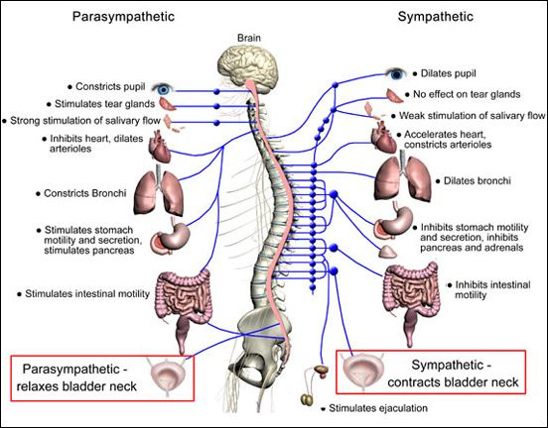
Autonomic Nervous System
“Rest &
Digest”
“Fight or
Flight”
Notes:
Here is the autonomic nervous system about which we have already talked a bit. You can see that it is divided into 2 types:
On the left side is the parasympathetic nervous system, sometimes referred to as the “rest and digest” aspect of your autonomic nervous system. Imagine that you are reclining on your couch after a hearty Thanksgiving dinner. The fluids in your body are flowing freely. Saliva has helped you digest your dinner, your heart and breathing rate decrease, and your digestive system is in full operation. Because you are relaxed and comfortable, you suddenly notice that you sort of need to pee. It is a passive state.
On the right side is the sympathetic autonomic nervous system, sometimes referred to as the “fight or flight” system. Imagine that you have just encountered a Tyrannosaurus Rex on your daily walk. Suddenly, your body reacts without your conscious decision to do so. Your pupils dilate (that means, to get larger) so that you can see more information. Your body turns away from digestive processes that unnecessarily consume energy, opens the bronchi so you can get more oxygen, and contracts the bladder so that you won't stop to pee while you're being chased. In this mode of operation your body needs to put all its energy into being active rather than passive.
The purpose of the autonomic nervous system is to act automatically so that we don't have to think about it. Consider all the actions your body takes during the course of a day of which you are not conscious: breathing , blinking, etc. Our amazing brain is causing our body to do many things that we need done without our having to think about it consciously.

Slide 5
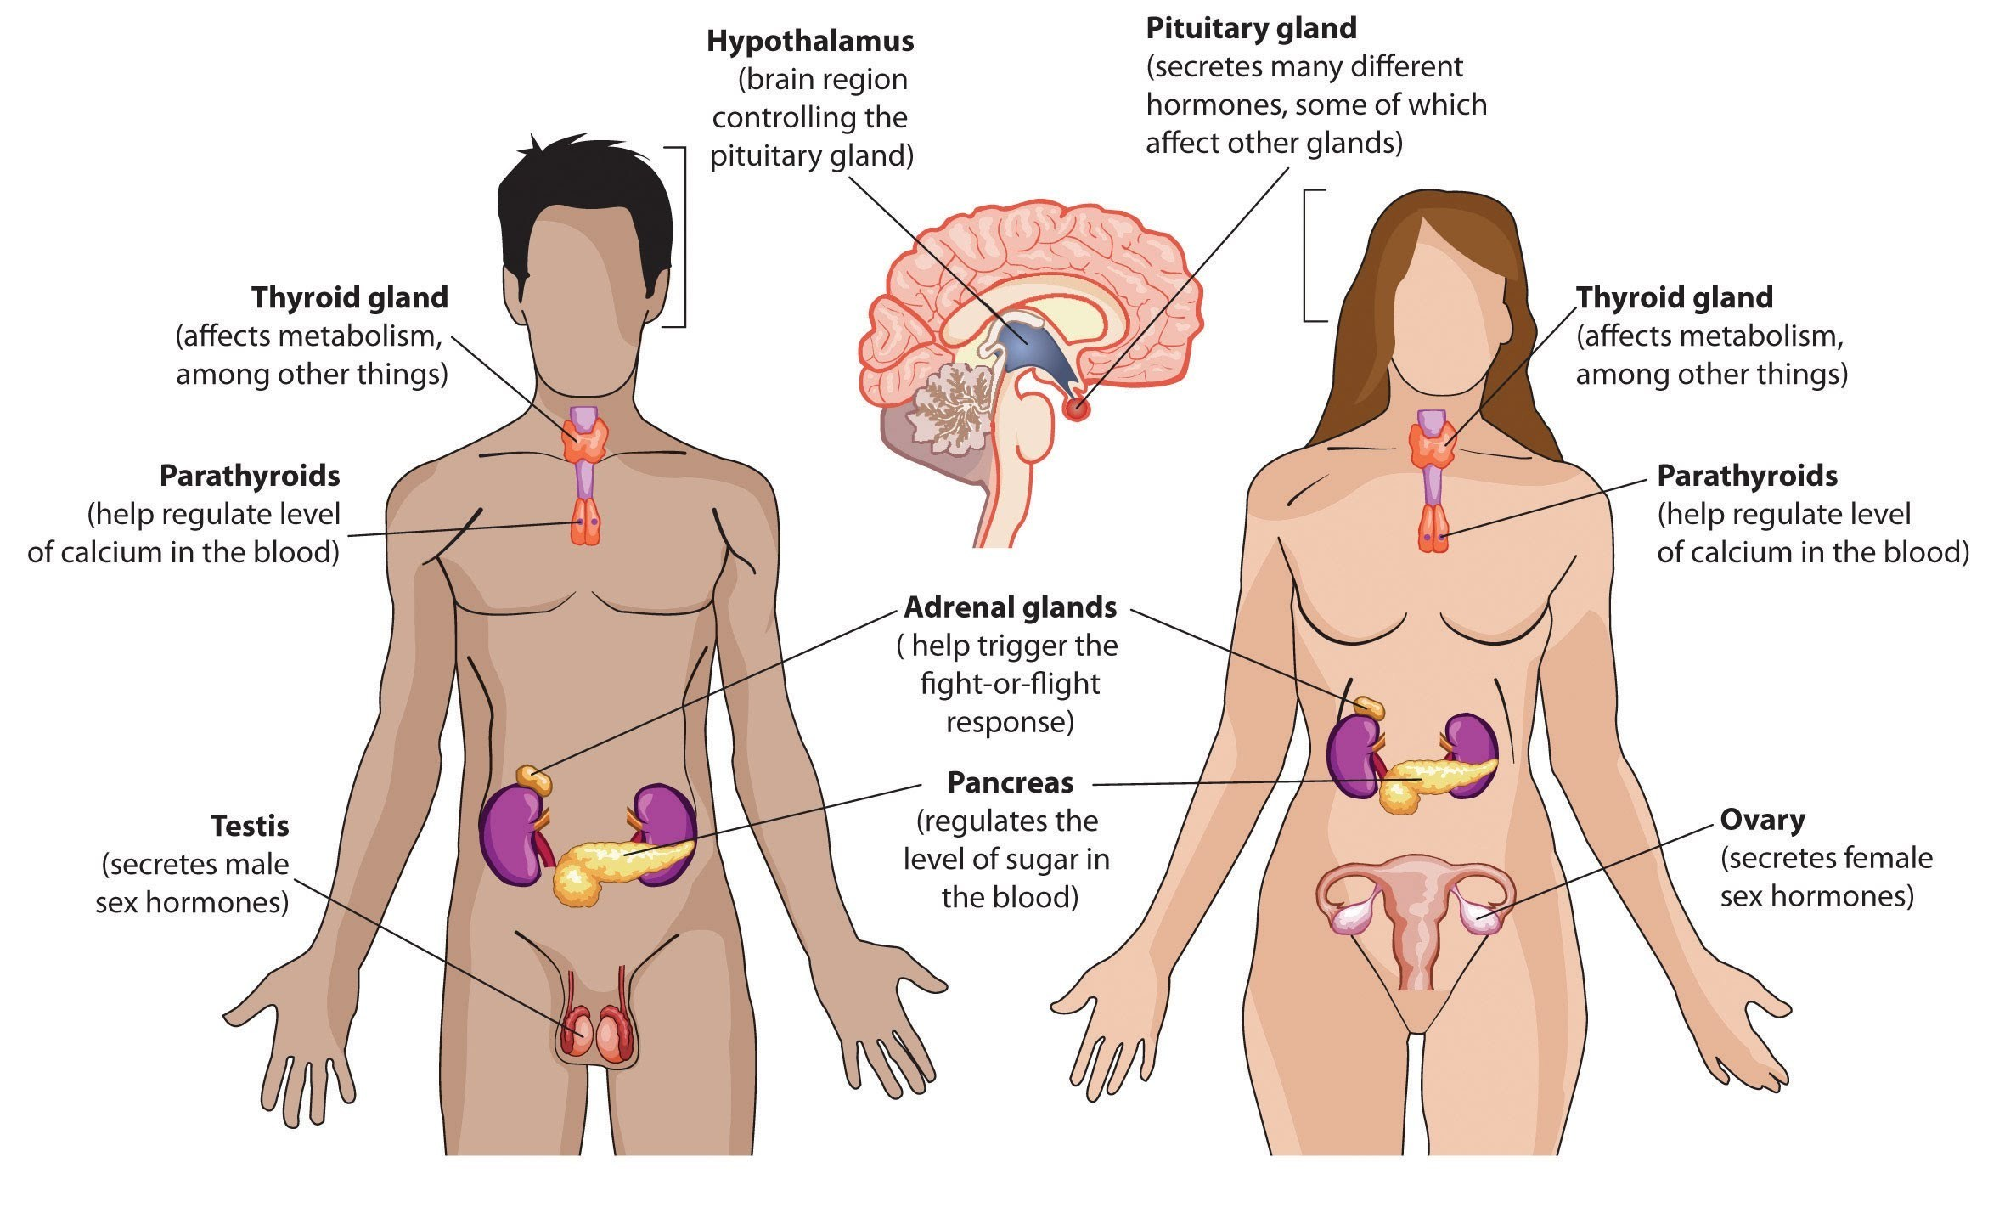
Notes:
This slide shows a few of the other glands in the human body that are producing chemicals that affect your brain and body functions.
*We will talk more about the hypothalamus on the next slide, but you can see that it controls the pituitary which controls some of the other glands. A malfunction in the hypothalamus could easily lead to malfunctions in other areas.
*The pituitary gland produces a wide range of hormones that can have major effects on the human body. A malfunctioning pituitary can cause visual impairment, weight gain or loss, sexual dysfunctions, abnormal bone development, and problems with blood pressure and menstrual cycles. It may often lead to depression and fatigue, which could be first noticed in a psychologist's office.
*The gland most directly affected by the pituitary is the thyroid gland. Malfunctions here are usually due to an imbalance of hormones produced. The thyroid is most connected with one's mouth, heart, and digestive system. Therefore, whether one has too much thyroid production or too little can determine whether one’s heart beats too fast or too slow, whether one is constipated or diarrheic, whether one perspires too much or too little, whether one’s nails are too brittle or too thick, etc.
*The adrenal gland is our fight or flight gland. A malfunction in this area could make it very difficult for a person to create enough energy to deal with dangerous circumstances.
*The pancreas , because it regulates the level of sugar in your bloodstream, means that it controls your body's energy level. A malfunction here could mean that your food is not being properly converted into the sugar needed for your body to operate properly. It could also lead to diabetes.
*The hormones secreted by the sex glands have a wide range of effects on our growth. They are responsible for our entry into and development during puberty, and also for our ability to reproduce. Because those hormones are directly tied to our gender, an overproduction or under production of those hormones can have wide-ranging impact. They effect the sex drive and women's menstrual cycles.

Slide 6
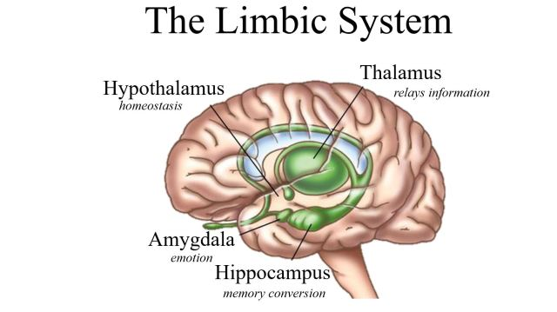
Notes:
The limbic system is the portion of the brain pictured in green in this diagram.
*The hypothalamus is the most important part of this system, as it is responsible for our homeostasis. I usually find that my students have been exposed to this term previously. Homeostasis means that one’s body and brain are in good balance. Obviously, for us to be psychologically well, a good balance within our internal systems is essential.
*The thalamus is the central relay station for information coming to the brain. All of the information from our neurons comes to this part of the brain where it is sent on to the appropriate areas for processing. Therefore, the thalamus relays math problems to one part of your brain, and the muscular activity necessary for driving to another.
*The hippocampus engages in memory conversion. In other words, it makes it possible for you to recall what a person looks like when you are only seeing their name. It helps turn information received by the brain into a sort of code that the brain will be able to later interpret back into the information that was received.
*The amygdala controls our emotional responses to things. It is believed that a larger amygdala causes people to be more emotionally reactive to a variety of circumstances, particularly things that are not physically threatening. (politics, religion, etc.)

Slide 7
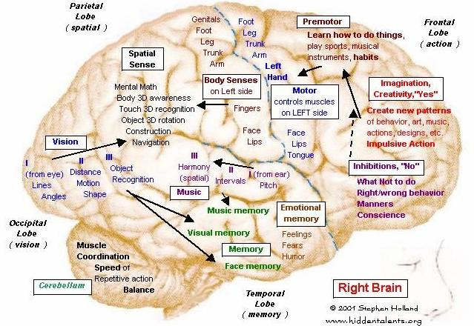
Notes:
I desperately hope that we will be back in the classroom when it comes time to look at this slide.
The first thing I would like for you to look at here are the black labels in italics that are beyond the actual drawing itself. These labels show you what the parts of the brain are called. Note that you are looking at the right side of your brain, which is demonstrated by the small eye and nose drawing in the lower right corner.
*Looking at those labels we will start with the frontal lobe. Since it is in the front, it that should be easy to remember. The frontal lobe is responsible for actions that you take. Any information that requires you to do something comes through the frontal lobe on its way into physical action. You will notice a wide variety of operations taking place here. At the lower part of the frontal lobe is the part that reminds you what not to do. It helps you choose the appropriate behavior for a particular situation. It's also the little voice that tells you when you have done something wrong. The center part of the frontal lobe is our imagination area. When we are creating something new, that action is taking place in this part of the brain. Note that it is labeled as the “yes” section, which means that it always wants to try new things. You will see the phrase “impulsive action” in this part of the brain . When we spontaneously do something, it is being generated by this particular area. This is why teenagers frequently get a bad reputation, because their frontal lobe is not yet fully-formed and they may be inclined to act spontaneously but irrationally. At the top of the frontal lobe is where we learn how to do things. When we are learning a sport, a musical instrument, a new physical behavior of any sort, it is taking place here. Please remember this only applies to the right side of the frontal lobe. When we get to the left side you will see significant differences.
*For our next label we will move across to the left corner to see the parietal lobe. This regulates our spatial perception - our ability to see things in space and recognize them for what they are. This is the area in which we would do math problems in our head, or recognize an object held in our hand even though we could not see it. It helps Construct something from Legos or navigate the hallways of our building without crashing into other people.
*Notice particularly the blue dotted line between the parietal and frontal lobes. Along this line are the sensations and muscle controls of the left side of our body. Though it seems counter intuitive, this information was a vital discovery for understanding the effects of stroke. Notice that the parietal side of the line is where information from our sensations arrives, and the frontal side of the line is where our muscles respond correctly to those sensations.
*Moving further to the lower left you will see the occipital lobe which is responsible for our visual information. This is another counter intuitive concept, since our eyes are in the front of our head but the information is received and processed in the back. On the right side of the brain we can determine the path that objects are going to take , how far from us they are, in what direction they are traveling, and recognize them to be specific things. Processing this information is vitally important to being able to drive a car or catch a baseball.
*Finally , we have the temporal lobe which is responsible for the storage of our memories. On this right side we store our Remembrance of musical themes and phrases, faces that we have seen, and our feelings from specific situations. This is the area that stores you are memory of how it felt to be criticized for the first time or the punchline of a joke that made you laugh out loud. Notice at the top of this area the affect of your sense of hearing , particularly with regard to music.
*I would also have you take note of the box in the lower left corner that contains the word cerebellum. The cerebellum is not properly considered a lobe since it is not hemispheric. In other words, it does not have two halves , but is one solid knot of nerves. The cerebellum is responsible for your muscle coordination, enabling you to successfully play sports and two stay balanced when you are engaged in physical activity.

Slide 8
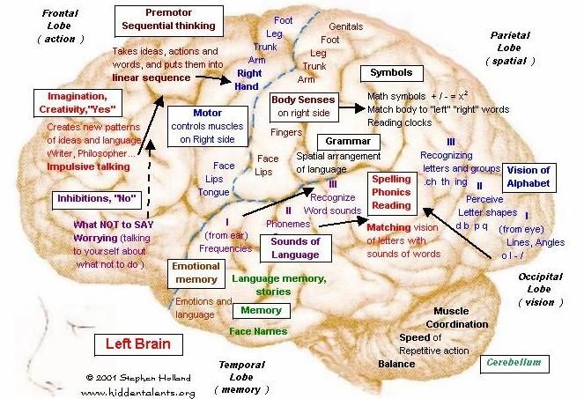
Notes:
As we move to the left side of the brain (note the eye and nose again) we see similarities and distinct differences between how the sides of the brain operate. Remember, that the brain has a channel running front to back down the middle separating the two hemispheres to some degree. This has an effect on how each side of the brain operates.
*Once again, we start at the frontal lobe. This time the lower part, still reflecting our inhibitions, is more worried about what to say than what to do. As we move up to the central part, we again see creativity, now focused on language, which in teenagers often leads to impulsive talking. At the top of the frontal lobe we are putting our actions into the proper sequence in order to get the result we want.
*The parietal lobe continues to operate in a spatial way accept now it is looking at the symbols that mathematics uses to create solutions to problems. It's why we can make sense out of a clock, and why we are capable of diagramming sentences in English class. Once again, the blue dotted line between the parietal and frontal lobes shows us sensations and actions controlled by this part of our brain. Now, these are affecting the right side of the body. We had previously mentioned stroke, a ruptured vessel in the brain, which effects the opposite side of the body from the area of the brain in which it occurred. Noticing the physiological manifestations of a stroke enables doctors to determine the part of the brain in which the stroke happened.
*The occipital lobe again controls vision however this time we are recognizing the alphabet. Again, since this part of the brain recognizes lines and angles, it recognizes a certain set of lines as the letter A. It also helps us attach sounds to combinations of letters when we see them in words. You should easily be able to see that section II might help explain dyslexia.
*The temporal lobe once again stores our memories but now it is more related to language than two musical sounds. This might explain why you can remember the tune to a particular song, but not its lyrics , or vice versa. It is also the area where face names are stored, which creates one of my most fun evidences of an illogical universe. The left side holds the name while the right side holds the face itself. Therefore, when I see you many years from now, I may immediately recognize your face but not be able to connect your name with it! What are they doing on opposite sides?!?!
*Once again, note that the cerebellum is just doing what it always does.

Slide 9

Why Do We Sleep?
Notes:
The better question here might be why do people sleep so differently? We all need our rest, but everyone seems to sleep in different quantities, in different qualities, and at different times. Why is that?

Slide 10
Why Do We Sleep?
Circadian Rhythms & “Battery Recharging”
Notes:
Part of the answer to our questions are encompassed by the two phrases above.
Circadian rhythms are natural patterns that all animals experience in a variety of ways. Birds flying South for the winter is a circadian rhythm. Women's menstrual cycles are circadian rhythms. Each of us likely has slight variations In our circadian rhythms from everyone else. This creates an interesting diversity that may be difficult to explain. One group of social scientists even created an entire theory based around our various circadian rhythms to explain the differences in our circumstances. It is called biorhythm theory, and I will present you with some information on it in a class exercise.
We are also aware that the human body consumes an incredible amount of energy on any given day. That means that her body must necessarily have some rest in order to prepare for the next days activities. Similarly, our brain requires time to process all the information we have gathered in the course of a day and “reset” itself prior to the next day's experiences. Each of us requires a different amount of time to get a proper reset.

Slide 11
Why Do We Sleep?
Circadian Rhythms & “Battery Recharging”
Sleep Cycles
  NREM-1
  NREM-2
  NREM-3
  REM Sleep
Notes:
That time comes in the form of sleep cycles. Each sleep cycle seems to consist of four different stages. The first three stages can be seen like a series of stair steps leading down into deep sleep. At each level, one’s body becomes more and more relaxed, eventually requiring very little energy. As we go down through the steps, we become more and more difficult to awaken.
NREM-3 shortens and disappears through the night, while REM increases. Cycles are longer for young people, while older folks waken more often and have less sleep and less REM sleep. But, younger people take longer to move into REM sleep while older people tend to jump to REM sleep relatively quickly.
Each person has their own optimal sleep cycle time. Mine seems to be about 87 minutes. The average is about 90. One of the ways we can tell whether we are getting good sleep is whether we are completing the correct number of cycles. My optimal number of cycles is 5 while yours is probably more like 6. Being awakened in the middle of a cycle is usually an unpleasant experience.

Slide 12

A dream is a wish your heart makes…
Notes:
Freud, who was famous for interpreting people's dreams, once said that a dream is simply a wish in another form.

Slide 13
A dream is a wish your heart makes…
…or is it?
Notes:
Many of us might disagree with Freud's assessment since Many of our dreams have been noticeably unpleasant. Most of us would not wish for some of the terrible things that have occurred in our nightmares. Freud would tell us that since objects in our dreams are merely symbolic of realistic things that we are misinterpreting the meaning those dreams are trying to express to us. Scientifically, we know that dreams are a manifestation of our brains attempt to resolve issues we have faced during the course of the day. Since concepts cannot be visualized, our brain puts us into imaginary circumstances that represent those concepts. Part of the reset process for our brain is too categorize and store the information we have received during the course of the day. Since some of that information seems to make no logical sense, our brain attempts to sort it out by creating imaginary circumstances that might help us understand the information better.

Slide 14
Screwed-up Teenagers
Notes:
This, of course, brings us to the difficult circumstance surrounding teenagers. In how many ways is your sleep schedule “screwed up”? When one considers that the average school schedule is not designed to be particularly exciting, then adds in the possibility that you might have an after-school job, or be responsible for some of your other family members, or currently be under a great deal of stress regarding the covid situation, it is not surprising that your sleep schedule or the quality of your sleep might be affected. Add in basic teenage angst and the social pressures to communicate or be up late at night and we find that students are seldom getting the best sleep possible.

Slide 15
Sleep Deprivation
(Causes)
Insomnia
Nightmares
Night Terrors
Sleepwalking
Apnea
Narcolepsy
Notes:
There are many things that can cause us to be deprived of sleep:
*True insomnia is quite rare, but many people suffer from milder forms of it. Being unable to sleep places greater stress on both the body and mind, and may result in falling asleep at inopportune times.
*Nightmares, particularly fearsome ones, can certainly make it difficult for us to go back to sleep and rest well.
*Night terrors are a syndrome most common in young children. Though kids frequently do not recall any dream activity, they often awaken screaming terribly and demonstrate rapid breathing and heartbeat.
*Sleepwalking is another item whose incidence is usually over-rated. Often caused by anxiety, and much more common in young people than their elders, those who experience sleepwalking are seldom aware of their actions or their surroundings. Scientifically this is properly known as somnambulism.
*Apnea is a disorder in which one's breathing ceases while sleeping. You may have seen advertisements for the C-pap machines which are designed to keep a constant flow of oxygen going into a person's lungs while they are asleep. People who snore heavily are particularly susceptible, as are people who are greatly overweight. This disorder must be taken seriously as it can be fatal.
*Narcolepsy is a condition in which a person is incapable of remaining awake regardless of the circumstances. Ironically, people with narcolepsy often fall asleep at the most exciting times. This is not the same as simply being overtired. Narcolepsy causes sleep deprivation, because sleep is occurring outside the normal activities of daily life, meaning that it still may be difficult to sleep at appropriate times.

Slide 16
Sleep Deprivation
(Effects)
Diminished attentional focus and memory
Increased risk of depression
Increased risk of High Blood Pressure
Suppressed immune system
Increase in hunger hormones
Increased fat production
Joint inflammation & arthritis
Reduced muscle strength, muscle memory, and reaction time
Notes:
This chart shows you the numerous effects that can be a result of sleep deprivation. Of great concern is the fact that some of these work in combination, making them even more dangerous.
Obviously, most of us are aware that sleeplessness makes it more difficult for us to focus and remember things. Other side effects have much greater potential to damage us for the long term. You should look at each of these possible effects to see how they can be debilitating to the quality of a person's life. Once again, we see that physiological difficulties can eventually result in psychological difficulties.
Now you should be ready to take a test!

