Slide 1
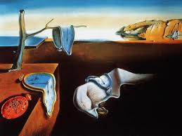
The Persistence of Memory
Notes:
This painting is by Salvador Dali. What do you suppose it means?

Slide 2
3 Types of Memory
Episodic
Semantic
Implicit (Procedural)
Notes:
Episodic is the things that happen to us. Semantic is the meaning we attach to things. Implicit is the memory we develop from participating in activities.

Slide 3
3 Processes of Memory
Encoding
  Visual or Acoustic
  Semantic
Storage (Your big filing cabinet)
  Maintenance Rehearsal
  Elaborative Rehearsal
Retrieval
  Context Dependent
  State Dependent
Notes:
We remember sounds longer than sights (unless we don’t).

Slide 4
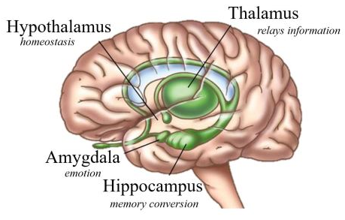
How is my brain involved?

Slide 5
Stages of Storage
(1) Sensory Memory
Sight (Visual) | Iconic | Eidetic
Hearing (Auditory) | Echoic | Lasts Longer Music helps
Smell | Olfactory
Taste | Savory
Touch | Haptic
Notes:
Why does music help our memory? Think about memories you have from each of these senses.

Slide 6
Stages of Storage
(2) Short-term Memory
(Working Memory)
[Are you a sieve or a sponge?]
[Do you rehearse?]
Primacy and Recency Effects
Chunking
Interference (Displacement)

Slide 7
Stages of Storage
(3) Long-term Memory
Mechanical/Rote (maintenance rehearsal)
Relating (elaborative rehearsal)
Reconstruction
Schemas
It is probably limitless!

Slide 8
Memory Tasks
Recognition
Recall
Relearning

Slide 9
Forgetting
Infantile Amnesia | Babies don’t remember things
Decay | Memory fades over time
Interference | Displacement by new information
Repression | Relieve anxiety, guilt, or shame
Amnesia | Trauma-induced
Retrograde Amnesia | Lose prior knowledge
Anterograde Amnesia | Lose subsequent knowledge
Notes:
Why do TV shows always use Retrograde Amnesia as a plot device?

Slide 10
Reyna & Brainerd
The
Search
for
Repressed
Memories

Slide 11
Reyna & Brainerd
Verbatim Trace Memory
Gist Trace Memory
Kids may be more reliable witnesses!
How about brain scans for lie detection?
Notes:
Researchers in repressed memory. Likely believe strongly that many repressed memories are false.

Slide 12
“When memories are ‘recovered’ after long periods of amnesia, particularly when extraordinary means were used to secure the recovery of memory, there is a high probability that the memories are false.”
            Royal College of Psychiatrists

Slide 13
What about False memories?
They can be planted.
Certainty is no guarantee.
Source Confusion
Elaboration
Modification
Excess pressure for details
Wish fulfillment
Notes:
Finish up with Bryan.

Slide 14
Can I improve my memory?
Take notes by hand
Use Context & State-dependent Memory
Use small, separated study sessions
Sleep well and Dream!

Slide 15
Can I improve my memory?
Drill and Practice – repetition
Make connections
Build Links
Mnemonics
Find Semantics!

