Slide 1
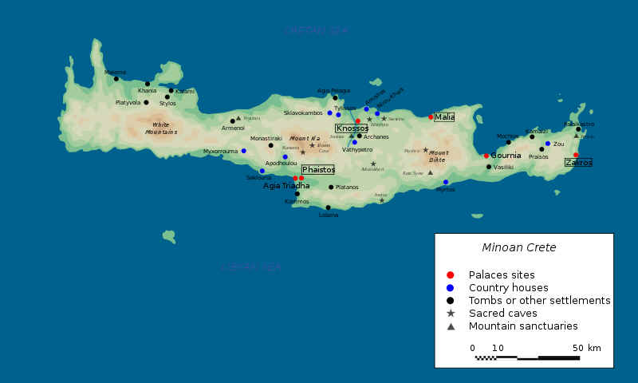
Notes:
In the middle of the Mediterranean lies the island of Crete. It is here that Greek civilization really begins. There are many similarities between Crete and Greece, indicating a definite connection. But, for many reasons, Cretan culture flourished then faded rather quickly, while Greek culture steadily grew to dominate their region.
This map shows you the major sites on Crete, which began to develop around 3000 BC, making it contemporary with the Old Kingdom of Egypt and the rise of the Phoenicians. The key location here is Knossos, where the king’s primary palace was. It was the excavation of this palace, and the discovery of numerous tablets there that taught us most of what we know about Cretan culture.

Slide 2
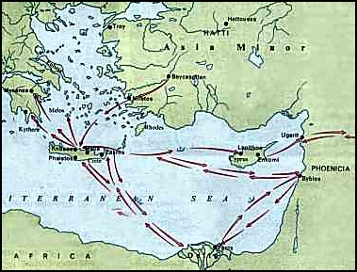
Notes:
This cute map from a Greek travel website shows the trade that the Cretans engaged in. You can see that they had contact with the Egyptians in the South, the Phoenicians and residents of Cypress in the East, the early Greeks in the Northwest, and scattered groups in the islands and Asia Minor. It was likely this early trade that caused their civilization to blossom.

Slide 3
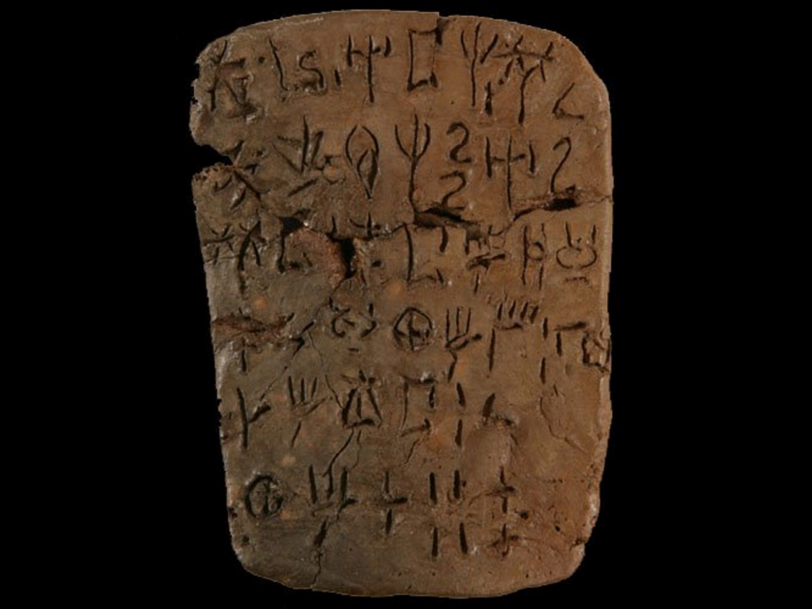
Notes:
This is one of the clay tablets discovered on Crete that helped us to understand its history. The form of the writing is called “Linear B” because (1) it is written in a line across the page, left to right; and (2) there was an earlier version also discovered that is referred to as “Linear A”. Linear B was deciphered in 1952 AD by a man named Michael Ventris. It is a difficult language to translate, because it contains both phonetic characters (combination sounds) and ideographs (characters that represent things – like animals, etc.) If you look closely, you can see certain symbols that are quite similar to ancient Greek. (Φ Ψ Ϩ) It is likely that the earliest Greeks adopted and modified this writing to their needs. Linear A has still never been translated, partly because no one knows what the earliest Cretans sounded like.

Slide 4
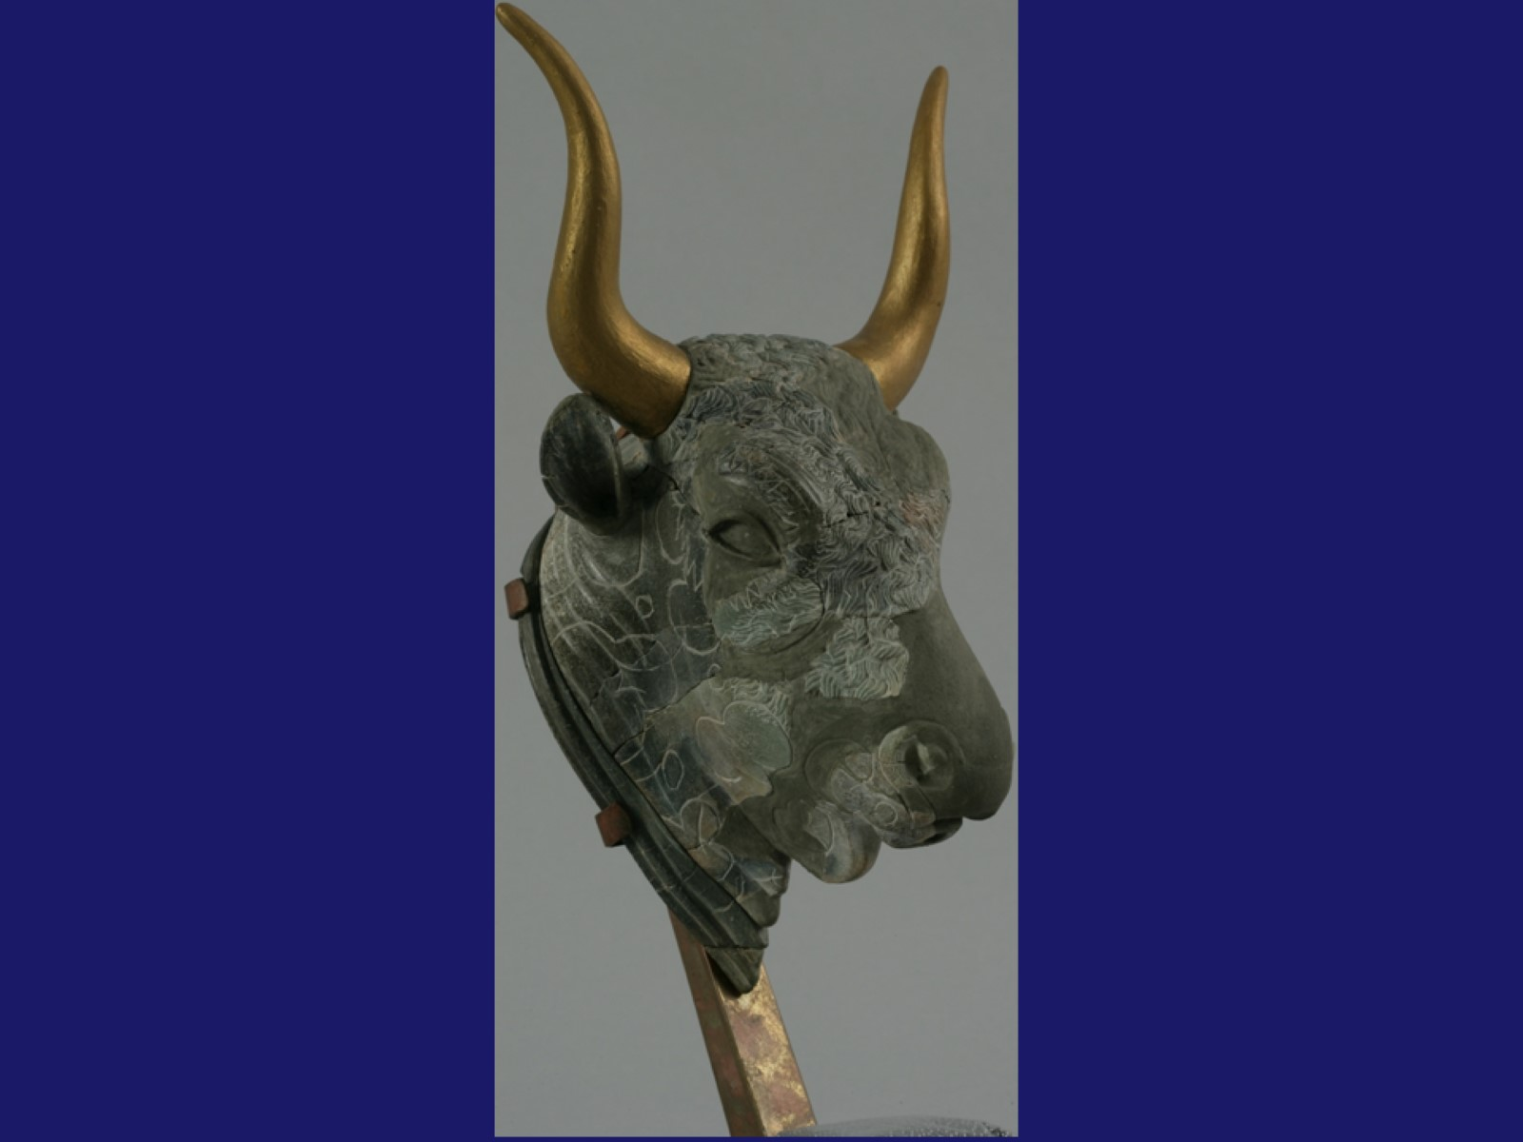
Notes:
The culture of Crete is centered around the symbol of the bull. In ancient societies, bulls were seen as extremely powerful creatures because one bull can rule an entire herd of cows. Every cow is impregnated by the same bull, and young bulls are often killed by the father in order to prevent competition. The symbolism, to the people was that only one ruler can be in control of the society. It also made it understandable that young men might kill their father in order to obtain power. Eventually the old bull must be replaced by a younger, stronger one.
The kings of Crete were called “Minos”, so we refer to the culture as Minoan. The Minoan kings probably wore headdresses like the one above as a ceremonial testament to their reverence for the bull. It is even possible that some “kings” of Crete were women, but who would know, under a hat like that!?

Slide 5
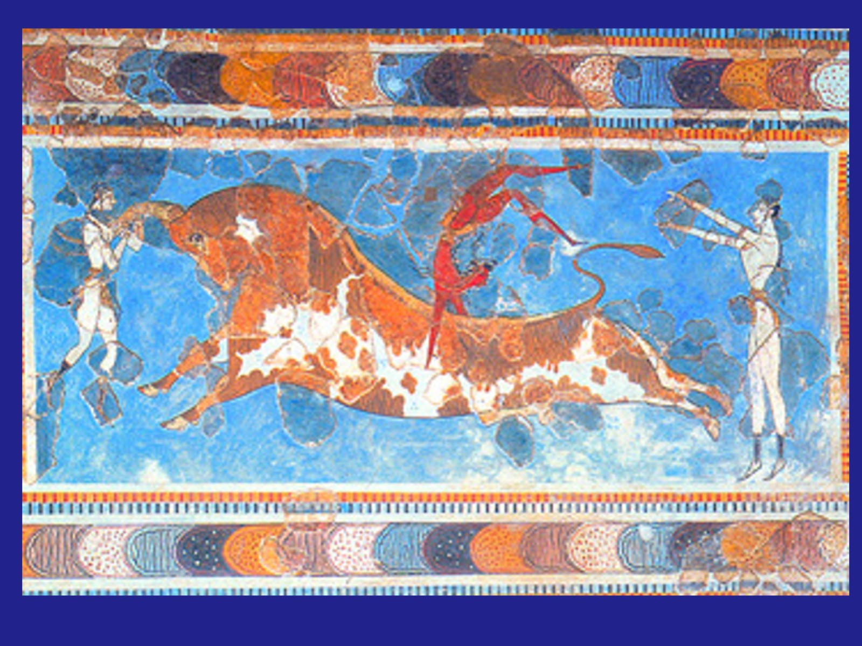
Notes:
A popular sport in Minoan culture was bull-throwing. Gymnasts, like the ones in this fresco, would enter a ring with a bull, performing death-defying stunts using the bull as a prop. Here you see an acrobat vaulting over the bull’s back as it charges. Another acrobat is literally “grabbing the bull by the horns”. It was symbolic of our slight irreverence for deities. We might worship the bull for its strength and virility, but we could also demonstrate OUR capabilities by teasing it a little. More recently, some cultures have engaged in bull fighting, in which the bull is eventually killed. This once again shows our superiority over a most powerful animal. At least in the killing sense. In Pamplona, Spain it is still a test of “manhood” to Run With the Bulls annually through town. Many manly men get stomped or gored.

Slide 6
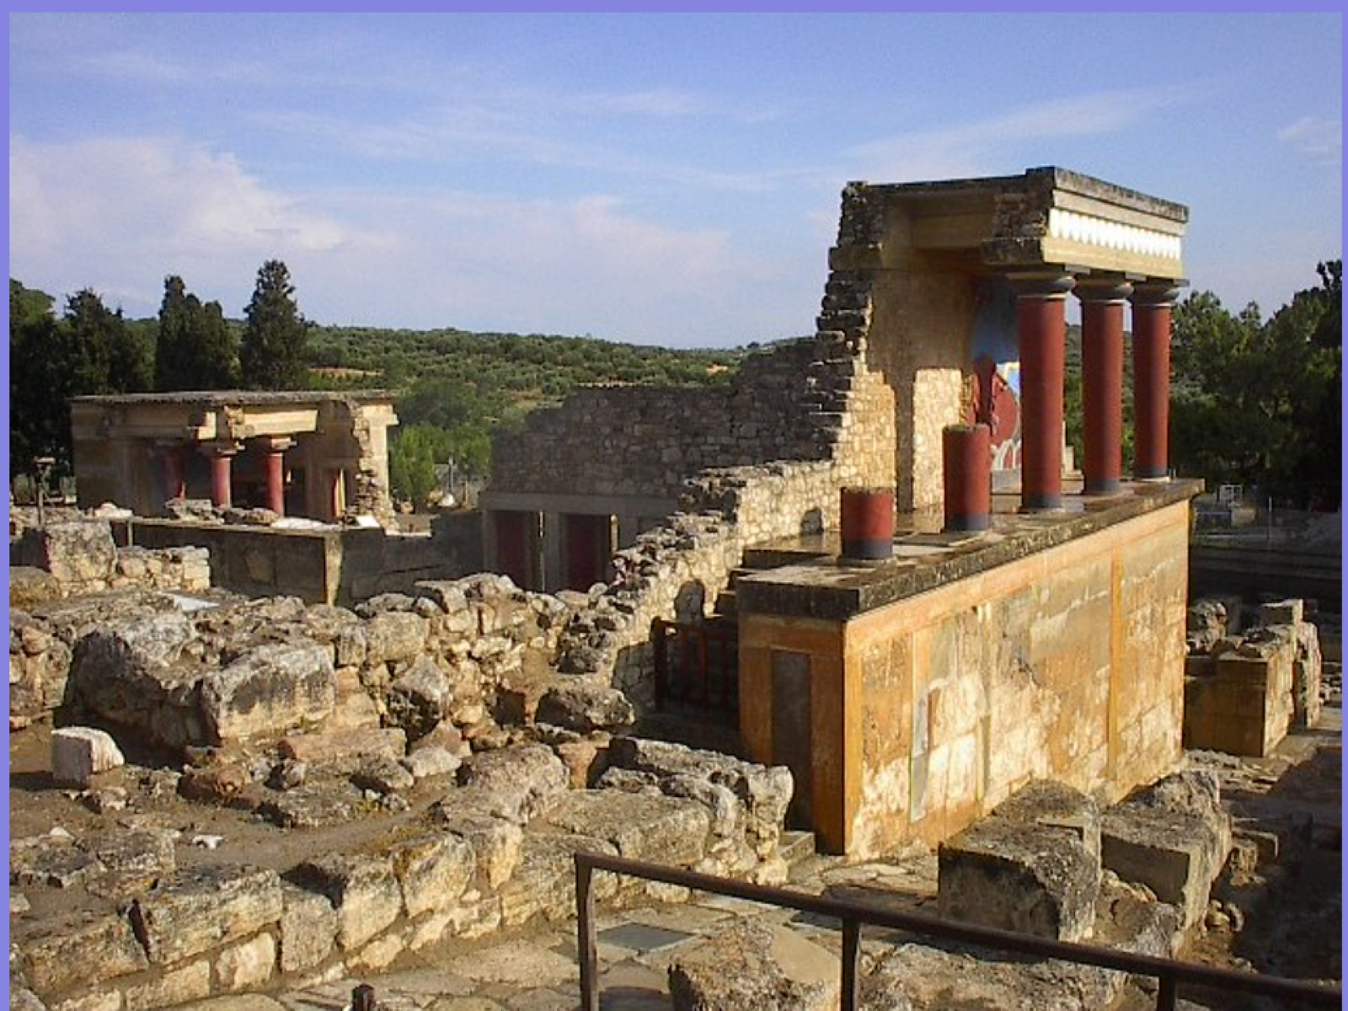
Notes:
These are the remains of the great palace at Knossos. Until they were unearthed, one of the great stories of Minoan culture seemed to be completely legend. When this palace was uncovered, one of the amazing finds was that the lowest level contained a maze (AKA labyrinth)! It is hypothesized that one of the “games” of Minoans was to have a person enter the labyrinth and attempt to find a “prize” at the center, while King Minos and his friends watched from a higher level. It seems likely that, at some point, in order to make the game more interesting, an assassin would be placed in the labyrinth to prevent the adventurer from reaching his goal. Of course, this might lead to some interesting “twists” on reality, such as…

Slide 7
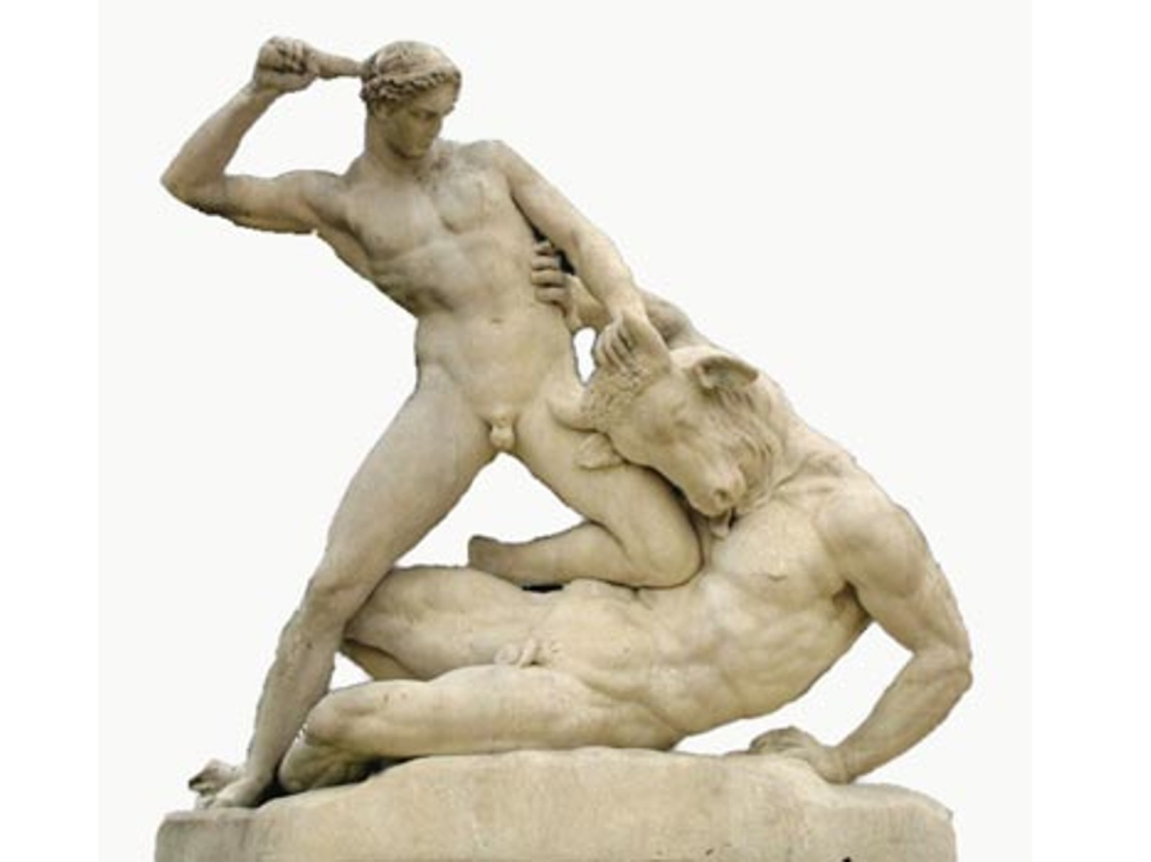
Notes:
…the story told of Theseus and the Minotaur.
Backstory: It was said that Minos’ queen, overcome by the power invested in Minoan bull culture, allowed herself to be impregnated by a bull. (We know this to be impossible, of course, but ancient peoples didn’t have much science about this stuff.) As often happens, she gave birth to a horrible, half-human, half-bull creature known as the Minotaur. (Probably not called this by Greeks, since Taurus is Latin, but…) King Minos, both ashamed and sorry for this creature, built the labyrinth as a “home” for the Minotaur, and sometimes “fed” him unsuspecting travelers for lunch. The Minotaur was understandably grumpy over being outcast from both human AND bull society.
- One day, a Greek prince named Theseus landed on the island of Crete. Being both bold and a bit arrogant, he presented himself to the king as the greatest thing since bread. (It wasn’t sliced yet.) The king soon tired of Theseus and decided to “give” him a beautiful prize, if he could only find it in the empty (“no, trust me, it’s empty”) labyrinth. BUT – the king’s daughter had taken a shine to Theseus, so she slipped him a ball of thread to help him find his way, and warned him of the Minotaur’s presence. When Theseus encountered the Minotaur, he defeated him, finishing him off by beating him to death with the bone of a previous victim. Theseus emerged, victorious, with his prize.
King Minos was outraged! He ordered Theseus to take his prize and get off the island, which he did. He also took the king’s daughter with him! Unfortunately for her, he tired of her quickly and dumped her off on another island during his trip. In true Greek fashion, however, he returned home to find that his father had died, making him king in Greece, with no more adventures in his life. (It’s boring being king.)
We should not miss the implied lesson here: Greeks are better than Minoans. The Greek hero outsmarts the labyrinth, outsmarts the king, defeats the Minotaur, and leaves Crete with no future. It is a good way for the Greeks to show that they had exceeded the Minoans in every possible way. We always like demonstrating the superiority of our culture over others’.

Slide 8
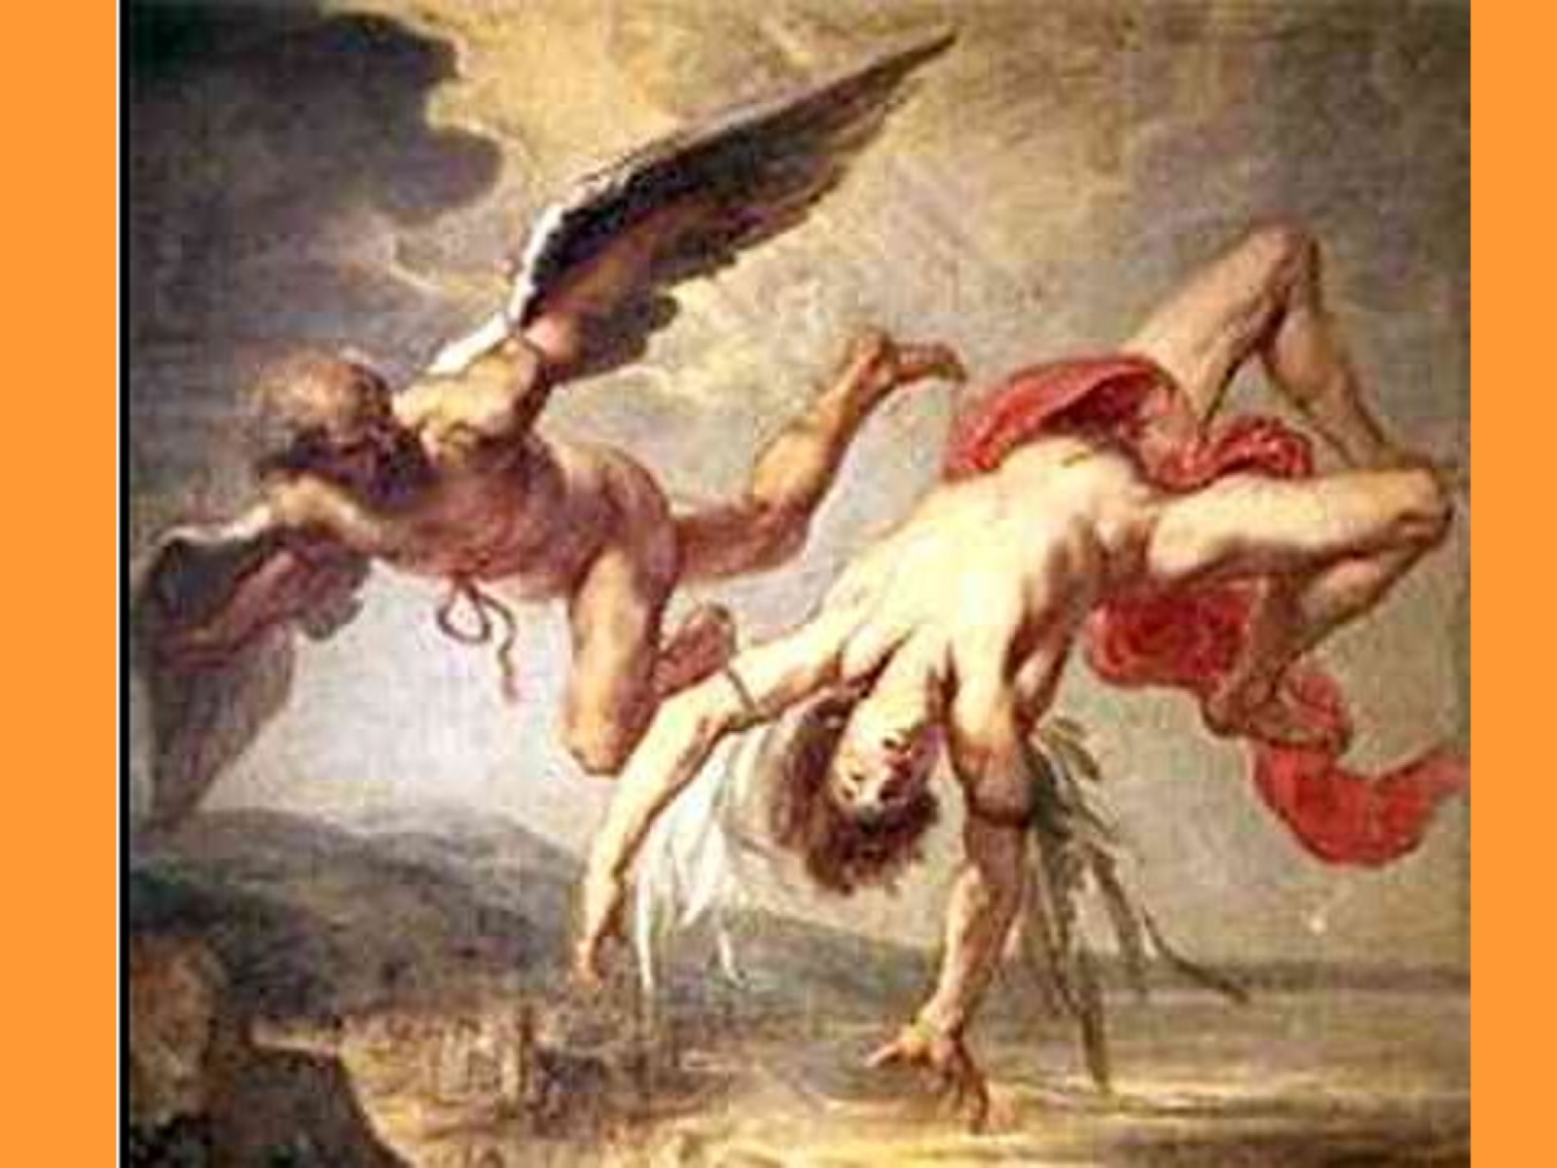
Notes:
One might wonder how such a complicated labyrinth got built in the first place. Once again we look to the Greeks, specifically the two pictured above. Daedalus (the guy on the left) was renowned for his engineering skills. According to the legend, when Minos was building his palace, he asked Daedalus to build an unsolvable maze in the basement. Because it was a BIG job, D. brought his son, Icarus along to help him. They worked for years to create the world’s most perfect labyrinth.
Nasty Minos rewarded them by locking them up in a tower! He didn’t want the secret to ever get out, so he planned to hold them forever! But D. was much too clever for that! D. & I. pretended to be voracious readers, demanding a constant supply of candles to give them light. They rationed their food, using excess crumbs to lure birds to their tower, where they would capture them and pull their feathers off. Eventually they had enough feathers that they could use the wax to glue them onto a framework that D. had made from small sticks and parts of his bed. He built them both wings, so they could fly away from Crete.
Plans never work out as intended, but Greek stories always do. Though he was warned, Icarus was SO thrilled at being able to fly that he became overwhelmed. He tried loops and rolls and eventually flew high up into the sky, too near the hot sun. The sun melted the wax, sending I. plummeting to his death in the sea below. (Dumb kids!)
The lessons here are many: Greeks are smarter than Minoans. Young people don’t listen to good advice. A man’s greatest tragedy will likely be caused by arrogance over his greatest strength. (Who dares to imagine that he can fly like the birds?) The Greeks call this arrogance “Hubris” – it is a pride that goes before a fall. Many, many Greek stories have the protagonist lose his humility and suffer a great loss due to his hubris.

Slide 9
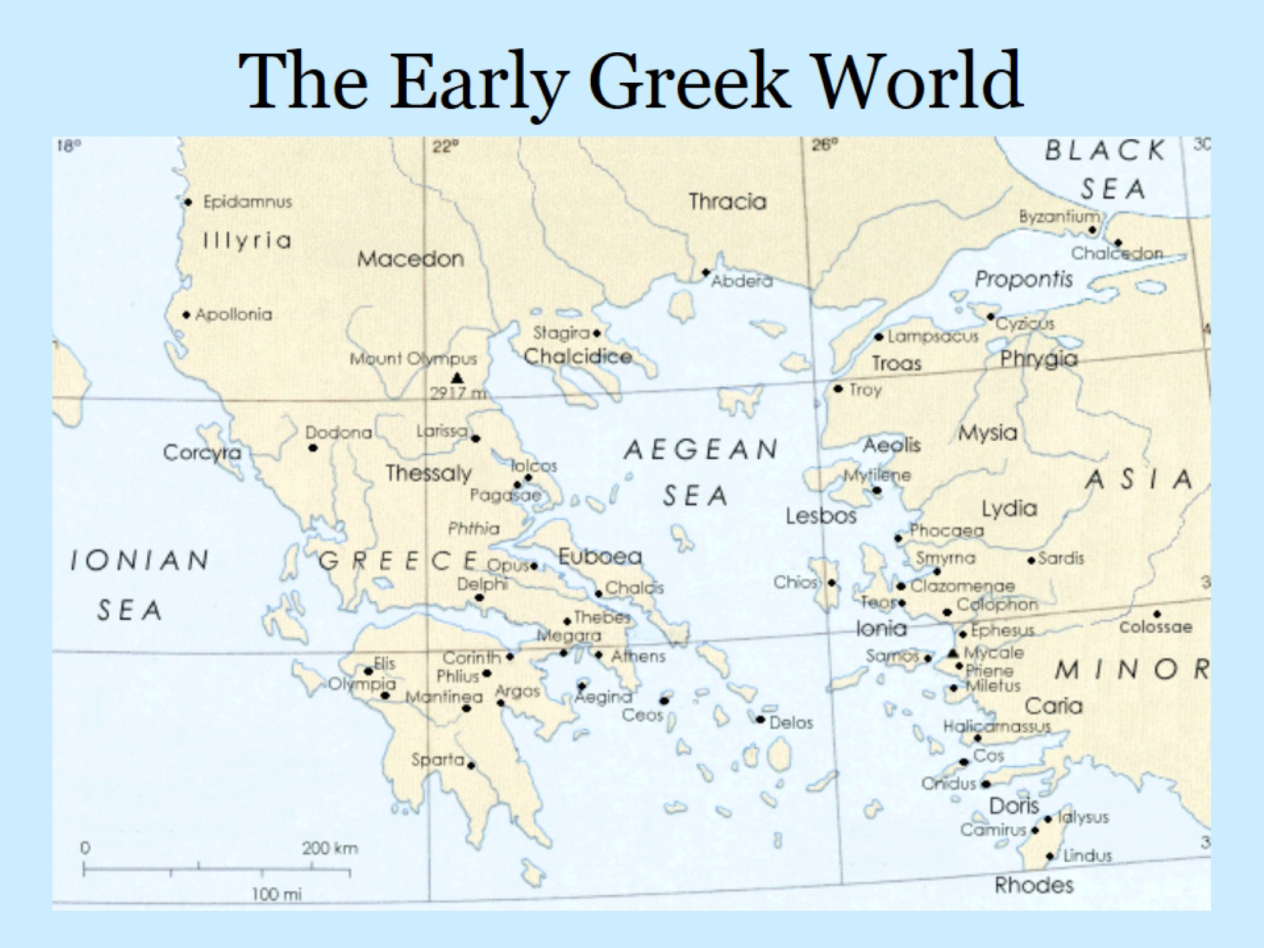
The Early Greek World
Notes:
This map gives you a hint about how far-flung the Greek world was. From a cultural standpoint, the ONLY thing that mattered to the Ancient Greeks was that you spoke Greek. If you spoke Greek, you WERE Greek – everyone else was a barbarian. This separation between types is what is called a “Dichotomy” (you might see that on your Unit Lesson Plan if you ever looked at the darned thing!)
It should be obvious from this map that the Greeks were seafarers, and they spread out their Greekness over a large area. Certain places on this map will be very important to us, so please take a bit of time to locate and internalize the following locations: Athens, Sparta, Corinth, Delos, Miletus, Ionia, Lydia, Thebes, Delphi, Lesbos, Troy, Byzantium, Thessaly, Macedon, and Mount Olympus. All of these locations will play an important role in our study of Greek history.
Greece looks much like a deformed hand, with Athens being on the “thumb” and Sparta between the middle and ring fingers. Each of these “fingers” is a peninsula, and a collection of peninsulas is called a “Peloponnesus”. It will be very important to remember that the Peloponnesus includes ONLY the four fingers of Greece, not the thumb.
Greece also has an isthmus (you thought Panama was the only one!) between Corinth and Megara that will be very important as well. It connects the “fingers” to the “thumb”, but is narrow enough that it had a wall built across it. Because of the islands that are scattered everywhere (many too small to be on this map), there are also many straits (narrow bodies of water), a few of which will become important.

Slide 10
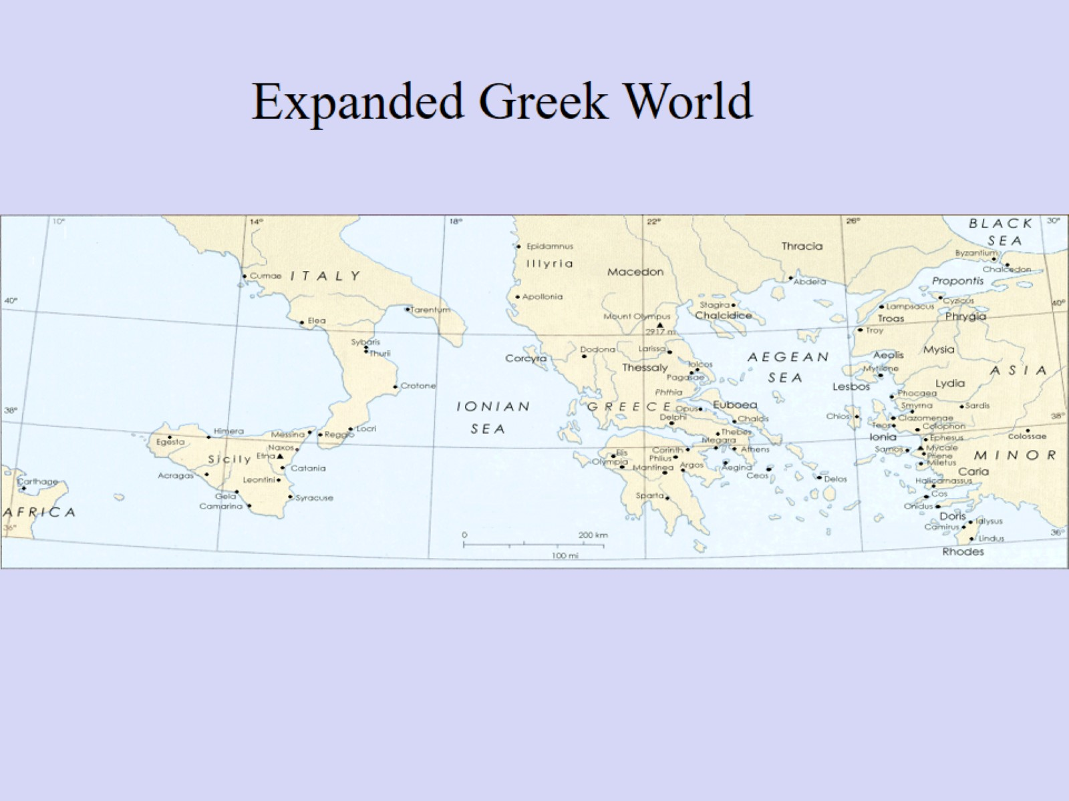
Notes:
Here is an even larger map. Notice that the Greeks established colonies almost everywhere they went. As a result, other aspects of their culture also got spread. (Remember what that’s called?) The Greek colonies in Italy would eventually come into conflict with the expanding Roman presence there. Why, would you imagine, the Greeks ended up with so many colonies over such a large area?

Slide 11
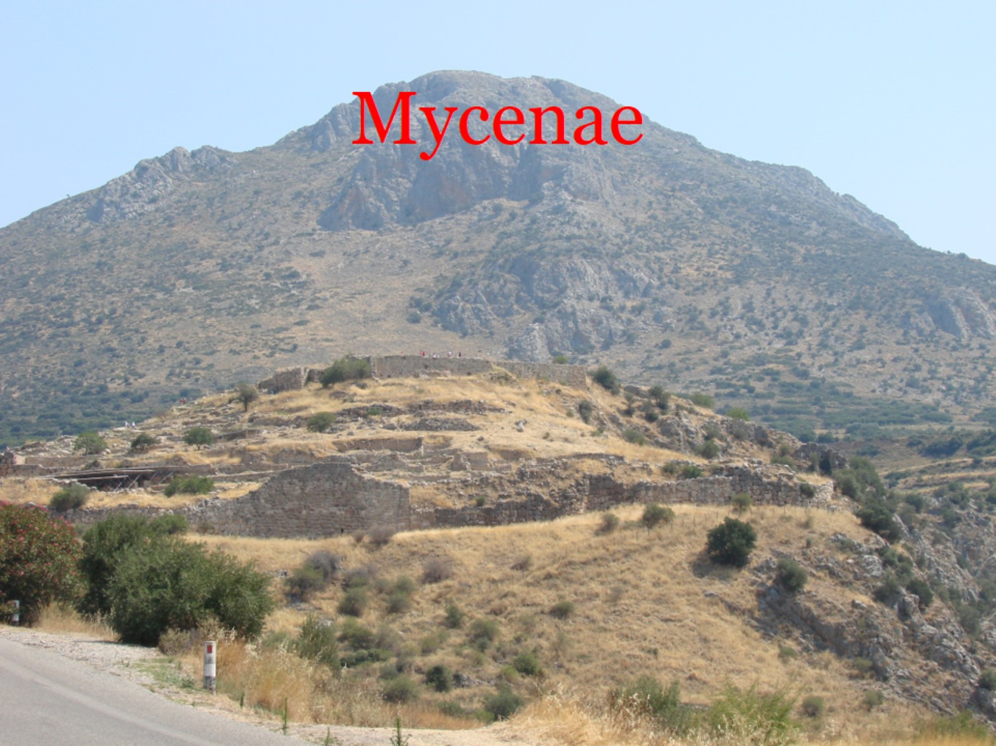
Notes:
Mycenae (My-seen-ee) is the oldest true Greek city, sometimes known as the “Golden City” because of all the gold that was purified there. Its remains now sit on the hilltop where it was originally settled. Had it been built later, it would have been situated on top of the higher hill in the background. It does not appear on your earlier map, but is located about where the 22nd degree of Longitude crosses the 38th parallel of Latitude. (That’s between Corinth and Elis.)
The origin of the Mycenaeans is unclear. They could have been an advanced tribe, a group of invaders, or a “lost nation” searching for a home. One legend even considers that they might have been a group of Egyptians who left their native land (reasons unknown) and settled in this place. Regardless, they play an important role in Greek History.
This photo, and all the others of Mycenae, were taken by me when I traveled with the WVU Alumni Band to Greece and Italy in 2010.

Slide 12
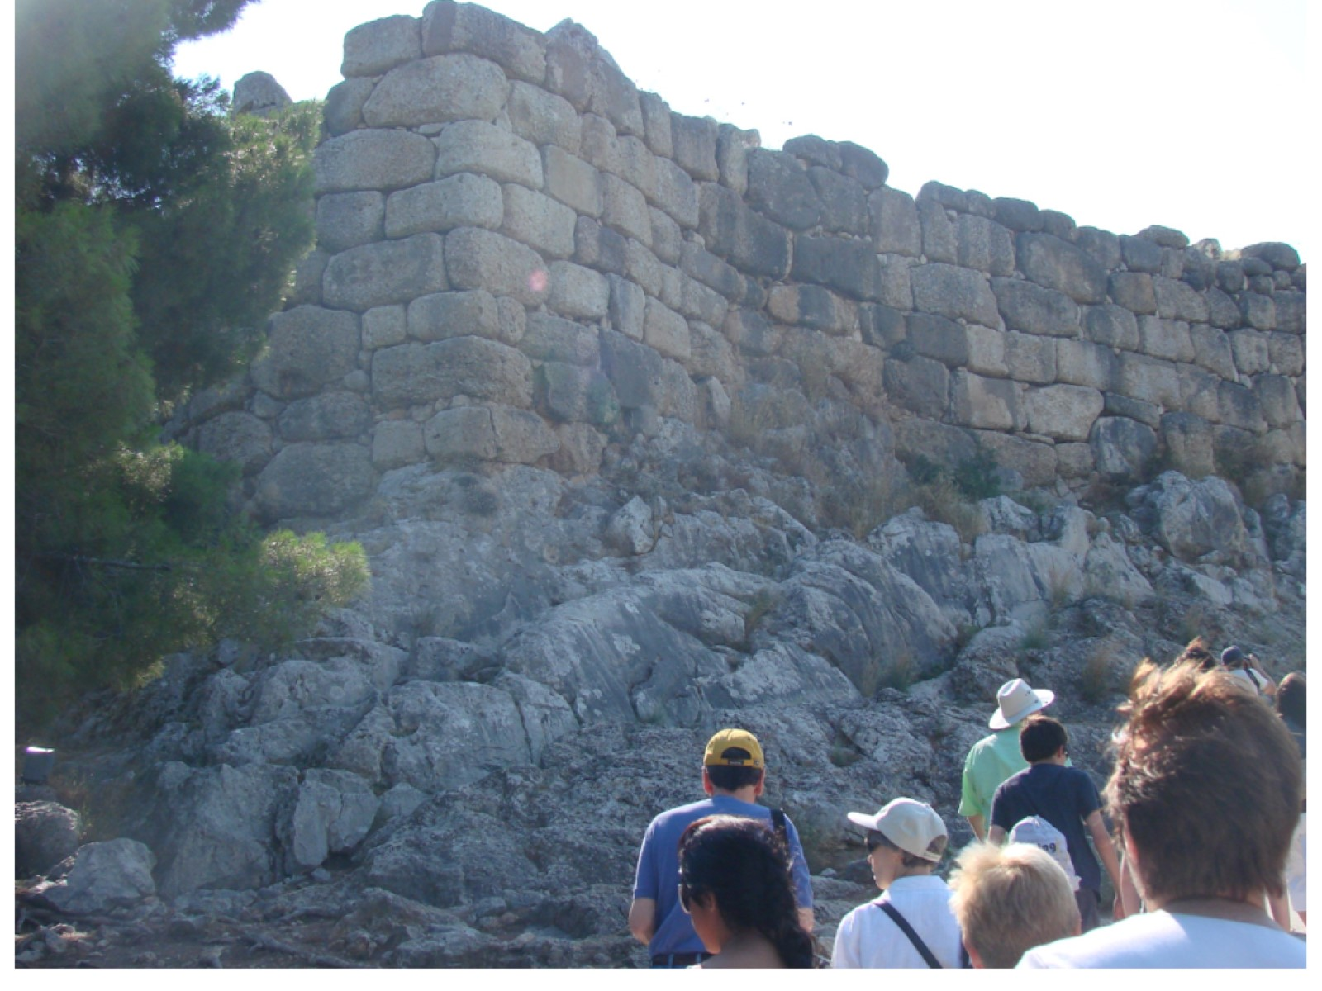
Notes:
Mycenae is surrounded by massive stone walls to keep invaders out. (The invaders in this picture will enter the city anyway.)

Slide 13
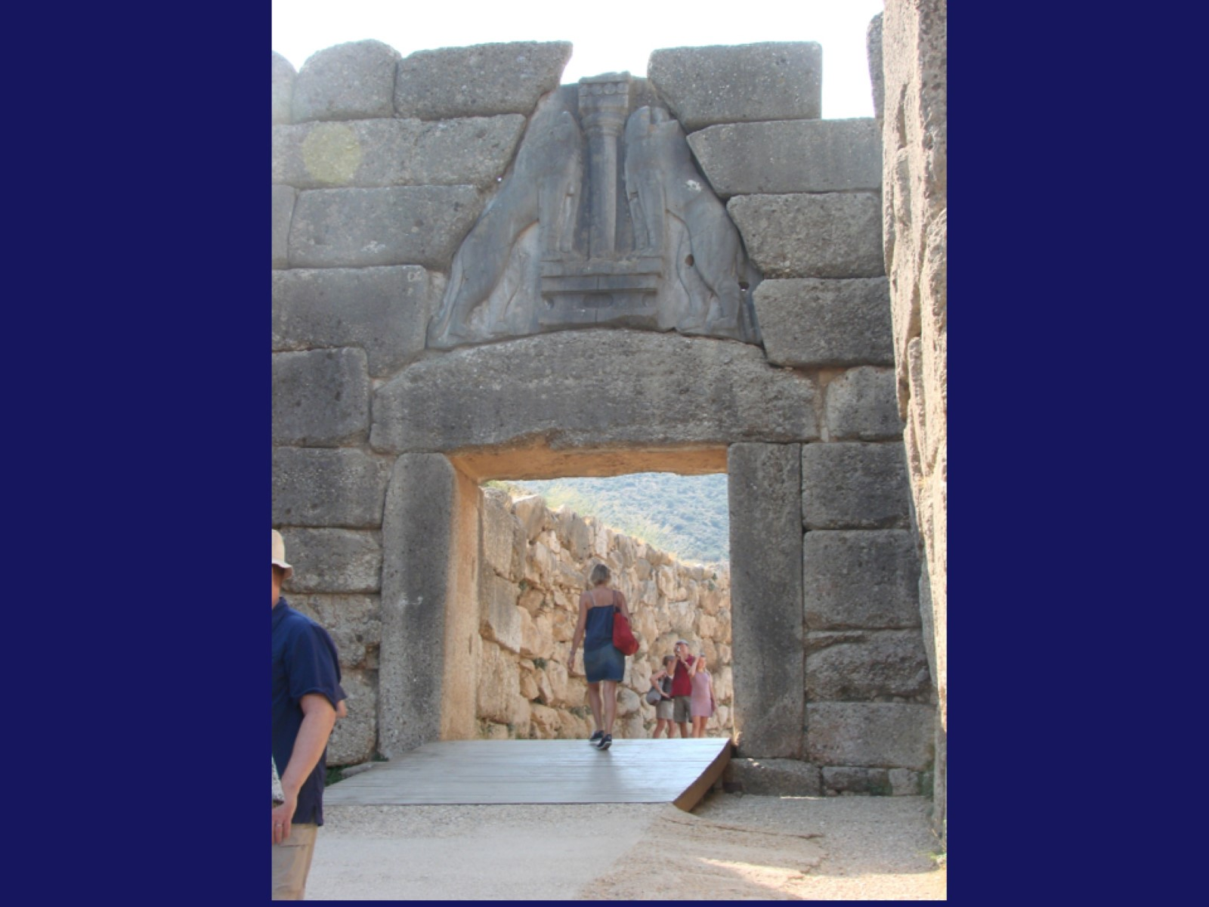
Notes:
The only entrance to the central part of the city is through this portal, known as the “Lion Gate” because of the two lions who guard this entrance. In ancient times, there would have been no ramp, and a massive wooden door would have closed up this entrance. It would have been very difficult for enemies to get inside.

Slide 14
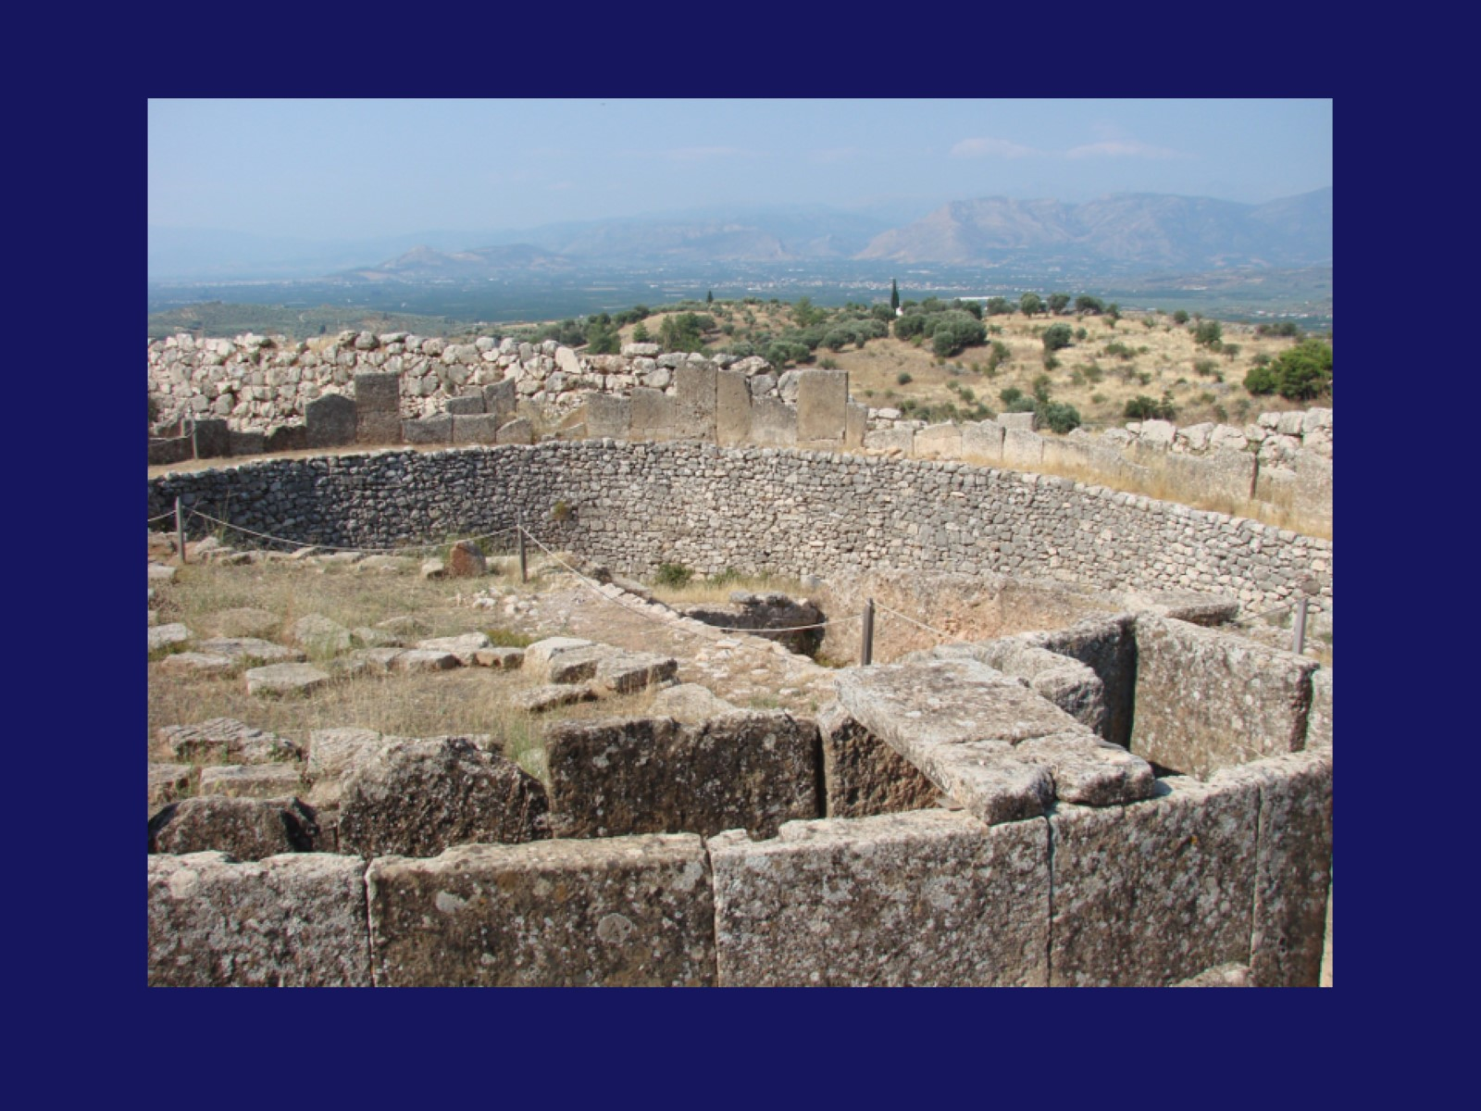
Notes:
It can be difficult, from the ruins, to fully assess the majesty of the city when it was thriving. Here you can see that it existed on at least two levels. The lower level would have been for peasants and tradesmen (blacksmiths, potters, etc.) while the upper (where the grass is) would have been for the upper class and government officials.
In the far back of this photo, you can see what is known as “Agamemnon Mountain” in honor of the greatest king of Mycenae. If you look carefully, starting just right of center in the photograph, you will see a light-colored rise that is Agamemnon’s “helmet”. Moving toward the right edge, you can see his eyes, his long, flowing mustache and beard, and his armored chest. It is said that when Agamemnon died, he laid down here and became part of the geography.

Slide 15
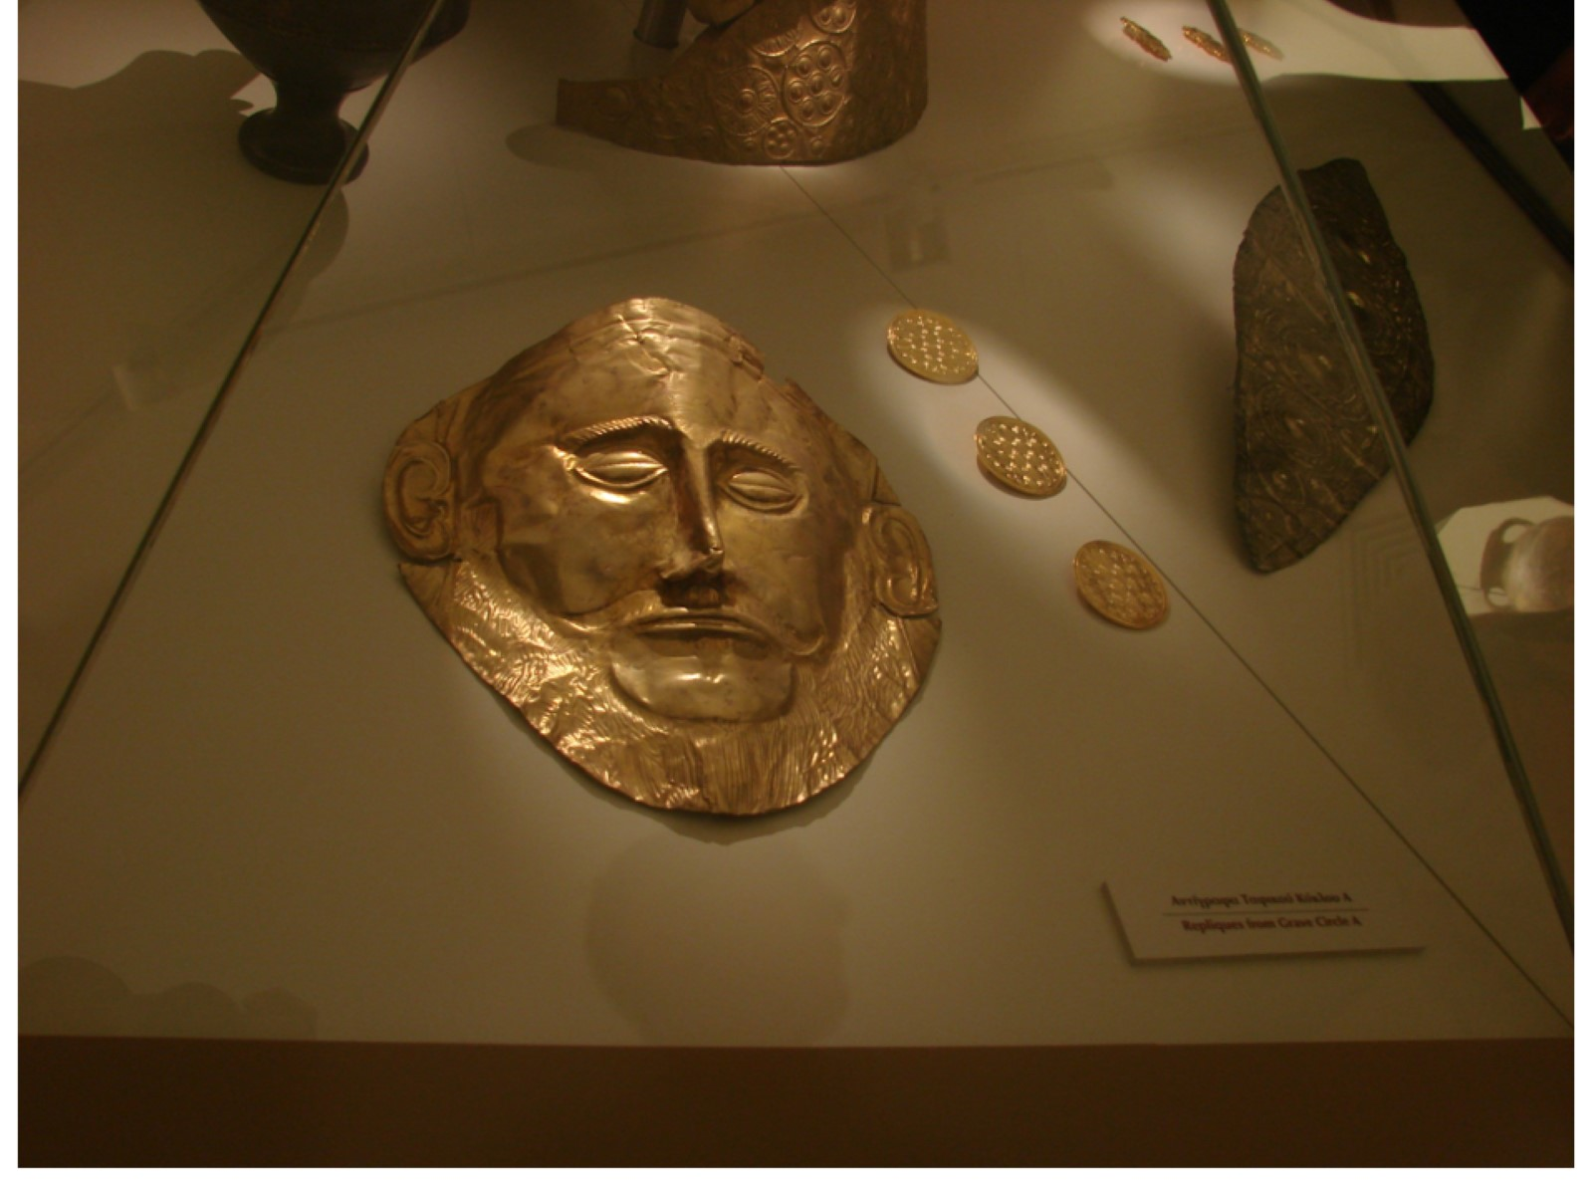
Notes:
This is the famed “Agamemnon Mask” – except that it isn’t.
This mask has been the symbol of Mycenae for nearly 3000 years. Made completely of hammered gold, it was long believed to be the death mask of Agamemnon himself, famed king of Mycenae and leader of the Greeks in the Trojan War. There are several problems with that story: (1) The mask above is a copy, because the original is irreplaceable, so kept in an undisclosed location. (2) The original, because of its style and craftsmanship, would have been made at least 400 years after Agamemnon died, probably more. (3) It is possible that Agamemnon never actually existed at all. Which would ruin the Iliad and several Greek tragic plays.

Slide 16
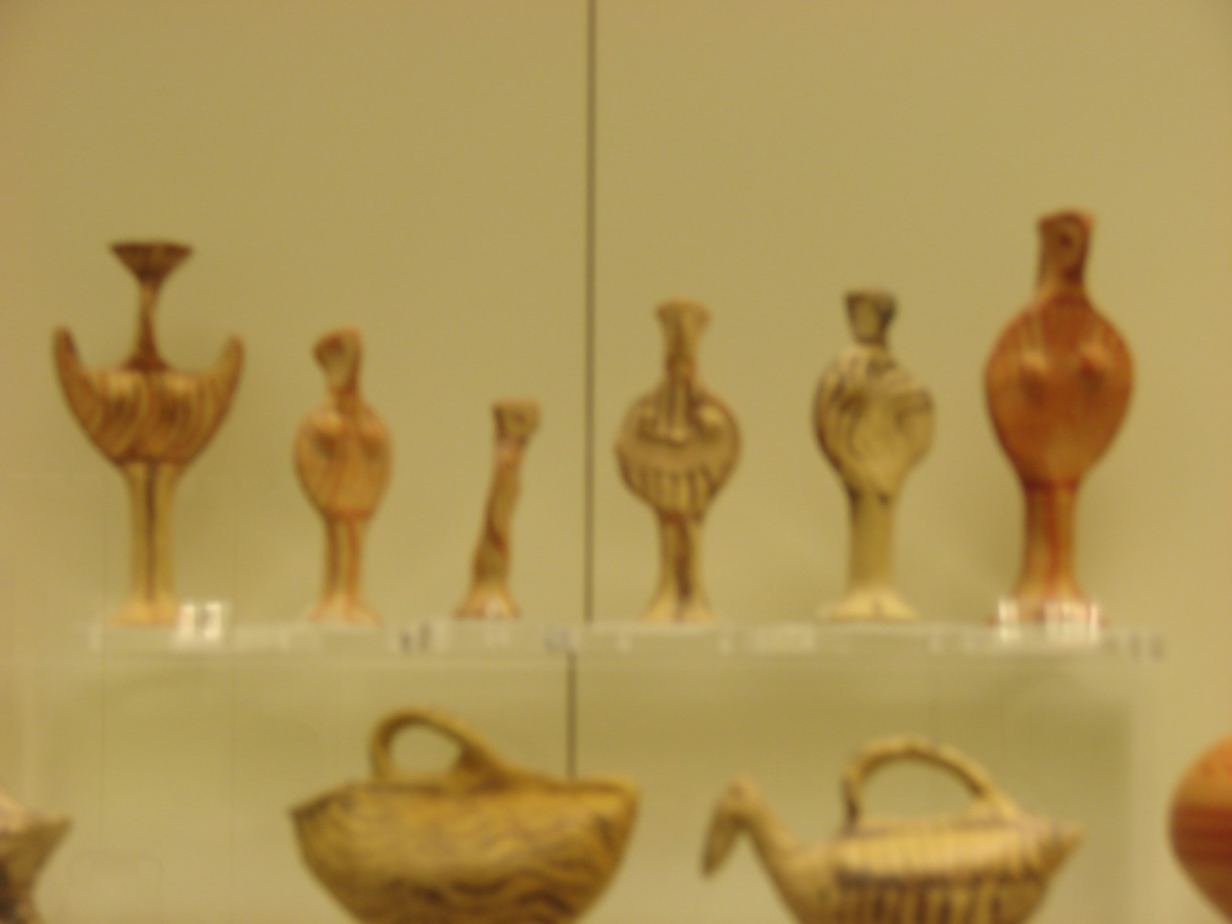
Notes:
Sorry about the blurriness of this photo, but I was shooting at a distance through heavy glass. These ancient clay figurines are over 3000 years old, and were found in the ruins of Mycenae. Such figures would have been playthings for children, but also in ceremonies intended to encourage fertility of the soil. Scroll back to the picture of the Linear B tablet, and you will see that these figures are very similar to some of the oldest characters in the Greek language.

Slide 17
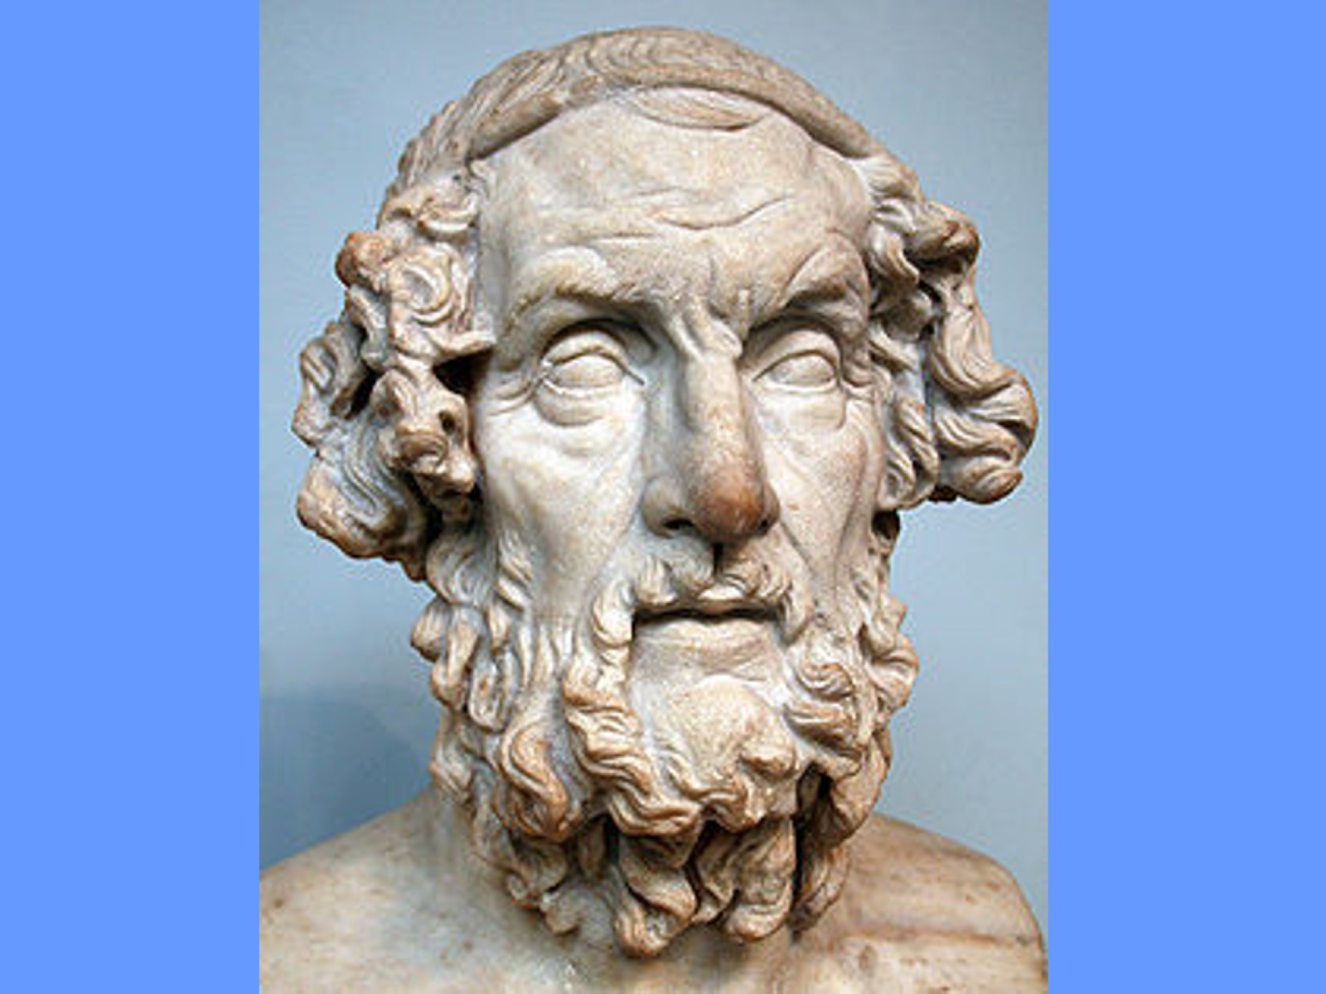
Notes:
This is Homer. (No, it isn’t.) According to legend, Homer was a wandering Greek poet of around 800 BC. He was blind, touring the country with a lyre player, telling great poetic stories of Greek history. Eventually, those stories were written down, and have become part of the foundation of Western culture. His most famous works were about events that took place at least 400 years before he was born, so their value as history is questionable. However, their value in understanding the principles by which the Greeks expected to live is tremendous. (I wish we could be in class to discuss these stories, but I will try to give you some insight into them during Teams meetings.)
Homer’s Iliad is the story of a tiny part of the Greeks’ war with Troy, which they called “Ilium”. If you look back at your map of the Greek world, you can see Troy’s location. Stories that lead up to the Iliad portray it as a romance, but in actuality, it was (like all wars) mostly caused by economics. Troy guards the narrow strait that leads up into Asia. Most likely, the Trojans were forcing people to pay a toll in order to pass through, and the Greeks were unwilling to pay tribute to any other culture. The Iliad tells only a tiny part of that conflict – one that involves the pride of Achilles, the stubbornness of Agamemnon, the heroism of Hector, and the cleverness of Odysseus. It begins and ends in the middle of the war, so we owe everything else we like about the War to later poets who answered the questions, “How did we get here?” and “What happened after that?”
Homer’s Odyssey tells of Odysseus’ trip home, a trial that takes 10 years. He encounters many interesting individuals and undergoes a great many difficulties to reach Ithaca, his home island. (Another historical problem, since no current island exists that has ever been called that.) Odysseus is the sort of person Greeks should strive to be: strong, intelligent, clever, determined, resourceful, curious, manly. (Well, Greek men anyway.) In many ways, it is a much better story than the Iliad, because, like most Western literature, it has a beginning, a middle, and an end.
Things that are NOT in the Iliad or the Odyssey: the Trial of Paris, the rape of Helen, the face that launched 1000 ships, the Trojan Horse, the destruction of Troy, the death of Agamemnon – all these are creations of other authors.
Both the Iliad and the Odyssey, being so ancient, are available on-line to read from a variety of sources. Google either one and check out some of the great epic poetry attributed to Homer.

Slide 18
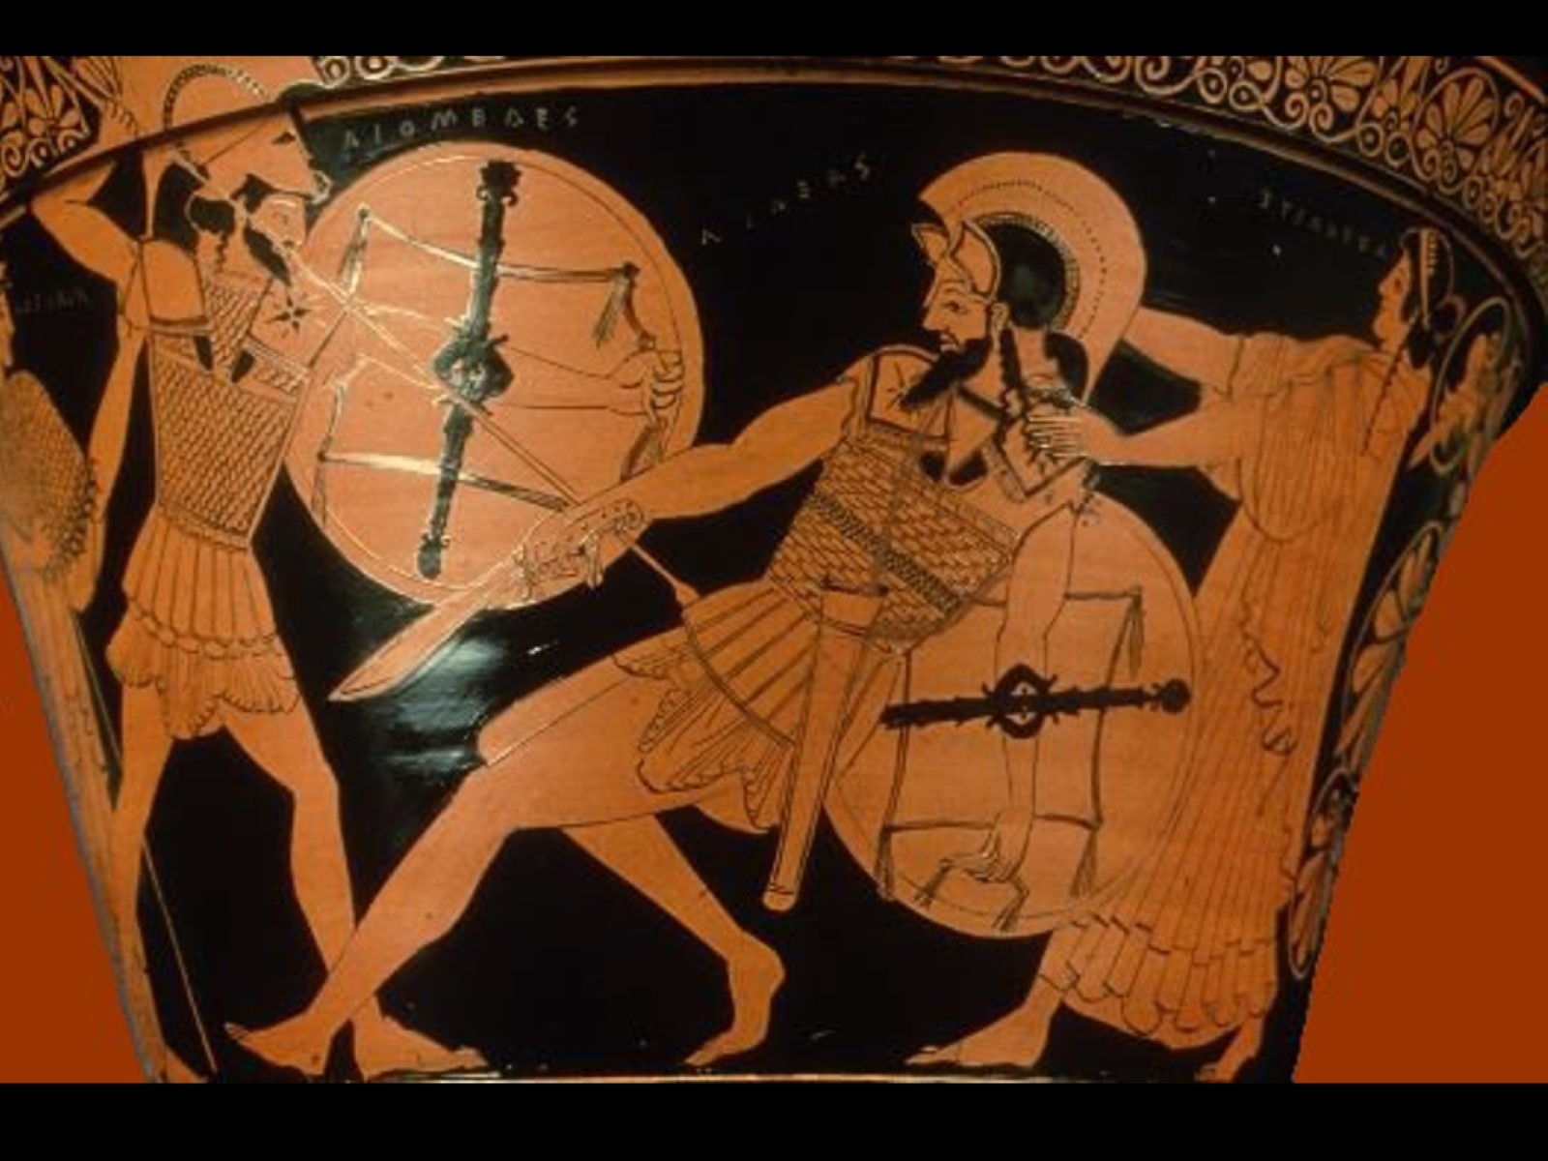
Notes:
This is an ancient piece of Greek pottery depicting Achilles (on the left) finally killing Hector, hero of the Trojans. A major part of the Iliad is the battle between these heroes. You might find it unusual that Homer would depict a Trojan as heroic, but it is Greek custom to value certain traits, wherever they find them. Hector is always pictured as noble, brave, and strong, but in the end, Achilles must win because Achilles is Greek. Hector is being “received” by a goddess, because he will have a good afterlife even though he was the “enemy”. Another goddess is steadying Achilles arm so that he may deliver the fatal blow. Greeks believed that their deities were directly involved in actions of their lives.
The artwork here is typical of fancy Greek pottery of the olden days. It has been painted with black lacquer, then had the scene painted over that in shades of orange. Take some note of the weapons they used, shields they carried, and armor they wore.

Slide 19
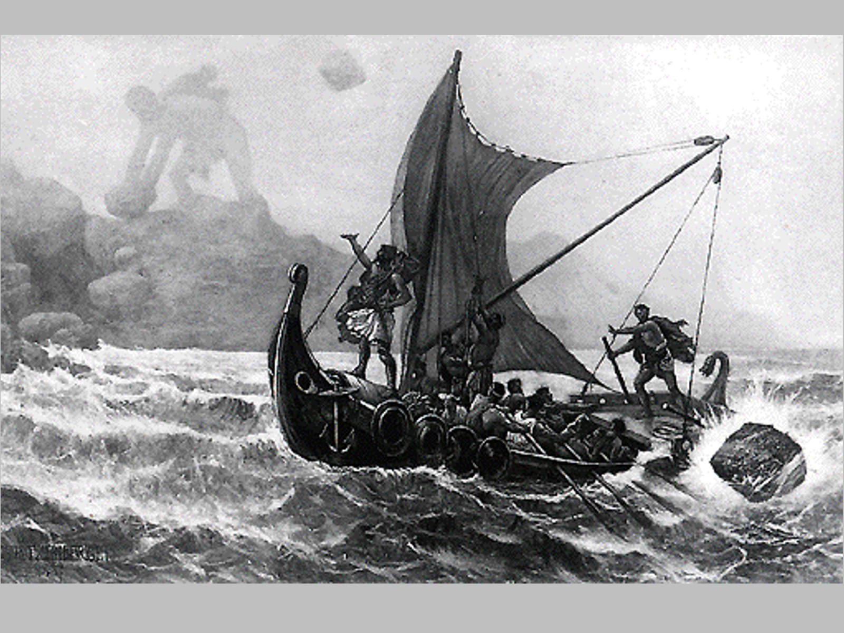
Notes:
This is a famous scene from the Odyssey. In the background, you will see Polyphemus, a cyclops, hurling rocks at Odysseus’ ship, nearly sinking it. Odysseus has managed a clever and bold escape from the island, but his hubris causes him to taunt Polyphemus, who he has blinded in the escape. Though the rocks miss the ship, Odysseus will pay for his actions. Cyclopes are said to be the sons of Poseidon, so that god punishes Odysseus by a series of trials that will delay his return home for 10 years. In the end, he will have lost this ship, the men on board, and all his war treasures.

Slide 20
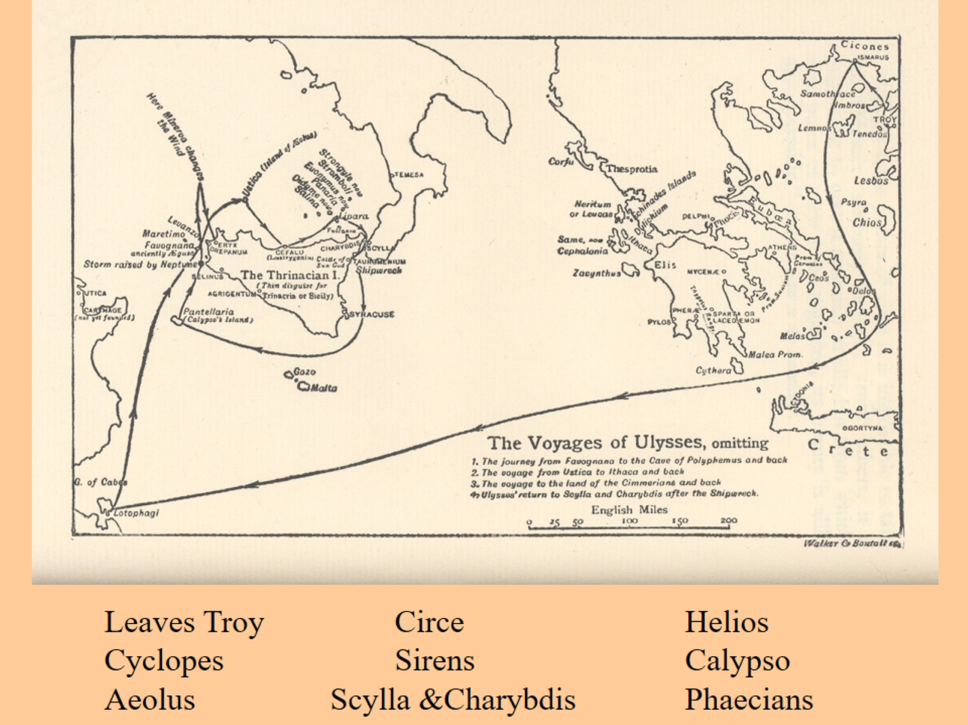
Notes:
This map shows the travels of Odysseus as he journeys home. I have listed the main events along the way at the bottom of the slide. It loses a lot by not taking place “live” in the classroom, but such is life… (The map says, “Voyages of Ulysses” which is the Roman name for Odysseus. Romans adopted major portions of Greek culture and adapted them to Roman culture.)
At the upper right part of the map, you can see Troy, where Odysseus has been victorious. He is intending to return home to Ithaca (an island to the upper left of the “hand” of Greece. Unfortunately, he is constantly thwarted by Poseidon.
~ At the Island of the Cyclopes, he blinds Polyphemus and earns Poseidon’s wrath.
~ At the island of Aeolus, he is given winds to carry him safely home, but the curiosity and jealousy of his crew ruins that.
~ At the island of Circe, his men are turned (temporarily) into pigs because of their bad behavior.
~ At the island of the Sirens, Odysseus tests his own resistance to temptation and finds that he is not perfect.
~ At Scylla & Charybdis, he is faced with a terrible choice: avoid the nasty monster that could devour some of his men, or sail too near the whirlpool that could destroy his entire ship. As fate would have it, he has to endure this danger TWICE, and ultimately fails both times.
~ At the Island of Helios, the Sun god, his men devour the sacred cattle and earn more godly anger.
~ At the Island of Calypso, Odysseus alone remains captive of a nymph who falls in love with him. He almost ends his journey, but if he did, he would not be the hero we want him to be
~ At Phaecia, Odysseus tells his story, and is helped to return to Ithaca by the Phaecians. They are punished by the gods for their assistance. (you will notice that there is no line on the map showing his return)
**After all this, Odysseus returns home to find his kingdom being ravaged by selfish nobles. They are eating all his food, drinking all his wine, and trying to marry his wife. The infant son he left to go to Troy, Telemachus, is now a 20 year-old man. Working together, they drive out the suitors, and Odysseus is reunited with his wife Penelope in a very heartwarming ending that requires cleverness on both their parts.
(Remember, both the Iliad and the Odyssey are in public domain, so you can Google the stories and read them if you wish.)

Slide 21
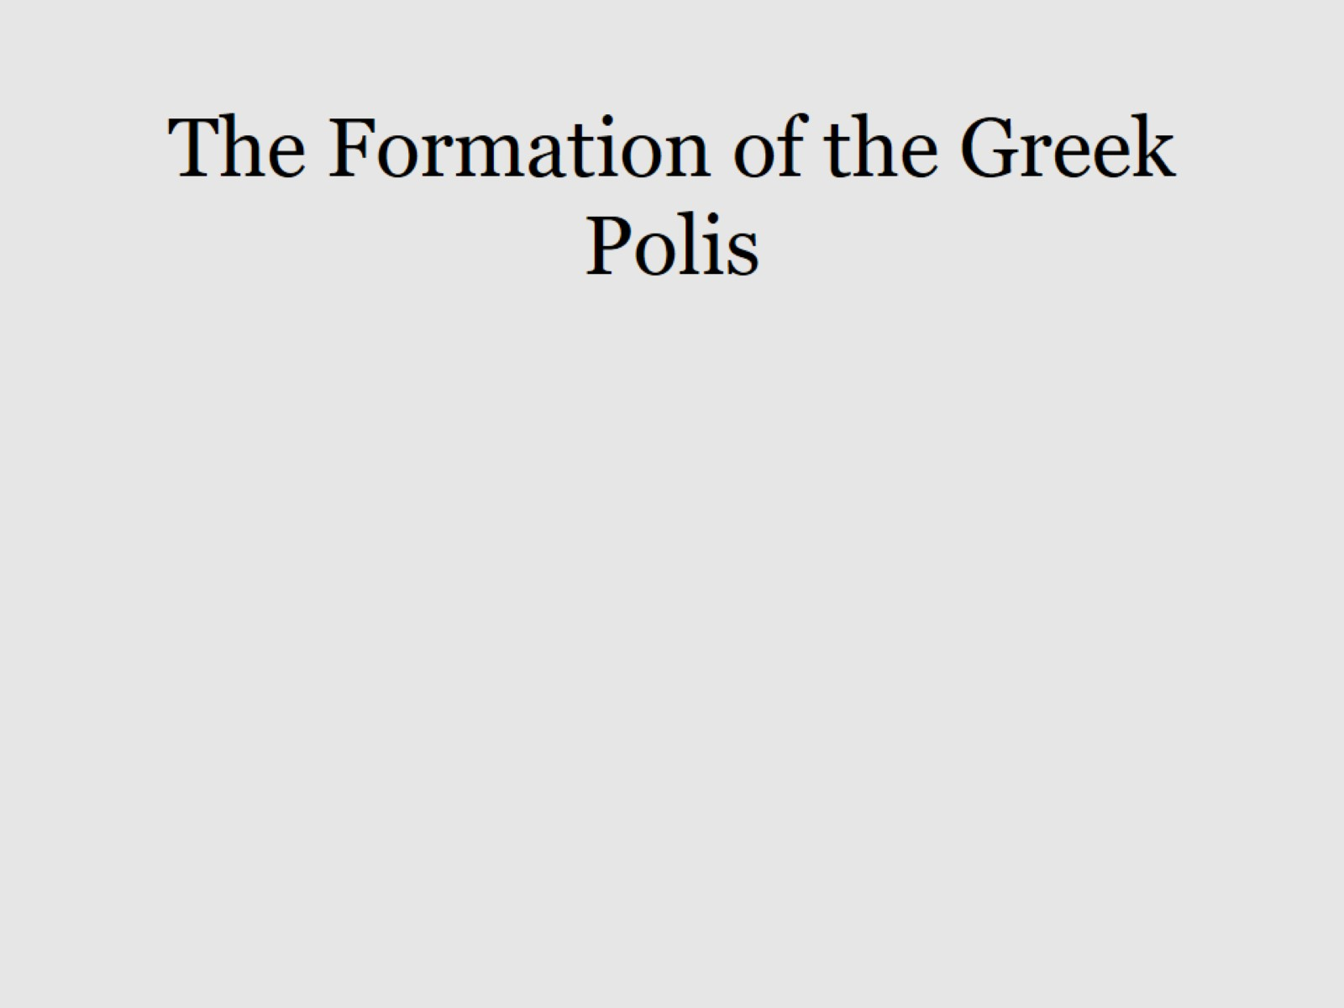
B
A
C
Notes:
Surrounding each of the cities you looked at on the maps earlier was a state, much like our own, though much smaller. Athens was the polis in the state of Attica, Sparta was the polis in the state of Laconia (earlier called Lacadaemon), etc. On your map, many cities are listed, but not many states.
The center of the polis was the highest mountain in the state. It is an old truth in military history that you should always seek the higher ground in order to have the strategic advantage. (It is very difficult to attack uphill, and many hills in Greece are very steep – as you will see.) This highest part is referred to as the “acropolis”, literally meaning “high city”.
The center of the polis held the most irreplaceable parts of the state – the king, the treasury, the temple, etc. Greek city-states had many different types of government, but we will focus on the earliest form, since that is when most of the polises were first settled. If you look at Part A in this excessively weird diagram of Athens, this would be the central part of the polis. Somewhere in this area would be the Megaron, the room where two vital things occurred: the central fire was kept here, never being allowed to go out, so the people would always have fire; the king also held council here, meeting with his nobles and deciding cases brought before him by the people. Those who were directly involved in the affairs of the polis were said to be engaging in “politics”, which is where our word gets its literal meaning (before politicians besmirched its good name!)
Part B would be the area where the people shopped and had various social events – theatres, the Agora (like a shopping mall), and other businesses occupied this area, along with relatively wealthy people.
Part C would be for the lower class residences, usually built in rows, with several apartments in a line, sharing inside walls with others. (thus the main plot device in the story of Pyramus and Thisbe.)
The blue lines here represent high stone walls, built to protect the people, similar to what you saw in the pictures of Mycenae.
Outside the walls of Part C were farmlands, and access to the seaports. Since the drawing above depicts Athens, it has something no other city had – a direct staircase to Piraeus, their seaport. Without being exposed to a potential enemy, Athenians could get to their ships, even when the polis was under attack.

Slide 22
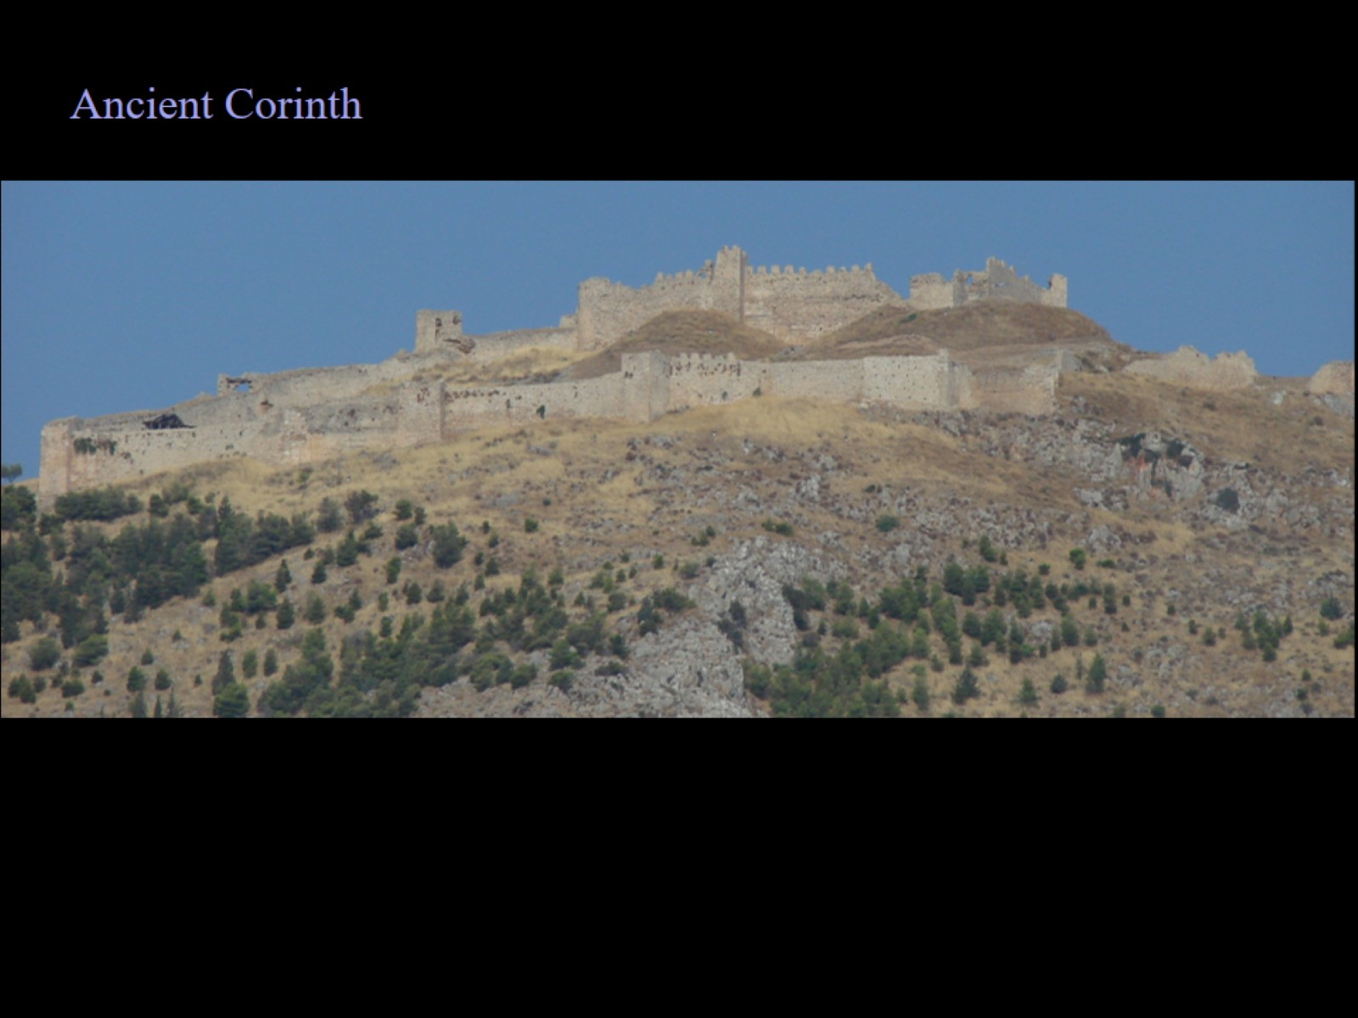
Notes:
This is what remains of the acropolis of Corinth. Notice how steep the hill is leading up to the top. Imagine being an invader and attempting to scale these walls while also being on such a hillside. Keep in mind that every polis you saw on your Greek map had an acropolis like this. When you consider how small Greece is, you will realize how frequently you would see one of these.

Slide 23
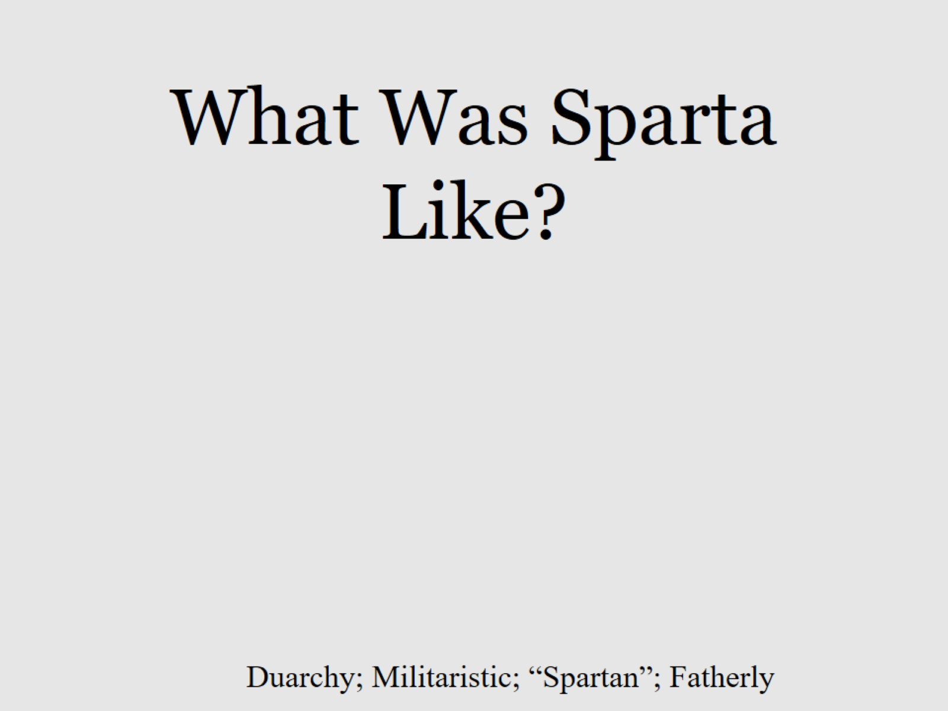
Notes:
I’m not sure what I would have drawn in this slide, but… notice the words at the bottom.
Sparta, unlike other states, had TWO kings – a Duarchy. One king ran the daily affairs of the government while the other ran the military. Since Sparta was VERY militaristic, that 2nd king had great power. Perhaps the most. Frequently, the interests of one king conflicted with that of the other. When it did, a council helped decide what to do. All these were influenced by the “Ephors”, a mysterious group of priests who determined what the fates had decreed. Superstition played a large role in Spartan decisions.
Simply calling them “militaristic” is not enough to do them complete justice. Spartans believed very strongly that weakness was unacceptable. If a child was born disabled, he was “given back to the gods” (left on a hillside to perish in the elements). Spartans saw it as cruel to protect such a child, only to have him destroyed later in life by a harsh world. Young boys were trained early in military arts, and sometimes forced outside the city to “test” themselves against the elements and animals. As they got older, discipline and harsh training ensured that they would be prepared for battle at all times.
We use the word “Spartan” to refer to a lifestyle without any luxuries. Spartans slept on stone beds with stone headrests. This toughened their bodies so that the harsh life in combat would be no different. Since they were from the state of Laconia, we also use the word “laconic” to indicate a person who speaks little, gets straight to the point, and moves on.
I also use the word “fatherly” here, because the Spartans had an interesting tradition: each man was expected to be father to every child. Since all Spartan men (or so we are led to believe) had the same standards and values, they could be expected to “raise” any child they met as if they were their own. In other words, if you were out in public, making a fool of yourself, ANY adult man there could punish you. I don’t suppose it would take long for everyone to have the same standards and values!
Because of their emphasis on physical conditioning and military training, the Spartans had little time for philosophy, writing plays, etc. That is why their culture has so litte impact on us today.

Slide 24
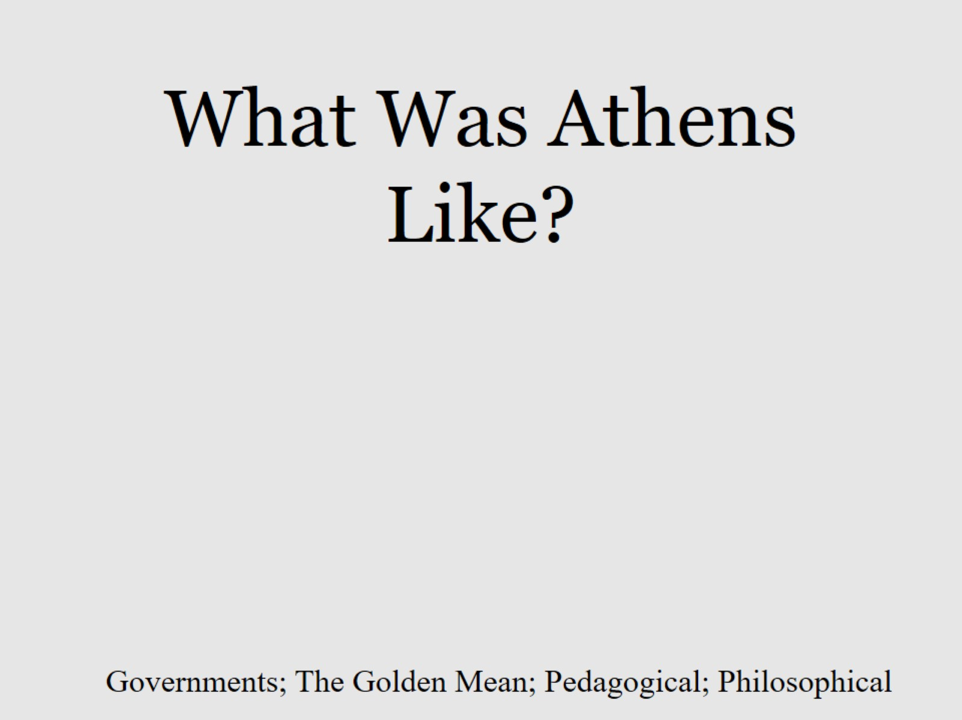
Notes:
In any study of Greek history, we end up comparing Sparta and Athens. The two states were incredibly different, which led to many conflicts between the two.
Athens did not maintain a monarchy for long. Due to their tendencies toward analytical thought and a desire for independence, Athenians saw kings as too powerful, potentially illogical, and likely to restrict the actions of others without good reason. They tried many different forms of government over the years, usually because of changing circumstances. They had, at various times, Oligarchy (rule by a chosen few), Plutarchy (rule by the rich), and Tyranny (total power invested in one person – once the winner of the Olympics!). They also tried councils of wise elders, called Archons. Eventually, they tried something no one else had – Democracy.
According to ancient legend, Greece was settled by 10 tribes. We can assume that these tribes had different cultures and values. Look back at the diagram of the polis. Imagine each level divided into 10 sections. Now you have 30 sections. Each of those sections was called a “deme”. If each section elected a representative to the “congress”, you would have 30 representatives. Athens decided to be sure that all were represented, so they had each deme choose 10 representatives, so now you had the Council of 300. This Council (think Congress) gave the impression that every person in Athens was being heard on every issue. It actually worked pretty well.
Athenians believed in the “Golden Mean”, often expressed as “A sound mind in a sound body”. In this case, the word “mean” has the mathematical meaning, “average”, as in balance. To be sure, Athenians went to the gym and worked out, similar to Spartans, but they also studied, read, and explored ideas. They saw the Spartans as meatheads, while the Spartans saw Athenians as sissies. Athenians were looking for balance in their lives, while Spartans were focused on the thing most likely to guarantee their survival.
Athenians were pedagogical – teachers afoot. It was a common sight in Athens to see teachers walking the streets, instructing their students about whatever subject the teacher was expert in. Most of the time, that subject was philosophy, because other subjects might be learned through apprenticeship (pottery, blacksmithing, etc.) Socrates was probably the most famous of these pedagogues, but there were many. Teaching was considered to be an art form, since it requires great skill to hammer ideas in to the thick heads of young people.
By the way, Philosophy is the study of how we know what we know. We often take for granted that we just know certain things to be true, but sometimes our faith in our experience is faulty. Perhaps the world is not what we think it is, but something different altogether. Philosophy allows us to explore other possibilities in order to create a better life by having a better understanding of the world around us. It helps us see WHY things are what they are. Because of the ideas they left behind, the Athenians have had much more long-term impact on the world than any other Greek polis.

Slide 25
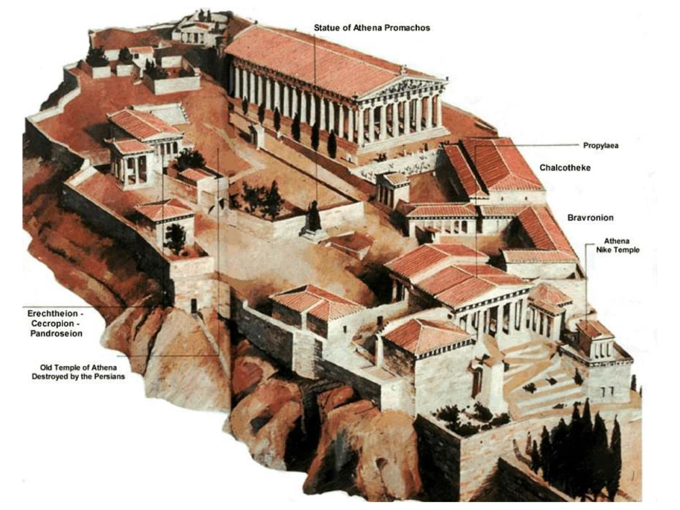
Notes:
This is a drawing of the Acropolis in Athens at its greatest time. Notice the enormous Parthenon dominating the area. (This is the building many of you knew from previous experience.) You might be surprised to see roofs on these buildings, but they were made of wood, which is why they no longer exist. The rear part of the Parthenon held the government treasury.
Athens was so named in honor of the Greek goddess, Athena, goddess of wisdom. There are several other small temples on the acropolis dedicated to her as well as the Parthenon.
Notice how the acropolis (section A in your diagram), even though built on a harsh rock outcropping, is also surrounded by high walls. There is only one way in, and under most circumstances, it would be unassailable. Most…

Slide 26
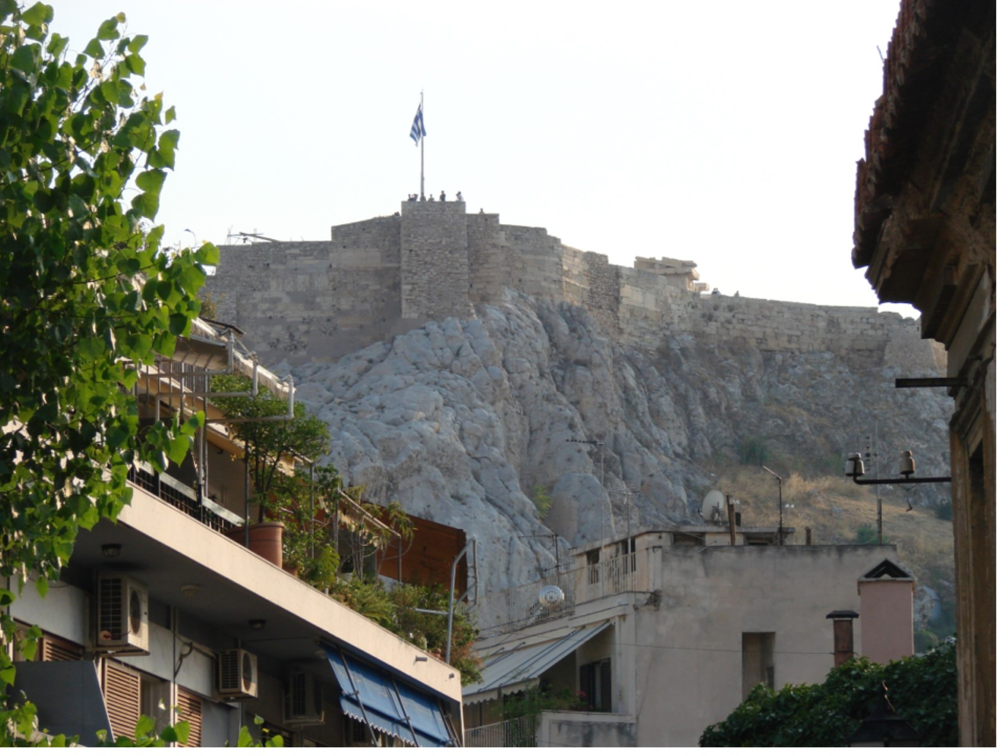
Notes:
This is a photo I took from the next level down from the acropolis. Here, you can see how rugged the rocks are, and how the walls rise up out of them.

Slide 27
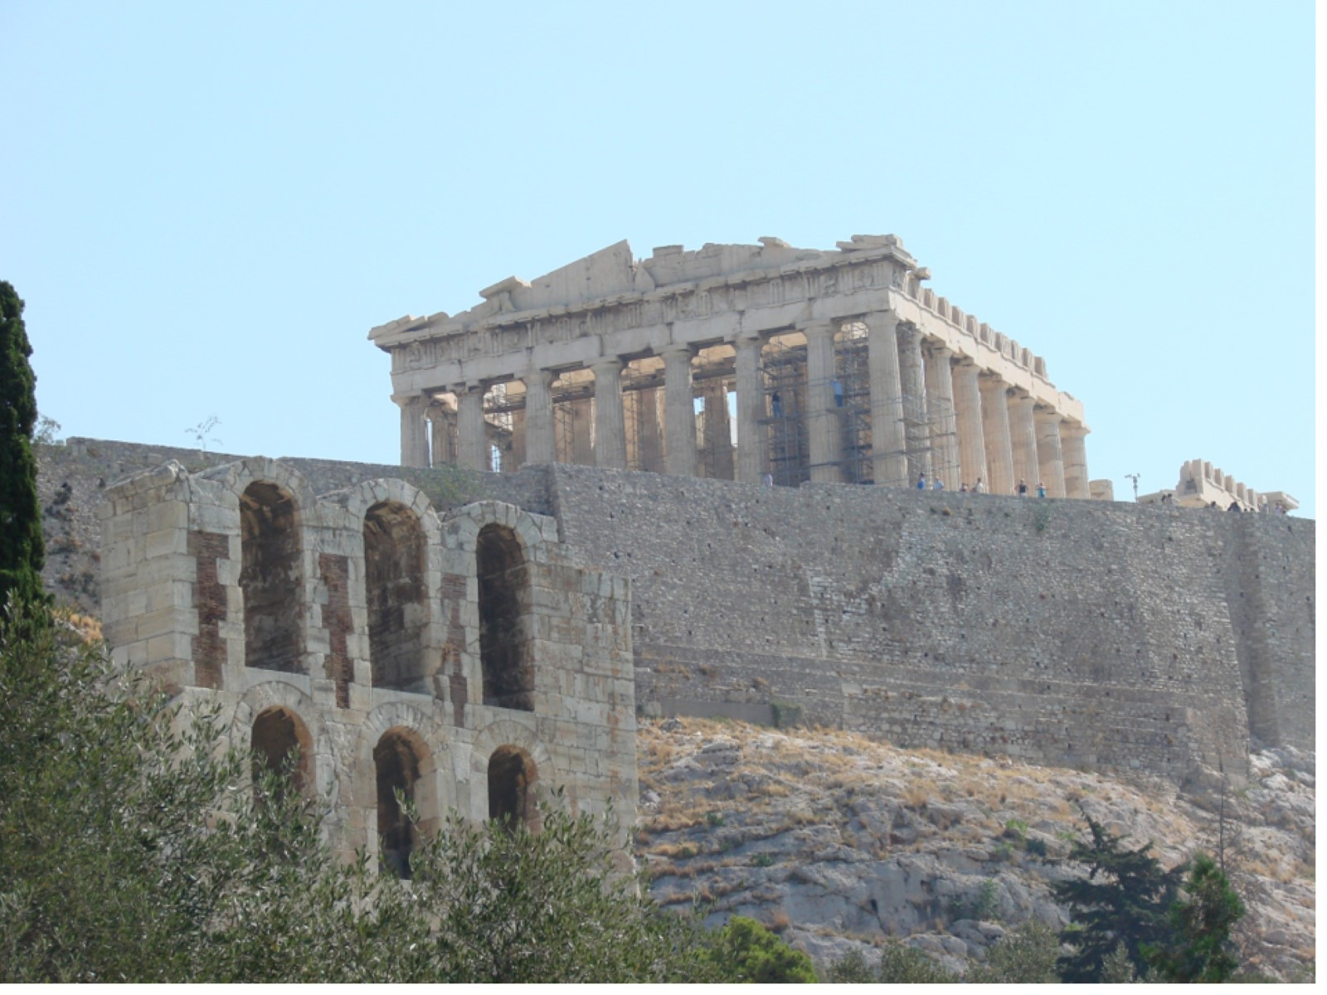
Notes:
As we walked up the road toward the acropolis, I took this shot to give you a better look. You can see part of a second-level building on the left. Behind me was the ancient hospital.

Slide 28
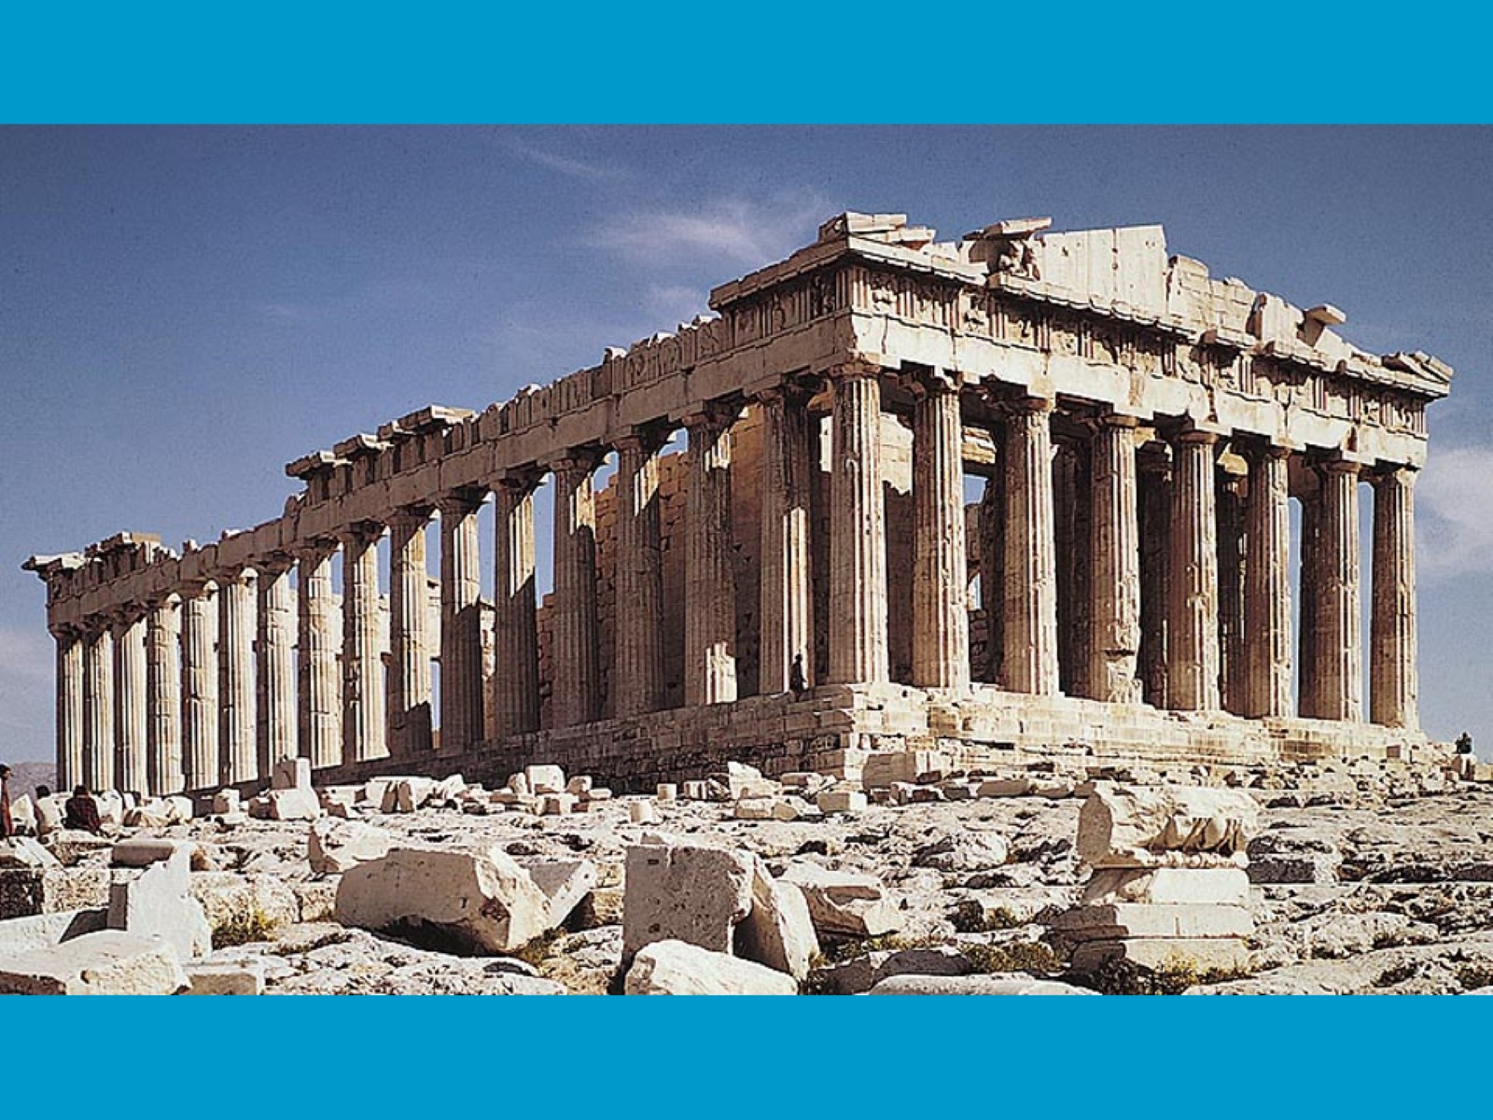
Notes:
This photo (not mine) gives you a good look at the Parthenon as it stands today. Again, we have a few problems:
This is not the original Parthenon, the Persians destroyed that. If you look back at the drawing of the acropolis, you can see a line pointing to the site of the original.
This is also not the rebuilt Parthenon, the Romans destroyed that. The Romans stole a whole bunch of statuary from here when Nero was Emperor. In a bit of poetic justice, the ships carrying the loot were sunk by a storm on the Mediterranean, but sadly the items have never been found.
The building is currently under repair again, because the 3rd version was highly damaged by earthquakes and World War II. I gave you this “postcard” photo, because mine are filled with scaffolding…

Slide 29
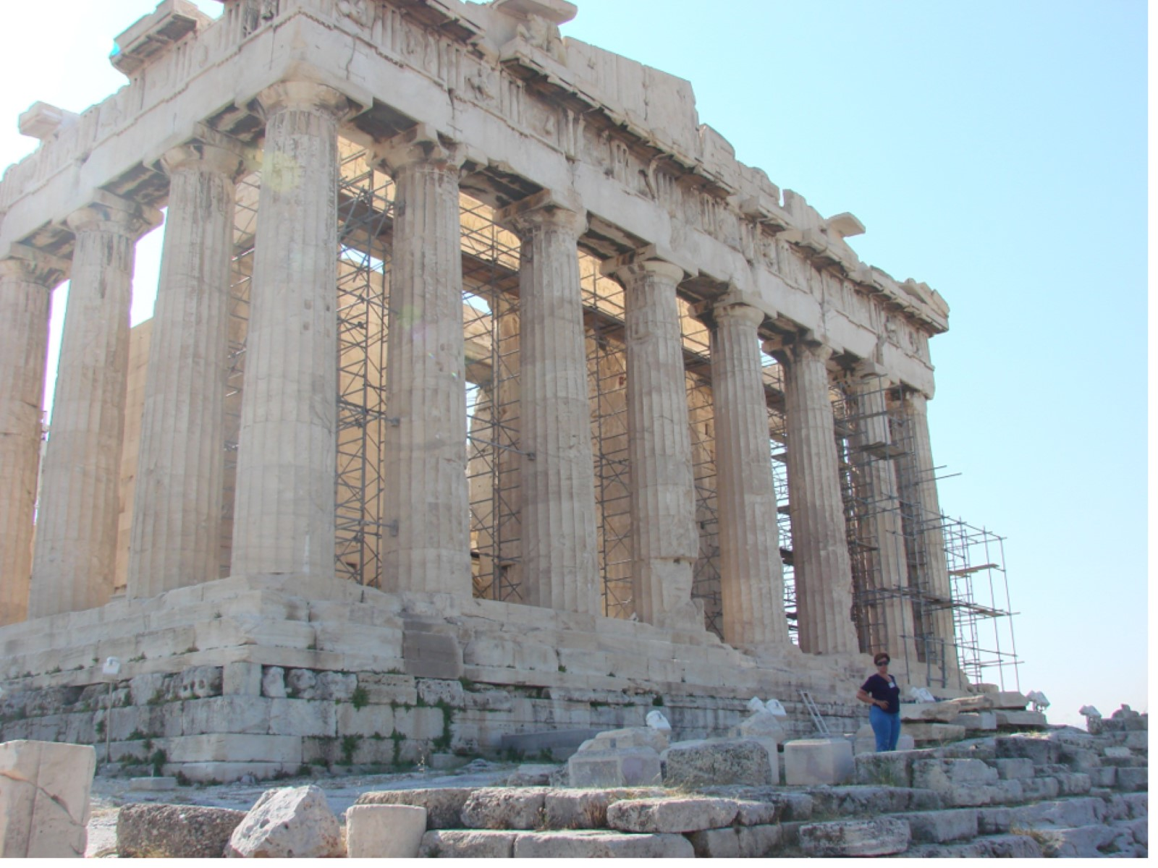
Notes:
This is one of the saddest photos I have ever shot. I was standing as close to the corner as I could (notice the “guard” in the photo, waiting to slap me if I got much closer.) As I lined up the shot, it occurred to me that there would be absolutely NO way a picture could give you the same feeling that being there gave me. The building is SO massive, SO historic, SO amazing that no photo will ever do it justice. I wish you could go there right now and see it. I have seldom felt “awe” in my life, but right here was one time of it!
I also still don’t know how I truly feel about them “rebuilding” the Parthenon again. Perhaps one day my grandsons will go to see it and it will look like it did in Socrates’ time. I’m not sure that they wouldn’t be missing something.

Slide 30
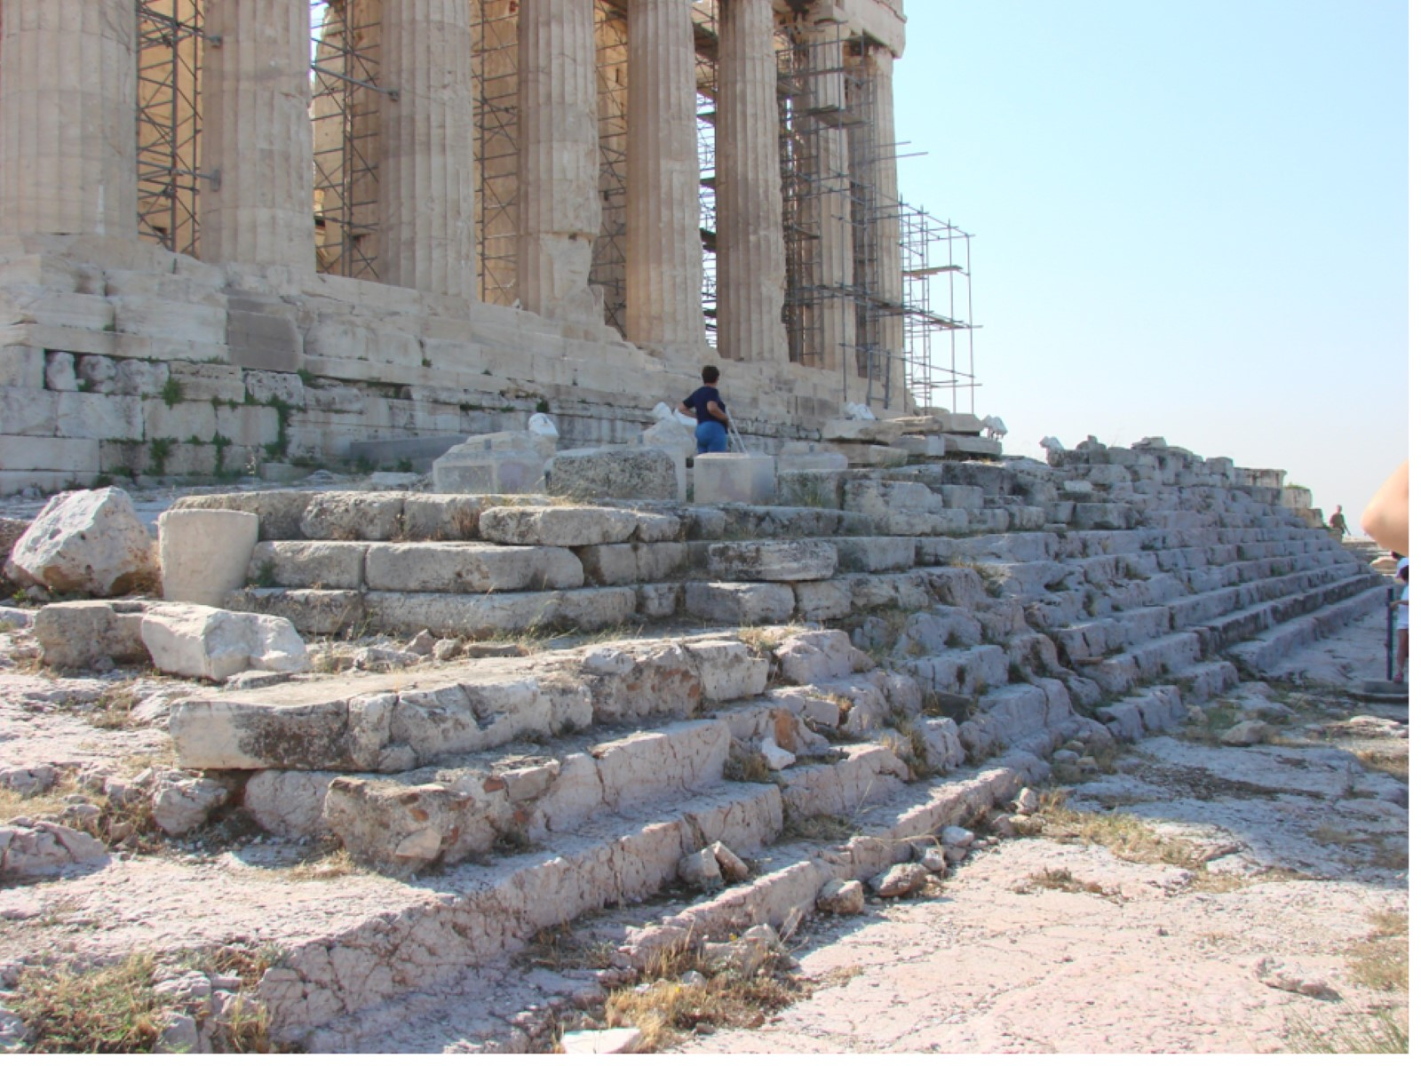
Notes:
There are certain elements of the construction that we must take note of. The Parthenon is the archetypal example of classic Greek architecture.
The first characteristic that defines that are the many low-lying steps leading up to the building. By having many more steps than necessary, it gives one the feeling that the building is rising up out of the ground. It also directs the eye upward, which the structure of the building will continue until you have reached the top.

Slide 31
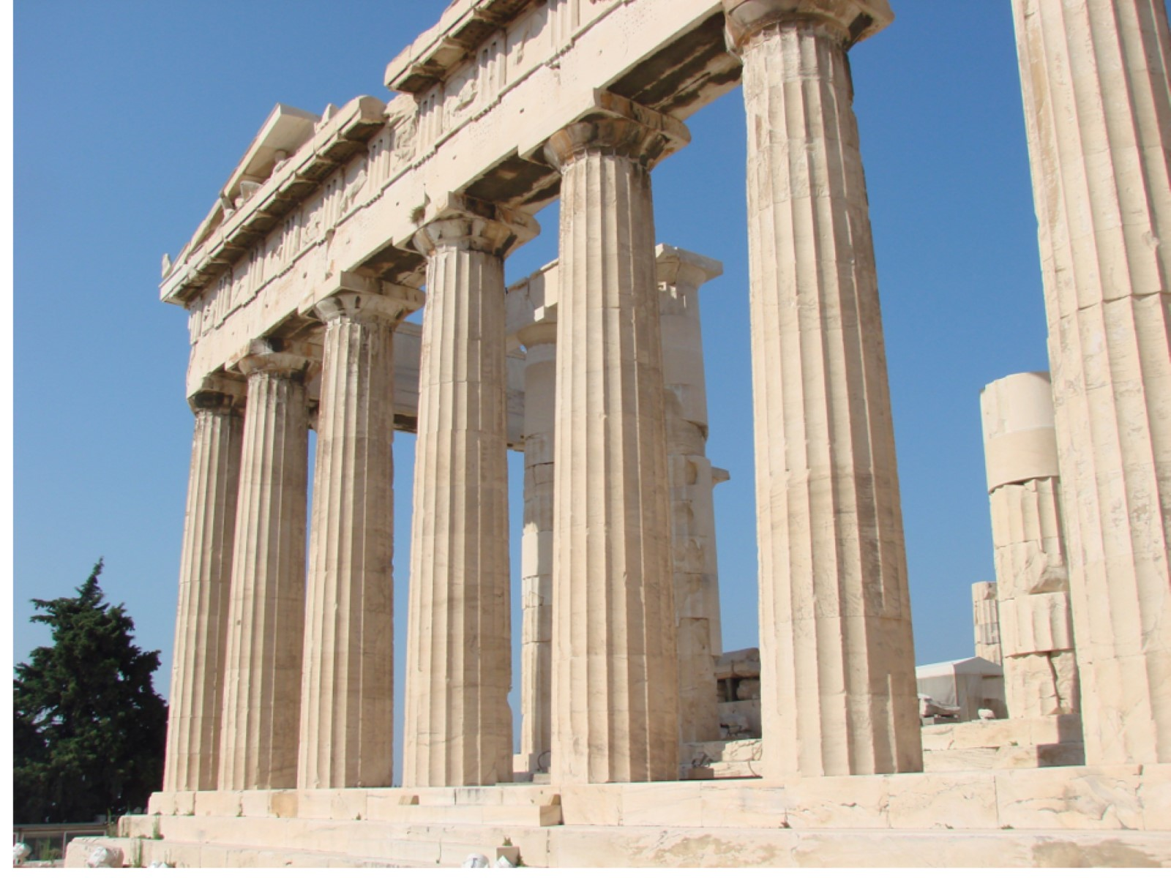
Notes:
(This is the back side of the building, by the way, which is how I cut the construction equipment out of the photo.)
The second thing you must notice are the rows of columns all the way around the building. These columns demonstrate the exceptional mathematical abilities of the Greeks. Their height, spacing, and form all represent certain mathematical relationships. Though the columns all look perfectly cylindrical from a distance, you can clearly see from this angle that they are fatter at the bottom than they are at the top, and slightly bowed outward in the center. The Greeks knew that if they made the columns cylindrical, they would LOOK bent from a distance, so they intentionally bent them so that they would look PERFECT from a distance! (Go back to the stock photo and look again.) They also appear parallel from afar, even though they aren’t.
You will also notice that these columns are not solid stone, but sections cut and stacked. Look at the right column in this picture and you can see the line where the parts come together. Again, pretty amazing engineering, to cut these stones in a quarry, bring them here, and stack them perfectly into columns!

Slide 32
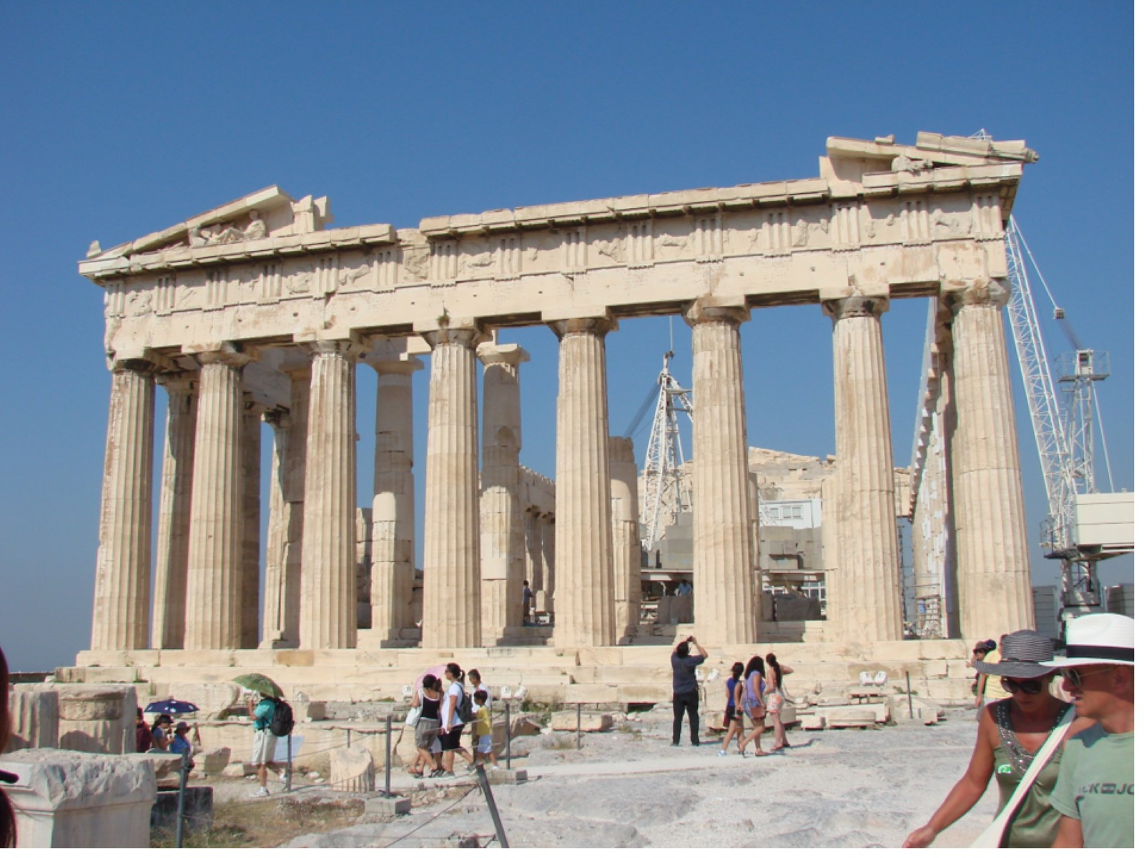
Notes:
From a distance again, you can see how much better the columns on the back side look.
Here, we also get to see characteristic #3 of Classic Greek architecture, almost. At the top of every such building is a triangular frieze carved with figured that tell a story. Sadly, it is almost always the first thing to go after the roof decays. If we were in class, I would draw lines up from the ends so that you could perceive the angles of that triangle, because they are very important.

Slide 33
Notes:
OK, here I did it (Sort of)
The two (sloppy) red lines show you the type of triangle (low-lying) that would have been formed by the original face. It also contains a “magical” numerical relationship that the Greeks were very fond of.
You already know that the Greeks were quite interested in irrational numbers. You have, no doubt, used π in a math class when trying to find the circumference of a circle. The infuriating thing about it is that it is 3.14etc. forever, so your calculation never comes out a perfectly even number. Darn!!! That IS infuriating, unless you find it gloriously magical. (Go on, try it for a second, you might like it!)
Now, I will give you ANOTHER irrational number: Φ This one is known as Phi (pronounced “Fee”)(unless you are an arrogant mathematician and want to call it “Fie”)(actually, it would just be pronounced “fff”) and represents 1.618033988749895 and on and on. There is tremendous magic in Phi. (I know you can already feel it!) Look harder at that triangle, and you will realize that it is actually TWO triangles (just drop down from the high point to the base, and ta daa! 2 triangles!) If you were to use the Pythagorean Theorem (a²xb²=c²) to solve the sides of these triangles, we would discover – WOW Phi!!! The hypotenuse would be exactly 1.61etc longer than the base! Magic!!!
You might imagine this is an accident, but it’s in ALL those classical Greek buildings.
THERE’S MORE!

Slide 34
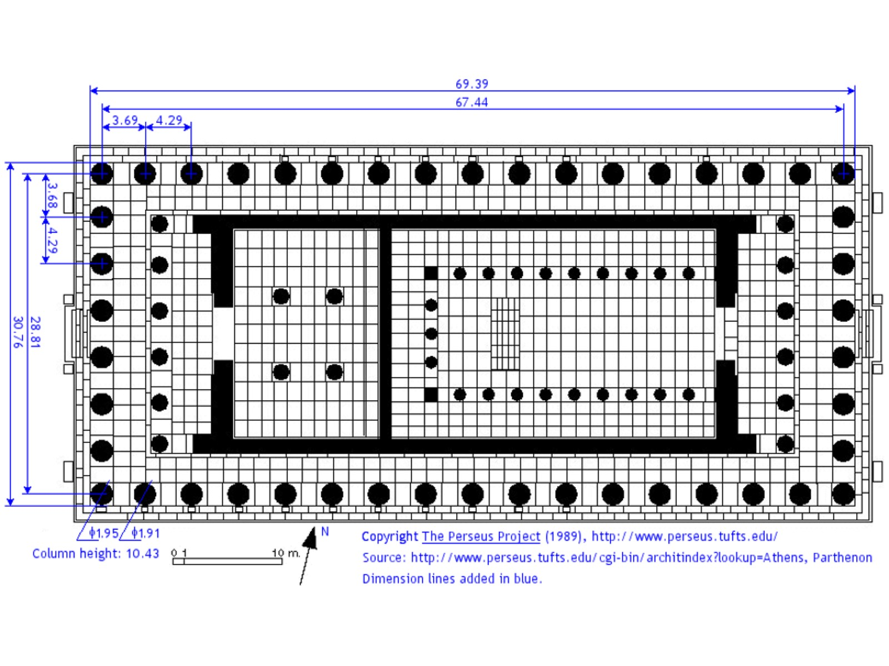
Notes:
If you look closely at this diagram of the Parthenon, as it originally existed, you will see Phi all over the place. If you look closely, you will see the character Φ in many locations, indicating that the relationship is in the sizes and spacing of the columns, the relations of the sides, etc. Take the width of the building, subtract it from the side, and you are left with…
(If you can’t guess by now, I’m done with you!)
BUT THERE’S EVEN MORE

Slide 35
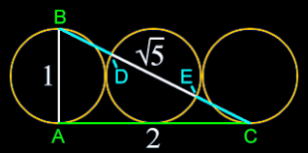
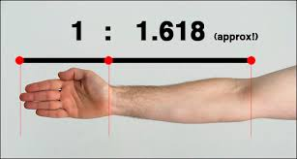
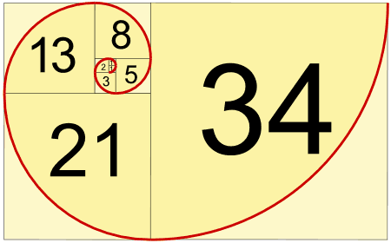

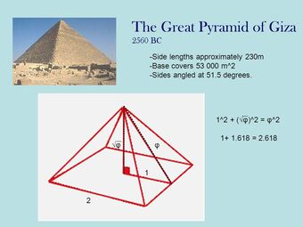
Notes:
Now, some mathematicians are going to tell you that this Phi thing isn’t all it’s cracked up to be, because many of these relationships aren’t EXACTLY 1.618etc. How you would go about measuring the exact spot on the Parthenon that was used to get the Phi relationship is impossible, therefore, mathematicians say, “It’s a nice idea, but it doesn’t hold up to mathematical exactness.” To which I reply, “Poop on you!!!” Let’s look at some doggone good (though nOt ExActLy PerFeCt) examples.
In the upper left, you see one of the ways that Phi is created mathematically. You have drawn a right triangle through three equal circles, where the line AB is the diameter of the first circle, and C lies at the exact bottom of the third circle. The line AB would be 1 unit long (make it whatever units you want) and line AC is 2 units long. (Hey, Mr. Woody, this ain’t Math class!) By the Pythagorean Theorem, line BC must be equal to the sum of the squares of the other two sides, when squared. So 1² is 1 and 2² is 4. 4 + 1 = 5, and the square root of 5 is… (go ahead, use your calculator, I can wait – But you KNOW what it’s going to be!) As an added bonus, the line DE is Phi times longer than BD and EC. Bwahahahahaaaaa
Below that, you have a diagram of a famous number system that is closely linked to Phi. A fellow named Leonard of Pisa (called: Fibonacci) created this series from a formula, showing that nature demonstrates this pattern frequently. The pattern is a simple one: start with 0, add 1, add those numbers together (1), add those two (1 + 1) again (2), add again (3), add again (5), add again (8), add again (13) and so on. It really was remarkable. Now, Fibonacci did this in 1202 AD, but it might have been done in India1400-1600 years earlier. If you looked at a pine cone, you’d find the Fibonacci sequence in its layers of nodes. You can find it in pine trees, lots of flower petal arrangements, and leaves on many trees. Know this: if you divide any Fibonacci number by the one preceding it, you will begin to approach… you guessed it – PHI! In this picture, we’d end at 34/21 = 1.619etc, but if you keep going 55/34=1.617etc, 89/55=1.618etc, 144/89=1.6179etc (don’t panic), 233/144=1.618etc, 377/233=1.618etc and so on and so on getting closer and closer to Phi. Somewhere, far out there is the largest of large Fibonacci numbers x/y=Phi. Notice that some artist here has show us that the curve would look very much like a nautilus shell you might find at the beach. Also interesting is the idea that you might place a grid over this chart, where each square was the size of that first box with the number 1 in it, so the second box would by 1x2, then 3x3, 5x5, 8x8, 13x13 etc. Pretty cool!
How about that Great Pyramid? You might have to blow the picture up to see it clearly, but the pyramid is such that, if its radius is a unit called 1, then its height is the square root of Phi and its hypotenuse is Phi. Great job, Khufu!
How about your arm? Your own arm! Even Leonardo da Vinci knew there was a relationship there. It’s pretty common. When we hear coaches talking about basketball players being “long”, it’s because they exceed that ratio.
And what about beauty? You can see that someone has placed a bunch of Phi rectangles over this beautiful woman’s face. (Of course, most of you boys don’t think she’s beautiful because you have no ability to tell such things. Already proven.) Many studies have been done that show that, the more Phi relationships a woman has in her face, the prettier she is considered to be. We can never put a specific definition on beauty, but maybe some hard-wired part of our brain “needs” to see those Phi relationships. (Until we become more mature, and recognize the beauty is only skin deep and inner beauty matters more!) Notice here how the different colored Phi rectangles are overlaid on her face to show the relationships: nose length to width, eyes height to width, pupil width to face length, mouth width to available space… When we see variations in any of these relationships, we say, “Gee, that person has ______ (small eyes, a big nose, a small mouth, big ears)” because it is noticeable.

Slide 36
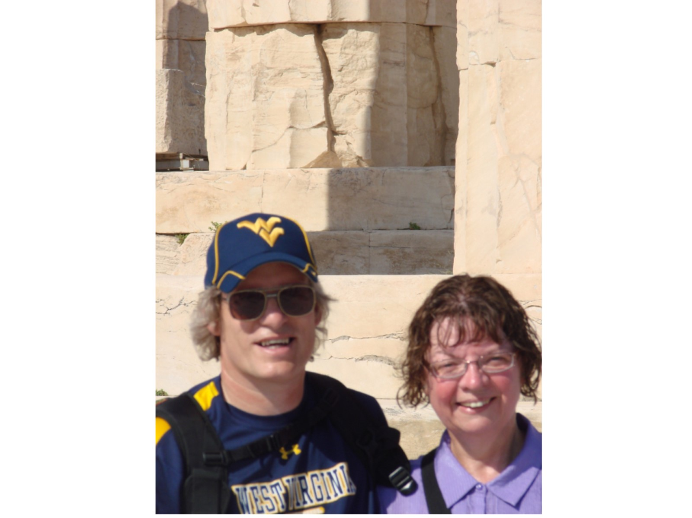
Notes:
I included this photo at the foot of the Parthenon just so you would know for sure that I was there.

Slide 37
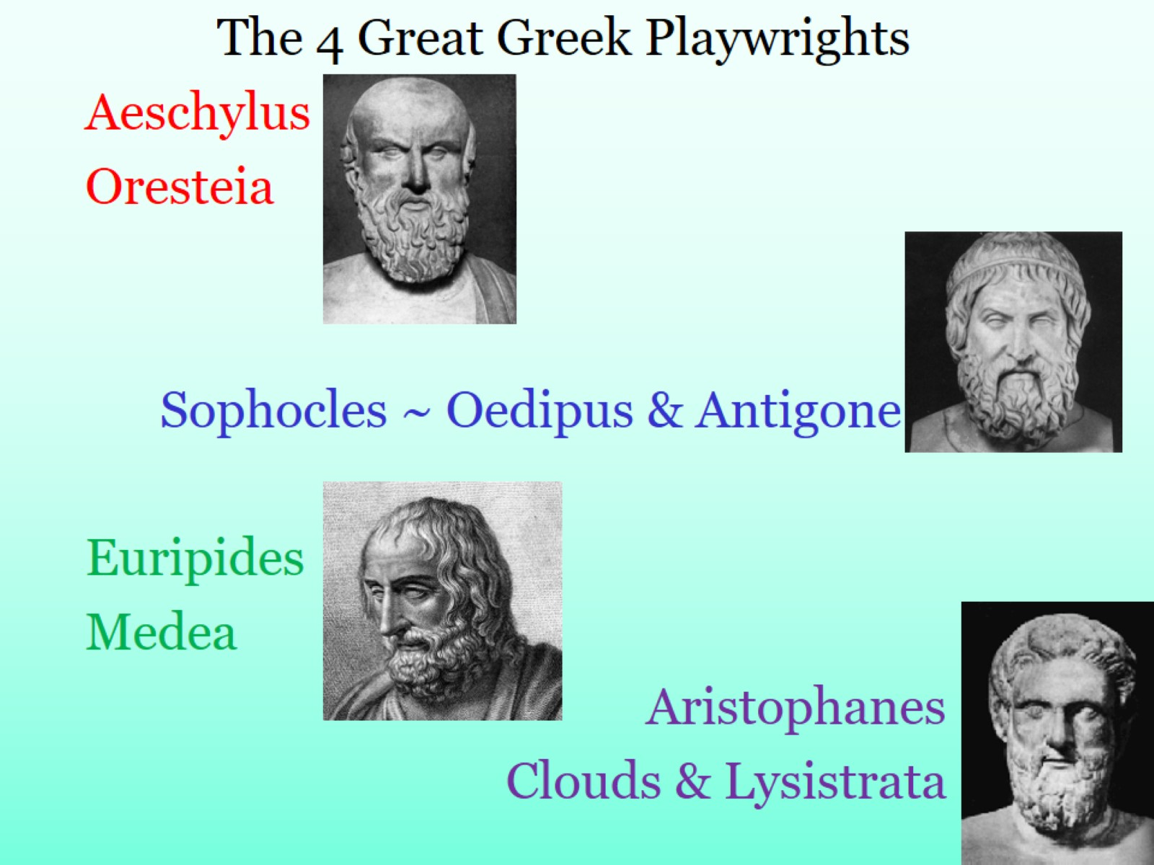
Notes:
These 4 playwrights are a key to understanding the Greek thought process. There are several things we should know before we attempt to know them.
~ The first Greek plays were not much like what you expect to see today. The earliest ones were presented by a “Chorus” – a group of people reciting the lines. It would be much like watching a team of folks recite a poem together.
~ Characters would be discussed, but not actual people on stage. Thus a play about Bob (imaginary guy I made up) would tell us about Bob’s life, but Bob wouldn’t actually appear on stage, not even played by someone else.
~ There were no real emotions. The Chorus did not “act” out the feelings expressed, we were expected to understand the feelings from the words presented to us.
~ As in everything else, the Greeks were quite competitive in their playwriting. Particularly in Athens, there would be contests each year to see who could write the best play. Writers from all over Greece would come to study and learn to write well. Whoever won the contest was given high honor all year long.
~ The trilogy (three plays tied together) was a popular form. After all, if one play was a great hit, why not capitalize on that by connecting two more?
~ The plays were mostly about the tragedy of life. It was the one thing we all had in common: we were born into an uncaring, harsh world, left to make our way the best we could despite obstacles and trouble along the way, and then we would die, losing everything we had gained along the way. What we COULD do was share in each others troubles. And if someone had much larger troubles than you – well, you could take some small consolation in the fact that your life wasn’t quite so bad.
* Not pictured here is THESPIS, who is generally considered to be the first “actor”. Thespis performed in plays as the one speaking part separate from the Chorus. He may or may not have used emotions to heighten his performance, but lead actors ever since have been referred to as “Thespians”.
*AESCHYLUS is considered the “Father of Greek Tragedy”. He is the first to set up the “rules” for an excellent play, and won many prizes during the most tumultuous time in Greek history. He is likely the first to add a 2nd actor, creating the possibility for dynamic interaction between them. That is certainly what we see in the Oresteia, his trilogy about Orestes, son of Agamemnon. Agamemnon returns home from the war with Troy, victorious and honored, except in his own household. He has brought with him a girl, Cassandra, who has become his mistress. In a righteous rage, his wife kills him, and is then killed by Orestes. Murdering one’s mother is a great crime in Greece, so Orestes must go on trial before the Furies, terrible even to the gods themselves. The main argument revolves around the relative “value” of types of murders!
*SOPHOCLES became the next big name in plays, winning more prizes than any other. He added even more actors, participating in many of his own plays! His two most famous surviving stories are connected. The Oedipus trilogy tells one of the most famous Greek stories. It reminds us that a man can never escape his fate, a common theme. Oedipus kills his father, becomes king, marries his mother, and causes all sorts of trouble. It is tragedy heaped on tragedy. Antigone is about one of his daughters, who breaks the law by burying her brother’s dead body. The new King condemns her to death. She is hanged, the king’s son (who loved her) commits suicide, when the Queen learns that her son is dead, SHE commits suicide, and the king is left a broken man.
*EURIPIDES changed the plays considerably. Others had told stories that left people feeling something, but Euripides left people thinking something, and that made him a bit less popular. In most plays, one knew who the good and bad guys were, so you knew how to feel about the results. With Euripides, people left the theater arguing about what had actually happened. In Medea, we have the story of a girl who falls in love with Jason (of The Argonauts, and Golden Fleece fame), abandons her people to go with him, bears him two sons, and then is rejected when Jason has the chance to marry a “proper” woman. Here is that Greek dichotomy played out in a life story. Medea then becomes vengeful, murdering Jason’s future bride, and that girl’s father, AND her two sons by Jason! She wants to destroy everything about his life, because he has destroyed hers. We are left with many questions: Do women have a fair chance in a world run by men? Do marriages matter? Are Greeks/Barbarians really so different? It is said that Euripides spent his last years in a cave, living alone with his thoughts. But we have more of his plays than of the others.
*ARISTOPHANES is a totally different guy. He wrote what is known as “Old Comedy” – that is to say, satire. He could see the flaws in his society, so he poked fun at it in a way that might cause it to become better. (That’s why satire is superior to sarcasm, it’s evil twin.) In Clouds, he pokes fun at philosophers, including even (gasp) Socrates! He causes us to wonder whether any good can come from pondering the deep questions of the universe. In Lysistrata, he mocks men’s obsession with war. After many failed peace attempts in which the men struggle to find common ground, the title character (a woman) finds an ingenious solution to the conflict: The women refuse to have sex with their husbands until the war ends. It ends quickly.

Slide 38
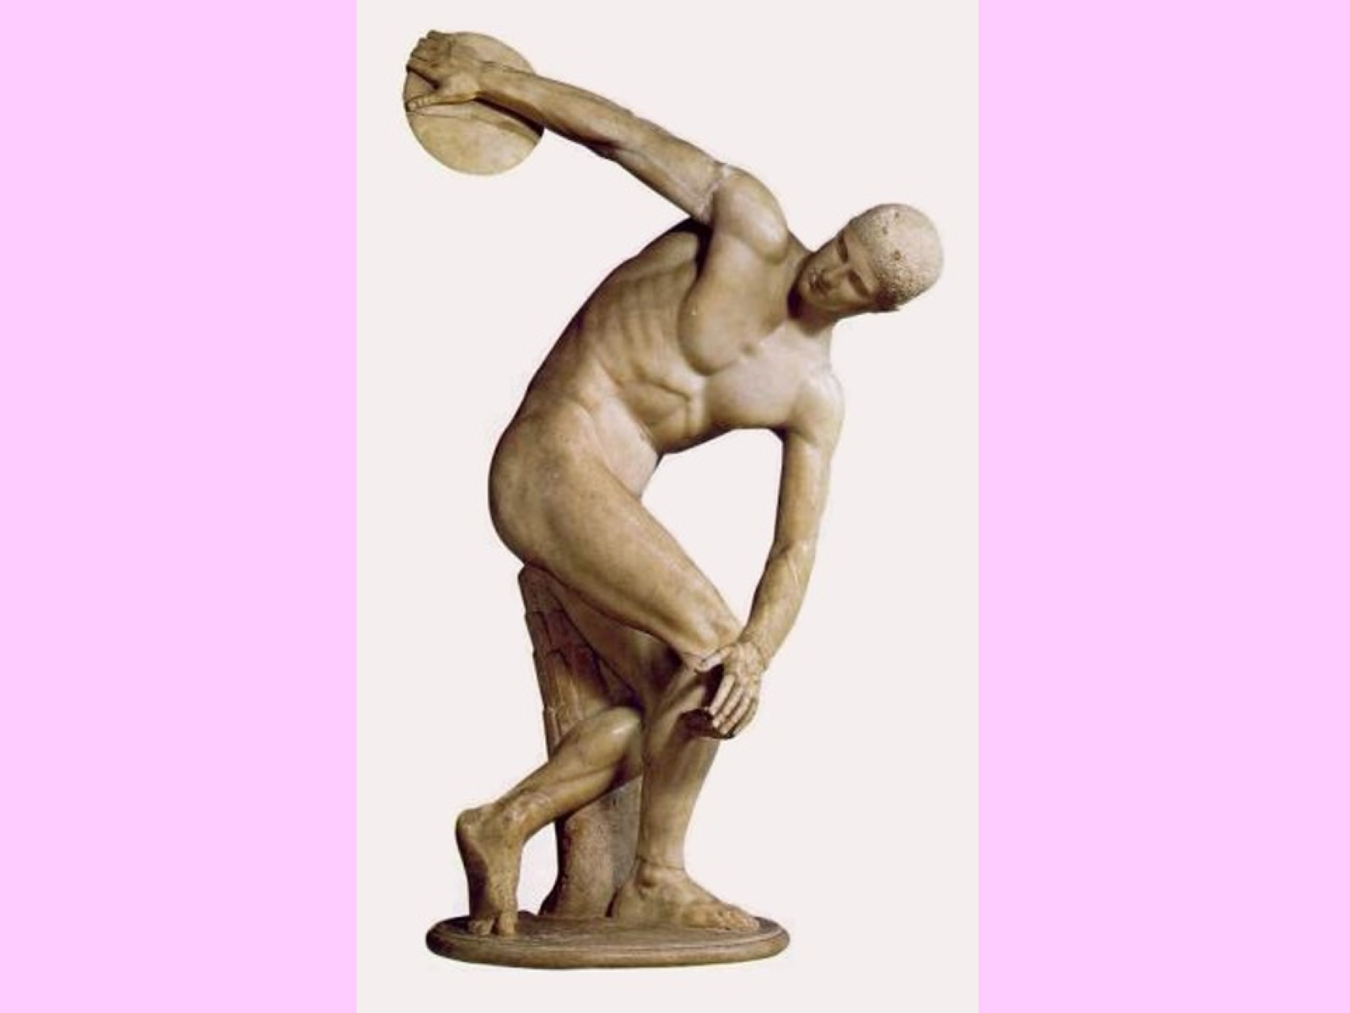
Notes:
This is one of the most famous sculptures of ancient times: Myron’s Discobolus. It is obvious that Myron studied human anatomy and was skilled at showing it in his sculptures. The muscles carved in stone seem ready to spring to life at any moment. The stump in the background was a common engineering device used to stabilize free-standing statues. Had the stump not been their, the weight of the stone would have soon caused the statue to break apart.

Slide 39
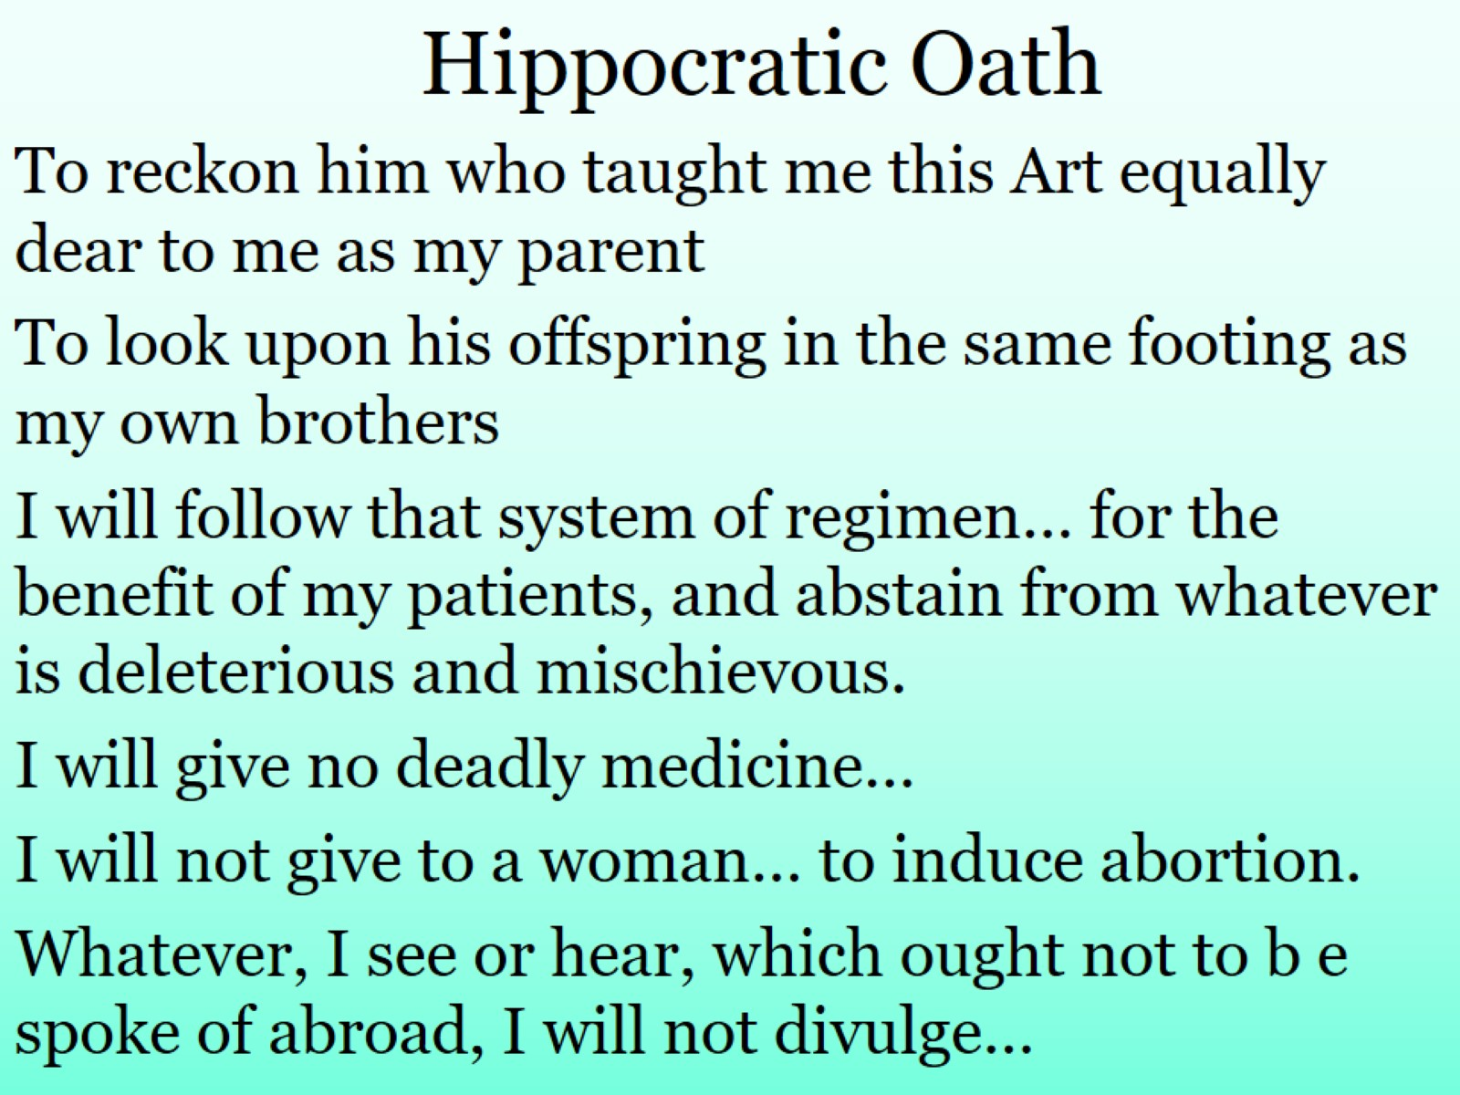
Notes:
Hippocrates is considered the “Father of Medicine”. Doctors in his day were not highly respected, because they often used their knowledge to harm people. Many folks hired doctors to use their knowledge of poisons to eliminate an undesired person. Doctors were also a very secretive bunch. They kept their knowledge to themselves, because knowledge is power.
Hippocrates changed all that. He decided to open a school so that doctors would learn proper medical treatments and eliminate misinformation and improper behavior. He established a set of rules that doctors today still follow, though that has become much more complicated because of changing social values. In his oath, you can see the basic principles he espoused:
1 Treat your teacher like a parent
2 Treat his kids like your brothers
3 Do no harm
4 Keep confidentiality

Slide 40
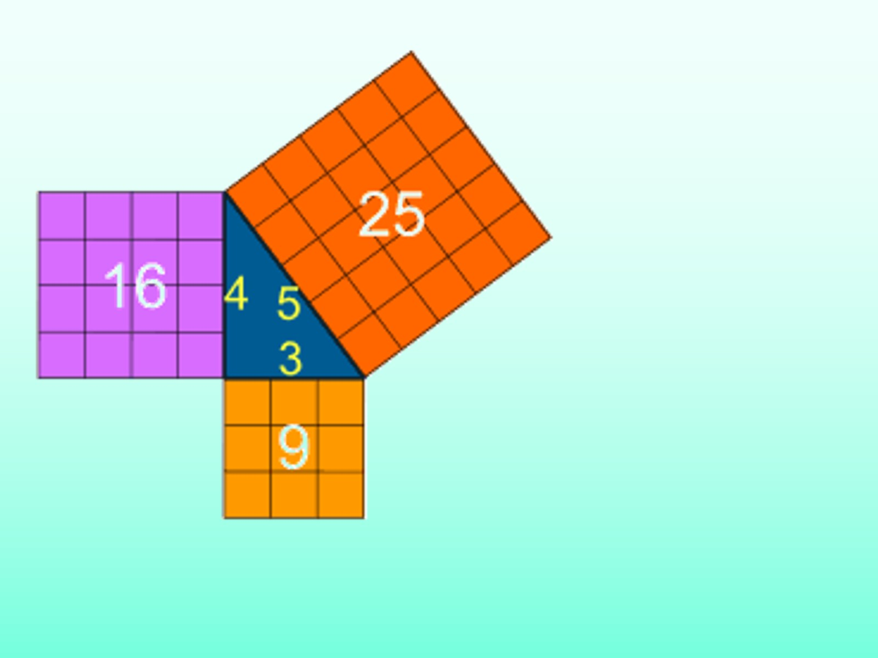
Notes:
Oh no! More math!
This simple diagram, of course, demonstrates the Pythagorean Theorem, that amazing equation almost everyone knows. In any right triangle (that’s one that has a 90º angle) the sum of the squares of the two sides is equal to the square of the hypotenuse. Therefore, if we know the length of any two sides, we can always find the third one! Yay! (also expressed as a² + b² = c² ) It has been proven to work in every plane right triangle we have ever measured. But if that’s true, shouldn’t it be a “Law” instead of a “Theorem”? Actually, no. For two reasons that you’ll have to ask about.

Slide 41
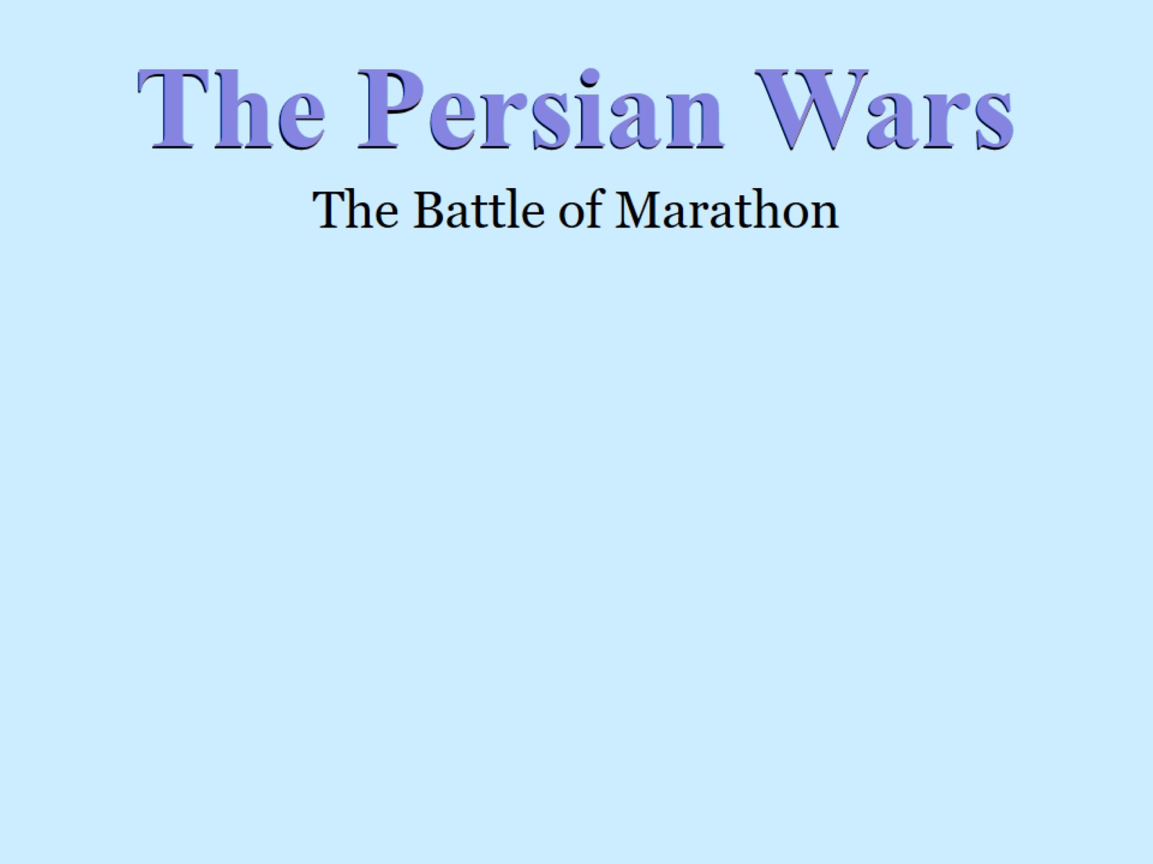
Notes:
This slide is simply not going to be the same without the drawings I would do in class. Prepare to use your imagination!
BACKSTORY: Looking back at your map of the Greek World, you can see how city-states sprang up on every island and coastline in the area. You will especially see numerous ones on the coast of Asia Minor, what the Greeks called “IONIA”. If you can remember back to a previous lesson, a group of people named the Medes had settled in Mesopotamia, adopted Zoroastrianism, and were called “Perse” by the locals, thus creating the Persian Empire. The empire had grown substantially over the centuries, and was now reaching to the Ionian coast. All the Persian asked was that cities in their empire pay taxes in tribute to the Emperor and swear their loyalty. They didn’t count on how difficult the Greeks could be. The Ionians rebelled, aided by Athens. They were able to turn back the Persian armies, infuriating the Emperor. That emperor, Cyrus the Great, died soon after, but his son Darius I (also The Great) had a servant whisper in his ear at every meal, “Sire, remember the Athenians.”
As it often does, History offered Darius an opportunity for revenge, in the form of another person who wanted revenge. A fellow named Hippias, who had been tyrant of Athens before he was ostracized (voted out of the society), came to Darius with a useful bit of information. Unknown to most foreigners (read: barbarians) was that among the rocky coasts of Greece was one nice, broad beach on which Persian ships could land. (Unlike the picture you saw earlier in the year of Phoenician ships, the model on which Greek ships were built, Persian ships were very long and narrow. That meant they needed much more room to land.) Hippias pointed out Marathon to Darius’ captains, with the only requirement being that he be made satrap (Persian governor) after their victory. Darius assigned Admiral Datis to lead his fleet to Marathon and victory over Athens.
In 490 BC, Datis and the Persian fleet, with perhaps 100,000 men landed at Marathon. (Numbers are often debated because our only record comes from Herodotus, the Father of History, who might not have been totally unbiased.) Only 26 miles from Athens, the Persians expected to sweep over the “thumb” destroy Athens, and gain their revenge. The Athenians had other plans.
The Archons of Athens knew they were in trouble. They sent an army of about 9,000 men (along with 1,000 Plateans) to the mountains at the edge of the plain, prepared to defend against the coming attack. A runner named Pheidippides was sent to Sparta to ask for help. At the time, Athens used a group of 10 Generals to run their army. Each evening, the group would turn to the next day’s leader for the next day’s plan. Each day, the leader said, “We will wait for help.” Unfortunately, none was coming. When Pheidippides got to Sparta, he was dismayed to find that they were in the midst of a religious festival, and the Ephors would not permit them to leave their city. “Wait until the full moon,” he was told. So he ran back home to deliver the bad news. Then he ran on to Marathon to tell the generals.
The next day was Miltiades day to lead. Unlike the other generals, he had wanted to surprise the arrogant Persians by attacking them first. Now he had his chance. What you can’t see on the bare slide above is that Marathon is basically a 1 square mile plain, with mountains at one end and the sea at the other. On each side are swampy marshes. (See how much easier this would have been in class?)
It is also necessary to get an understanding of how the forces were equipped: Persians had cavalry (soldiers on horseback) who wore lightweight armor made of leather. They used bows and arrows as artillery and long, thin, curved swords to slash at their enemies. They carried shields make of woven reeds (essentially, wicker). The Greeks used infantry (soldiers on foot) who had metal breastplates, helmets, and shin guards. They carried large, heavy metal shields and probed at their enemy with long spears. In battle, they locked the shields together in a sort of a wall – this formation is called a hoplite phalanx (the soldier is a hoplite, the line is a phalanx) If the wall broke down, the soldiers had short, heavy swords to hack at their enemies.
For several days, the Persians had sat in their camps, assuming the Greeks would surrender to their awesome power. Imagine their surprise, when Miltiades and his men woke them suddenly by charging across the plain, screaming loudly as they came! The battle was almost lost in minutes, but the Persians managed to get enough horsemen to slow the Athenian charge, then began to push them backward. As the day wore on, the Greek line retreated to the foothills. They were only saved by the marshes on either side, or the Persian cavalry would have surrounded them. When they reached the hills, the horses were much less effective, giving the Greeks time to regroup. They began to push back.
As the fighting continued, the armies found themselves in the middle of the plain. Now Miltiades unveiled his greatest plan. He ordered the center of his line to retreat slowly. Pheidippides (yes, him again) ran from end to end of the line relaying Miltiades’ commands. Slowly the center fell back, the Persians gaining hope of victory. The Persians forced more men into the center, trying to break the line, and revealing Miltiades’ trap. When the Persian army was in the middle, the “wings” of the Greek troops slammed in on them from both sides. The Persian lines were broken, and they began to retreat rapidly. Now the Greeks pushed forward with renewed spirit, chasing the Persians back to their ships. Some of the ships were set on fire, and the massacre was tremendous. The might Persian Empire had been defeated by ONE Greek city-state. (Plataeans don’t count.)
Pheidippides was sent back to Athens to relay the news. According to legend, he ran into the central polis, shouted “V I C T O R Y victory, that’s our battle cry!” (or something like that) and dropped over dead. (A reminder that too much running just isn’t good for you!) [Of course, this is why some people run Marathons of just over 26 miles!]
The sneaky Persians, thinking that no one would be in Athens to protect the city, took their ships around to the other side of the “thumb” to try to attack them. Imagine their surprise when the sun rose, to see Miltiades and his army standing on the mountain top, waiting on them! He had marched his men all night to cover the 26 miles back to Athens. The Persians returned home, tremendously disappointed. Darius was outraged, but died before he could get revenge for his failed revenge.
A few days late, the Spartans showed up to help, but it was too late. Not only had they been denied glory in battle AND in victory, but that victory had been won by those delicate little poetic Athenians! What a disgrace!

Slide 42
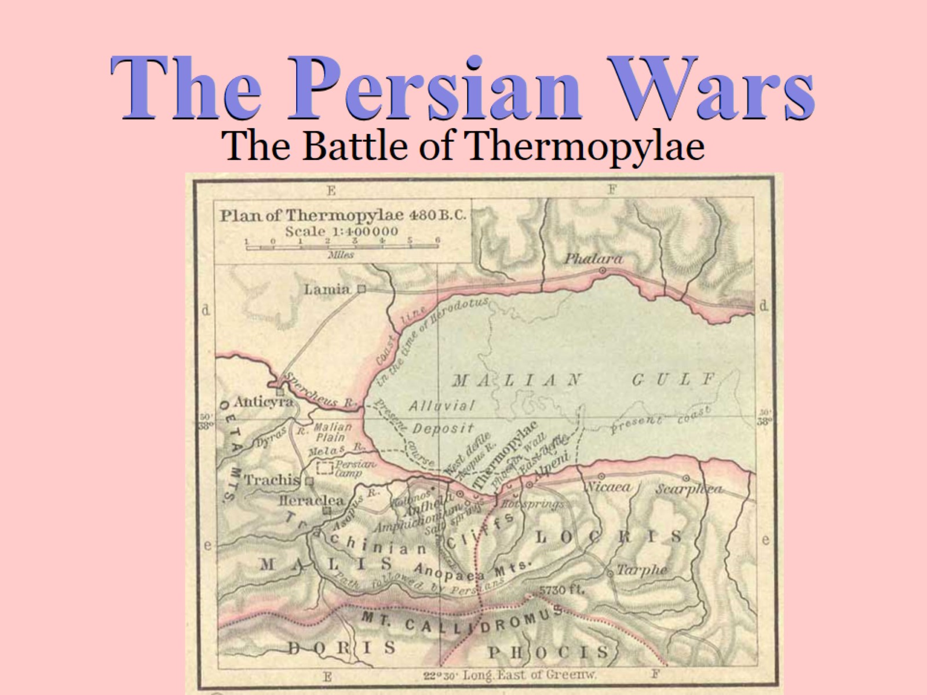
Notes:
Darius was succeeded by his son, Xerxes, who vowed to expand his empire to include the Greeks. His plan was enormous in its complexity. Having lost at Marathon through lack of an escape by sea, he decided to attack Athens by a land route. If you look back at your original Greek map, you will see a narrow strait of water between Asia Minor and Europe. This strait is called the “Hellespont” – literally, “Greek water”. Marching an enormous army, Xerxes tied his boats together to make a bridge across this strait so his troops could march across.
As he slowly moved across Eastern Europe, he gathered allies among those people who were also considered “barbarians” by the Greeks.

Slide 43
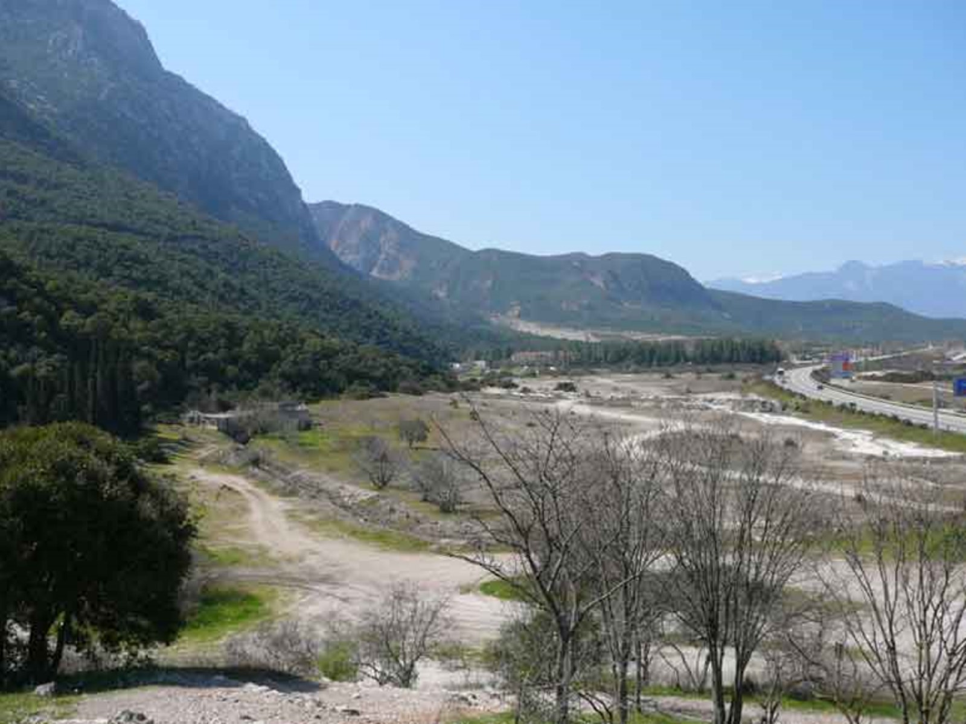
Notes:
This is what Thermopylae looks like today – not so different from then except for the highway. Just to the right of the road is the steep drop into the sea. King Leonidas of Sparta and his 300 best soldiers waited here patiently for the Persians to arrive. Wave after wave of Persian soldiers failed to break the Greek lines. Like a cork in a bottle, the Spartans kept the Persians from leaking into Greece.
This might have gone on much longer, but a Greek shepherd from the nearby hills sold out to the Persians and revealed a path through the mountains. The entire army could not go through, but an elite troop might. That troop managed to come down behind the Spartans, thus surrounding them. Having to fight in all directions at once, the Spartans were now overwhelmed. All 300 were killed, including King Leonidas. Now, Southern Greece lay completely open to the Persian force.

Slide 44
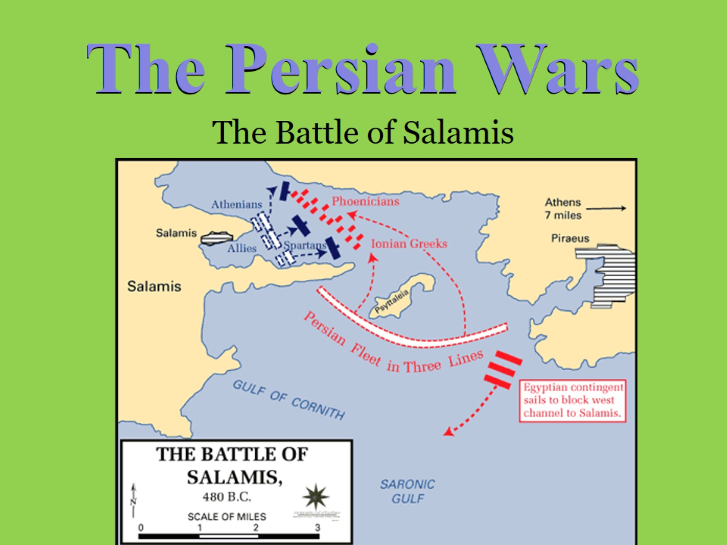
Notes:
In the years following Marathon, the Greeks had made many preparations in case they should have to meet the Persians again. One of the most important ones was proposed by a leader named Themistocles. He insisted that Athens should build a strong navy, in order to prevent the Persians from landing their ships. He met opposition until a new silver deposit was discovered “creating” much more money for the economy.
By 480 BC, Athens had many ships at its disposal. When word of the defeat of the Spartans at Thermopylae reached Athens, some tough decisions had to be made. Realizing that the armies could not stand against Xerxes, Themistocles had the city evacuated. Their ships carried citizens to nearby Salamis, which the Persian Army could not reach.
When Xerxes reached Athens, he was outraged to find nobody home. He destroyed buildings (including the original Parthenon) and burned the farms (depriving his own troops of food.) Then he came down to the coast to watch his navy destroy the Athenians altogether. But it was not to be.

Slide 45
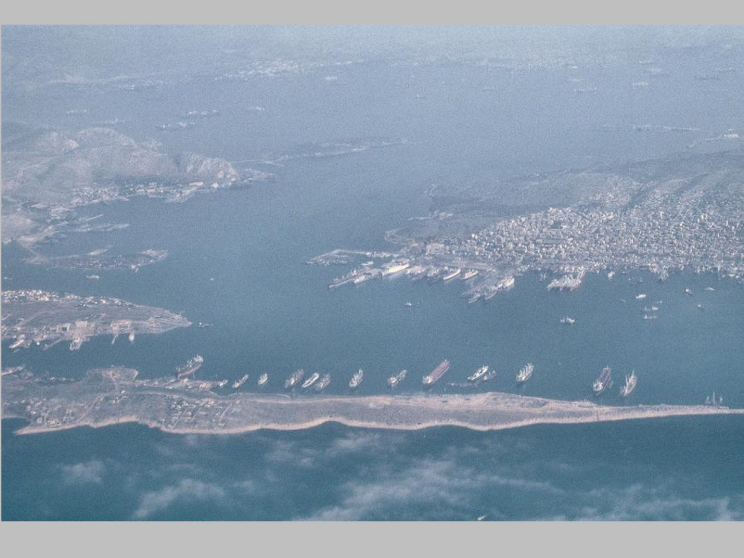
Notes:
I took this photo of Salamis from the highway (literally – High!) so you could see proportion. The straits of Salamis are twisty and narrow.
The Persians ships, as you know, were quite long and narrow – the Greek ships short and heavy. The Persians had made an enormous mistake bringing their ships into these narrow channels. They took so long to turn and maneuver that the Greek ships sped around them, wreaking havoc on the Persian navy. Xerxes watched glumly as his ships were destroyed. His army was useless, having been stopped at the narrow Isthmus of Corinth. Then, he left for home.
Possessing the mainland of Greece, Xerxes decided that matters in Persia were more pressing to him. He left his army behind to protect what he had conquered, but his confidence once again proved unfounded. A year later, a unified Greek army defeated the Persians at Plataea, and Greece was free once more.
We are left to ask ourselves, “How would the world have been different if the Persians had won?” It’s an important question.

Slide 46
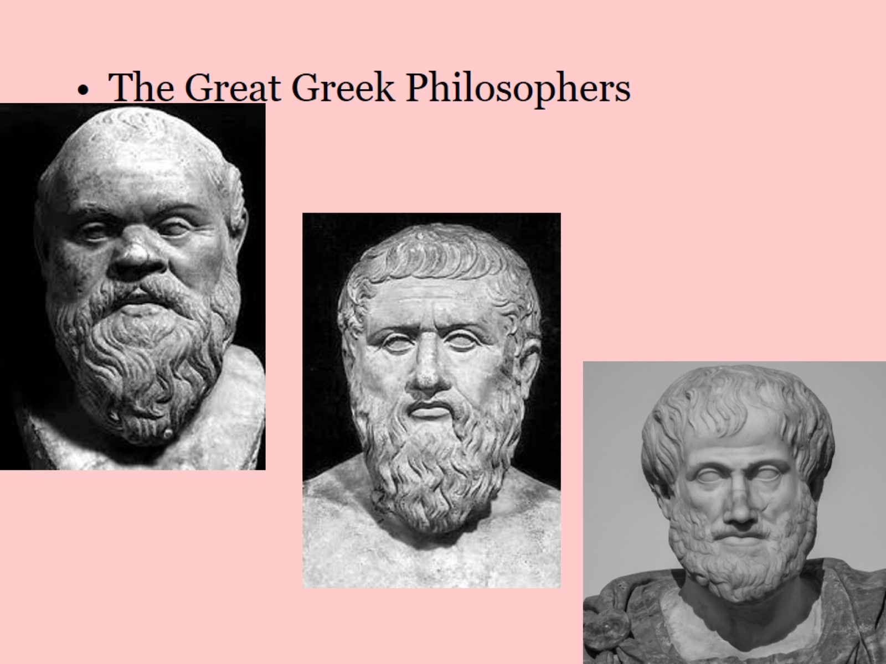
Notes:
These are the greatest of the Greek philosophers. Philosophy is an investigation of the meaning of life.
Our first subject is Socrates, the famous Pedagogue of Athens. Socrates was a veteran of the Persian Wars who became quite philosophical in later life. He could be seen in the streets of Athens, walking along with his students, exploring the meaning of important issues. He had a unique “method”, still famous today, of exploring those issues by asking his students to explore what they already knew about the issue at hand. By investigating their own ideas, they would eventually reveal what was “right”. Sadly, the powerful men in Athens, saw free-thinking as a dangerous behavior. They accused Socrates of being impious (irreverent of the gods) and asked him to recant his teachings. Out of principle, he refused, and was sentenced to death. Unfortunately for us, Socrates never wrote anything down, but one of his students did.
Aristocles, better known as “Plato” learned well from the master. He wrote a series of “Dialogues” – conversations students had had with Socrates, so that people would remember the important lessons. Plato expanded on his teacher’s work (as all good students do) becoming quite famous in his own right. He wrote an extensive and complex book, The Republic, discussing the best sort of society man could have. He introduced us to concepts like Atlantic, Utopia, the best educational system, and his famous Allegory of the Cave. Philosophically, he was known as an “idealist”, meaning that he thought every object in the universe was an attempt to create in reality what was somewhere a perfect idea. (In better words, every pine tree you’ve ever seen was an attempt to make real the “idea” of “pine tree”.)
Among Plato’s students was a young man named Aristotle. This student set himself to learn everything about everything. Really. It can probably be said that Aristotle knew more of all the knowledge there WAS to know than any other person has ever done in their lifetime, AND, he wrote it all down. He wrote books on Logic, Physics, the nature of Man, Biology, Ethics, Politics, and Language. One of the important lessons we learn from him is that what is “known” at any given time, may not actually be correct. Regardless, he eventually created a Lycaeum to encourage the education of all interested students. As the most famous teacher in Greece at his time, he was hired to teach a young man who was being groomed to be the King of all Greece.

Slide 47
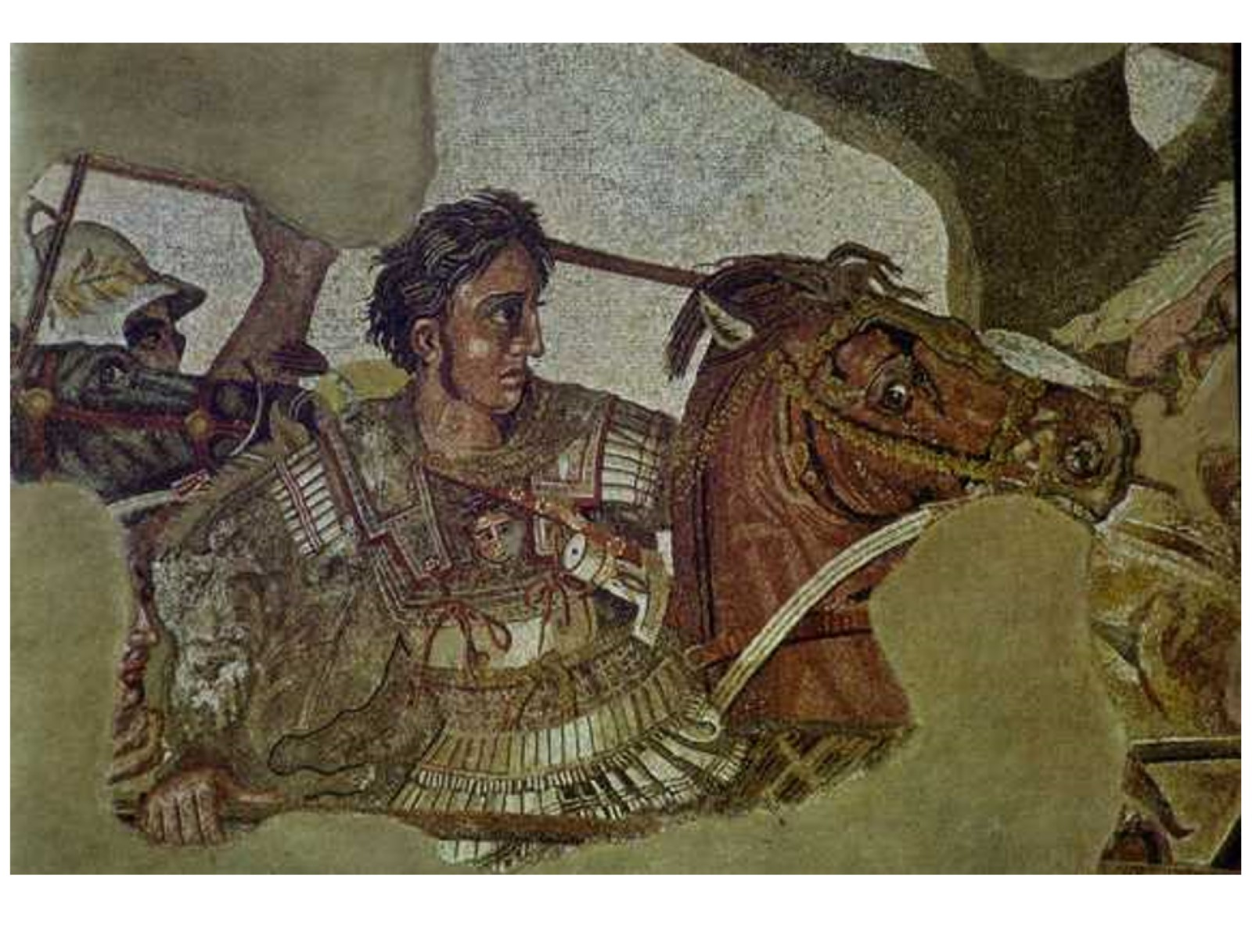
Notes:
That young man was Alexander, son of Philip II of Macedon, a northern state of Greece. Alexander was only one of Philip’s many children, but destiny held great things for him. Though Macedonians had long been considered “barbarians” by other Greeks, Alexander’s father had great dreams to unify Macedon with all the rest of Greece. Philip I had unified Macedonian tribes, now his son was carrying that dream one step further. Alexander, by virtue of his abilities, distinguished himself as Philip II’s logical successor. He also believed that it was his destiny, since his mother had convinced him that he was actually the son of Zeus, rather than Philip.
Alexander’s character is revealed many times over through the events of his life. As a young man, he tamed Bucephalus, a wild horse that no one else could handle. As a student of Aristotle, he proved to be intelligent, clever, and thoughtful. He read the Iliad many times over, seeing in the heroes of that story his own chance at heroism. Eventually, he led his father’s army at the Battle of Charonea, in which the Macedonians conquered a combined army of Southern Greeks.
Once on that path, Alexander determined to take the next logical step, conquering the world! Since most of the known world was controlled by the Persians, it was easy to convince his army that they should take revenge on the Persians for the destruction they had caused in Greece. As he moved Eastward, Alexander again displayed his true nature. He cleverly solved the Gordian Knot, brutally solved the problem of Tyre, liberated the Egyptians and established a great city, and twice defeated enormous Persian armies under the command of Darius III.
One of the lessons we must assume that Alexander learned from Aristotle was that there truly was no dichotomy among men. Alexander treated all his enemies with respect, even admiration if they proved honorable. He refused a traitorous “gift” from Bessus, and adopted many Persian customs. Many Macedonians saw this as weakness, including Alexander’s best friend, whom he killed in a fit of rage. After destroying Persepolis as revenge for the burning of Athens, Alexander proceeded on to India, where he conquered their armies as well. Unfortunately, he also suffered numerous wounds that began to deteriorate his health. He survived an arduous journey back to Persia, losing Bucephalus along the way, but died shortly afterward. He was only 33.

Slide 48
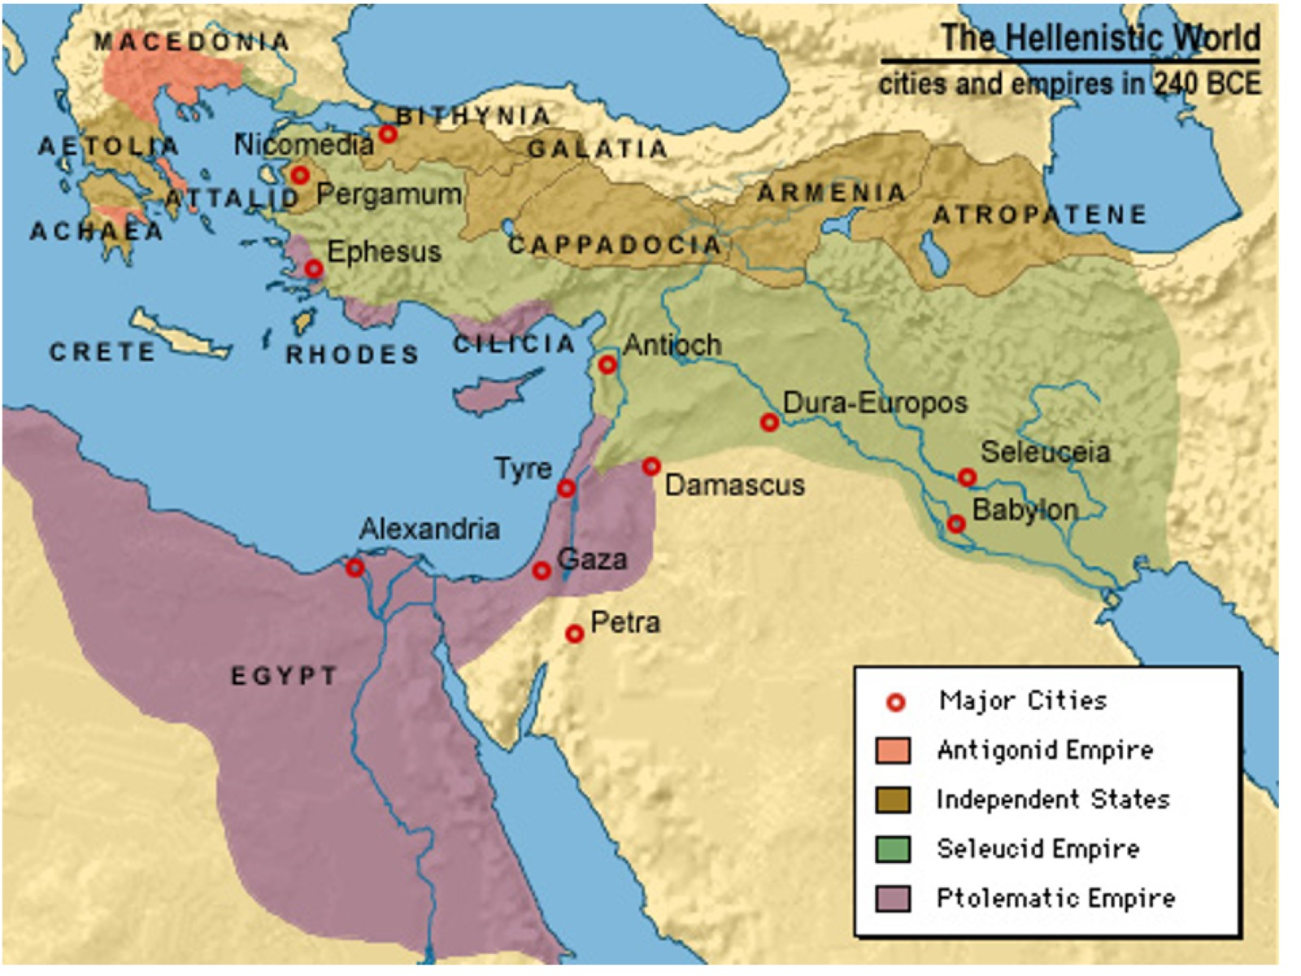
Notes:
According to legend, as Alexander lay dying, he was asked, “To whom do you leave your Empire?” He is said to have responded, “To the strongest.”
We can debate whether that occurred, as his world split into 4 major parts, not including India, which reverted to local control under Chandragupta. The Generals Antigonus, Seleucus, and Ptolemy each took major portions for themselves, creating kingdoms that lasted varying lengths of time, but which all eventually came under Roman control.
Note the word, “Hellenistic” on this map, which refers to areas that had been given Greek-like life by Alexander’s influence. People in these areas were taught the Greek language, given a Greek educational system, and had many other aspects of Greek culture.

Slide 49

Notes:
Alexander wasn’t the only thing going on in the Alexandrian Age.
Zeno was a philosopher who created an interesting thought-problem. A paradox is a statement that makes sense even though it also seems to contradict itself. Zeno’s question involved the behavior or arrows, which he imagined seeing in extremely slow motion. At any given moment, the arrow would seem to be parallel to the ground, therefore, by definition, the arrow could never actually land anywhere. Additionally, since the arrow would, at any instant, be only within a space its own size, and since it was ALWAYS within a space its own size, it could not actually be moving.

Slide 50

Notes:
Euclid was introducing us to the principles of plane geometry. He compiled a book known as “The Elements”, in which he described those principles. They begin very simply, then move toward the more complex. They are still the basic principles of geometry today.
Archimedes lived much farther away (that Greek world was large, remember) in the city of Syracuse on Sicily. Archimedes was interested in 3-dimensional geometry because of its applications to the real world. He discovered that objects displace their own mass in water, that water could be “lifted” out of the ground by a simple machine, and is rumored to have created some war machines of incredible proportions. Sadly, he was killed by an impatient Roman soldier when Archimedes would not leave a problem he was working on.
Eratosthenes was another mathematician who happened to be traveling through Egypt when he noticed something interesting. He looked down into a well, noticing the reflection of the sun there. As he traveled back, he noticed that the Sun’s reflection had moved. Quickly performing a few simple calculations, Eratosthenes calculated the circumference of the Earth. As it turns out, his calculations were extremely accurate.

Slide 51

Notes:
The Arts had advancement also.
On the island of Lesbos, a woman named Sappho was writing poetry. This was not the epic poetry of Homer, but a newer style known as lyric poetry. Where Homer’s poetry had formal structure with rhyming couplets and usually told long stories of heroic events, Sappho’s poetry was more free-form and usually about emotions such as love.
Menander was a playwright, but unlike our earlier examples, he was not so interested tragedy as he was comedy. Unlike Aristophanes’ “Old Comedy” (satire), Menander engaged in “New Comedy”, what we might call “Situation Comedy”. In fact, it has been said that Menander invented the 9 main situations from which such comedy derives its humor. These situations are all common circumstances that people might find themselves in, particularly in their relations with other people.

